Slide 1
Concept and System Design of Rate-Controlled Drug Delivery System
By
Prof. Dr. Basavaraj K. Nanjwade M. Pharm., Ph. D
Department of Pharmaceutics
KLE University’s College of Pharmacy
BELGAUM-590010, Karnataka, India
E-mail: bknanjwade@yahoo.co.in
Cell No: 00919742431000

Slide 2
Contents
Introduction
Classification of rate controlled DD Systems
Rate programmed Drug Delivery System
Activation Modulated Drug Delivery System
Feedback regulated Drug Delivery System
Effect of System Parameters on Controlled Drug Delivery System
References

Slide 3
Introduction
Sustained release, sustained action, controlled release, extended action, timed release dosage forms are the terms used to identify drug delivery systems that are designed to achieve a prolonged therapeutic effect by continuously releasing medication over an extended period of time after the administration of single dose.
The term “Controlled release” has become associated with those systems from which therapeutic agents may be automatically delivered at predefined rates over a long period of time.
But, there are some confusion in terminology between “Controlled release” & “Sustained release”

Slide 4
Sustained Release :
The term sustained release has been constantly used to describe a pharmaceutical dosage form formulated to retard the release of a therapeutic agent such that its appearance in the systemic circulation is delayed &/or prolonged & its plasma profile is sustained in duration.
Controlled Release :
This term on the other hand, has a meaning that goes beyond the scope of sustained drug action.
It also implies a predictability & reproducibility in the drug release kinetics, which means that the release of drug ingredient from a controlled delivery system proceeds at a rate profile that is not only predictable kinetically, but also reproducible from one unit to another.

Slide 5
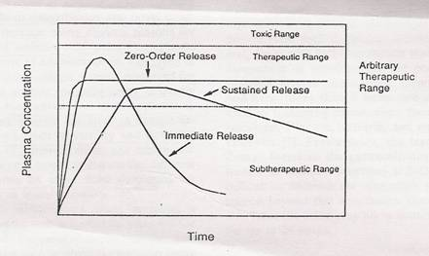
An ideal controlled drug delivery system is the one which delivers the drug at a predetermined rate, locally or systematically for a specified period of time.

Slide 6
Advantages :
Less fluctuation in drug blood levels.
Frequency reduction in dosing.
Improved patient convenience & compliance.
Increased safety margin of the high potency drugs.
Reduction in total health care cost.
Disadvantages :
Decreased systemic availability in comparison to immediate release conventional dosage forms.
Poor in vivo – in vitro correlation.
Possibility of dose dumping.
Retrieval of drug is difficult.
Higher cost of formulation.

Slide 7
Classification
Based on their technical sophistication :
Rate preprogrammed drug delivery system
Activation-modulated drug delivery system
Feedback-regulated drug delivery system
Site targeting drug delivery system

Slide 8
Rate preprogrammed drug delivery system
In this group , the release of drug molecule from the system has been preprogrammed at specific rate profile.
They can be classified as
Polymer membrane permeation-controlled drug delivery system
Polymer matrix diffusion-controlled drug delivery system
Microreservior partition-controlled drug delivery system

Slide 9
1.Polymer membrane permeation-controlled drug delivery system
In this type, drug is totally or partially encapsulated within drug reservoir.
Its drug release surface is covered by a rate-controlling polymeric membrane having a specific permeability.
Drug reservoir may exist in solid, suspension or solution form.

Slide 10
The rate of drug release is defined by,
Q ₌ Km/r Ka/m DdDm x CR
t Km/r Dmhd + Ka/m Ddhm
Where,
K_{m/r} & K_{a/m} = partition coefficient of the drug molecule from reservoir to rate controlling membrane & from membrane to aq. Layer respectively.
D_{d} & D_{m} = diffusion coefficient of rate controlling membrane & aqueous diffusion layer respectively.
hm & hd = thickness of rate controlling membrane & aqueous diffusion layer respectively.
CR – drug conc. In reservoir compartment.

Slide 11
Release of drug molecules is controlled by :
Partition coefficient of the drug molecule.
Diffusivity of the drug molecule.
The thickness of the rate controlling membrane.

Slide 12
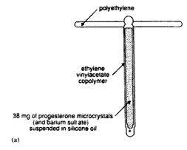
Ex. Progestasert IUD
The drug reservoir is a suspension of progesterone & barium sulphate in silicone medical fluid & is encapsulated in the vertical limb of a T-shaped device walled by a non-porous membrane of ethylene-vinyl acetate co-polymer.
It is designed to deliver natural progesterone continuously in uterine cavity at a daily dosage rate of at least 65 μg/day to achieve contraception for 1 year.

Slide 13
2. Polymer matrix diffusion-controlled drug delivery system
In this type, drug reservoir is prepared by homogeneously dispersing drug particle in rate controlling polymer matrix from either a lipophilic or a hydrophilic polymer.
The drug dispersion in the polymer matrix is accomplished by either,
1) blending therapeutic dose of drug with polymer or highly viscous base polymer, followed by cross linking of polymer chains.
2) mixing drug solid with rubbery polymer at elevated temp.

Slide 14
The rate of the drug release from this system,
Q = (2AC_{R}D_{p})^{1/2}
Where,
Q/t^{1/2} - rate of release of drug
A – initial drug loading dose in the polymer matrix
CR – drug solubility in polymer
D_{p} – diffusivity of drug in polymer matrix
t

Slide 15
Release of drug molecule is controlled by
Loading dose
Polymer solubility of drug
Drug diffusivity in polymer matrix.
Ex. Nitro-Dur :
Nitro-Dur is a transdermal system contains nitroglycerin in acrylic-based polymer adhesives with a resinous cross-linking agent to provide a continuous source of active ingredient.

Slide 16
It is designed for application on to intact skin for 24 hrs to provide a continuous transdermal infusion of nitroglycerin at dosage rate of 0.5 mg/cm²/day for the treatment of angina pectoris.

Slide 17
3.Microreservior partition-controlled drug delivery system
In this type, drug reservoir is fabricated by micro dispersion of an aqueous Suspension of drug in biocompatible polymer to form homogeneous dispersion.
Depending upon the physicochemical properties of drugs & desired rate of drug release, the device can be further coated with a layer of biocompatible polymer to modify the mechanism & the rate of drug release.

Slide 18
The rate of drug release is defined by,
dQ = D_{p}D_{d}mK_{p} nS_{p} – D_{l}S_{l}(1-n) 1 + 1
Where,
n = the ratio of drug conc. At the inner edge of the interfacial barrier over the drug solubility in the polymer matrix.
m = a/b, a – ratio of drug conc. In the bulk of elution solution over drug solubility in the same medium.
b – ratio of drug conc. At the outer edge of the polymer coating membrane over drug solubility in the same polymer.
[
(
]
(
dt
k_{l}
K_{m}
D_{p}h_{d} + D_{d}h_{p}mK_{p}
h_{l}

Slide 19
K_{l}, K_{m} & Kp = partition coefficient for the interfacial partitioning of the drug from the liquid compartment to the polymer matrix, from the polymer matrix to the polymer-coating membrane & from the polymer coating membrane to the elution solution respectively.
Dl, Dp & Dd = diffusivities of the drug in the lipid layer surrounding the drug particle, the polymer coating membrane enveloping the polymer matrix, & the hydrodynamic diffusion layer surrounding the polymer coating membrane with the thickness h_{l}, h_{p} & h_{d}.
S_{l} & S_{p} = solubilities of the drug in the liquid compartments & in the polymer matrix, respectively.

Slide 20
Release of drug molecules from this type of system can follow either a dissolution or a matrix diffusion controlled process depending upon the relative magnitude of S_{l} & S_{p}.
Release of drug molecule is controlled by,
Partition coefficient
Diffusivity of drug
Solubility of drug

Slide 21
Ex. Syncro mate - c
It is fabricated by dispersing the drug reservoir, which is a suspension of norgestomet in an aqueous solution of PEG 400, in a viscous mixture of silicone elastomer.

Slide 22
After adding the catalyst, the suspension will be delivered into the silicone medical grade tubing, which serves as mold as well as the coating membrane & then polymerized in situ.
The polymerized drug polymer composition is then cut into a cylindrical drug delivery device with the open ends.
It is designed to be inserted into the subcutaneous tissue of the livestock’s ear flap & to release norgestomet for up to 20 days for control of estrus & ovulation as well as for up to 160 days for growth promotion.

Slide 23
Activation modulated drug delivery system
In this group of controlled release drug delivery system, the release of drug molecules from the delivery system is activated by some physical, chemical, or biochemical process and/or by energy supplied externally.

Slide 24
Based on nature of the process or type of energy used they can be classified into
1. Physical means
a. Osmotic pressure-activated DDS
b. Hydrodynamic pressure-activated DDS
c. Vapor pressure-activated DDS
d. Mechanically activated DDS
e. Magnetically activated DDS
f. Sonophoresis activated DDS
g. Iontophoresis activated DDS
h. Hydration-activated DDS

Slide 25
2. Chemical means
a. pH- activated DDS
b. Ion- activated DDS
c. Hydrolysis- activated DDS
3. Biochemical means
a. Enzyme- activated DDS
b. Biochemical- activated DDS

Slide 26
a. Osmotic controlled activated drug delivery system.
In this type, drug reservoir can be either solution or solid formulation contained within semi permeable housing with controlled water permeability.
The drug is activated to release in solution form at a constant rate through a special delivery orifice.
The rate of drug release is modulated by controlling the gradient of osmotic pressure.

Slide 27
For the drug delivery system containing a solution formulation, the intrinsic rate of drug release is defined by,
Q P_{w} A_{m}
For the drug delivery system containing a solid formulation, the intrinsic rate of drug release is defined by,
Q P_{w} A_{m}
=
( π_{s} – π_{e} )
t
h_{m}
=
( π_{s} – π_{e} )
S_{d}
t
h_{m}

Slide 28
Where,
Q/t - rate of drug release
Pw - permiability of semipermiable housing
Am -effective S.A. of semipermiable housing
hm - thickness of semipermiable housing
( π_{s} - π_{e}) – differential osmotic pressure between the drug delivery system with osmotic pressure π_{s} & the environment with osmotic presure π_{e}.
S_{d} – aqueous solubility of the drug contained in the solid formulation.

Slide 29
Rate controlling factors :
Water permeability of the semi permeable membrane.
Effective surface area of the semi permeable membrane.
Osmotic pressure difference across the semi permeable membrane.
Ex. Alzet Osmotic pump

Slide 30
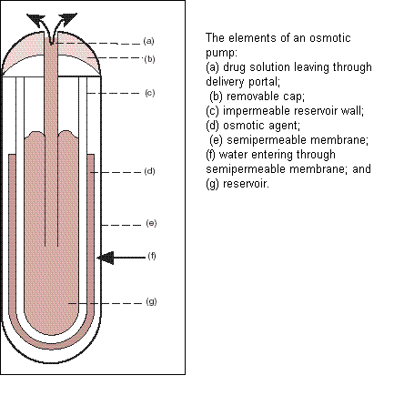

Slide 31
b. Hydrodynamic pressure-activated Drug delivery system
Also called as push-pull osmotic pump.
This system is fabricated by enclosing a collapsible, impermeable container, which contains liquid drug formulation to form a drug reservoir compartment inside rigid shape-retaining housing.
A composite laminate of an adsorbent layer & a swellable, hydrophilic polymer layer is sandwiched.

Slide 32
In the GIT, the laminate absorb the GI fluid through the annular openings at the lower end of the housing & becomes increasingly swollen, which generates hydrodynamic pressure in the system.
Rate of drug release is defined by,
Q ₌ Pf Am ( θ_{s} - θ_{e})
t h_{m}
Where,
Pf = fluid permeability
Am = effective Surface area
hm = thickness of wall with anular opening
(θ_{s} - θ_{e}) = differential hydrodynamic pressure between the drug delivery system & the environment.

Slide 33
Rate controlling factors :
Fluid permeability
Effective surface area of the wall with the annular opening.
Hydrodynamic pressure gradient.

Slide 34
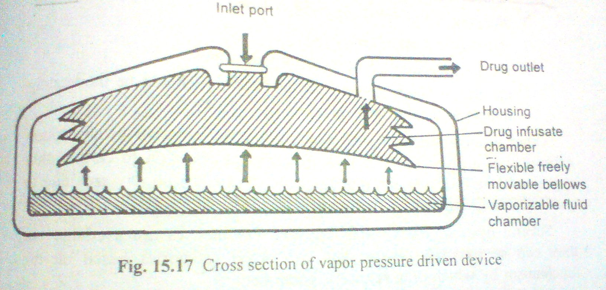
c. Vapor pressure-activated drug delivery system

Slide 35
In this system, the drug reservoir in a solution formulation, is contained inside an infusate chamber.
It is physically separated from the vapor pressure chamber by a freely movable bellows.
The vapor chamber contains a vaporizable fluid, which vaporizes at body temp. & creates a vapor pressure.
Under the vapor pressure created, the bellows moves upward & forces the drug solution in the infusate chamber to release, through a series of flow regulators & delivery cannula into the blood circulation at a constant flow rate.

Slide 36
The rate of drug release is defined by,
Q ₌ d⁴ (Ps -Pe)
t 40.74 μl
Where-
Q/t - rate of drug release
d – inner diameter of cannula
l – length of cannula
(Ps -Pe)- the difference between the vapor pressure in the vapor chamber & pressure at the implantation site.
μ − viscosity of the drug solution.

Slide 37
Rate controlling factors :
Differential vapor pressure
Formulation viscosity
Size of the delivery cannula
Ex. An implantable infusion pump for the constant infusion of heparin for anti-coagulant therapy, insulin in diabetic treatment & morphine for patient suffering from the intensive pain of terminal cancer.

Slide 38
d. Mechanically activated drug delivery system
In this type, drug reservoir is in solution form retained in a container equipped with mechanically activated pumping system.
A measured dose of the drug formulation is reproducible delivered in to a body cavity, for ex. The nose through the spray head upon manual activation of the drug delivery pumping system.

Slide 39
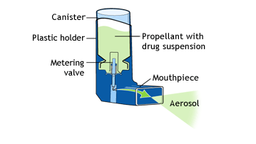
Ex. Metered-dose inhaler
the volume of solution delivered is controllable, as small as 10-100 μl & is independent of the force & duration of the activation applied as well as the solution volume in the container.

Slide 40
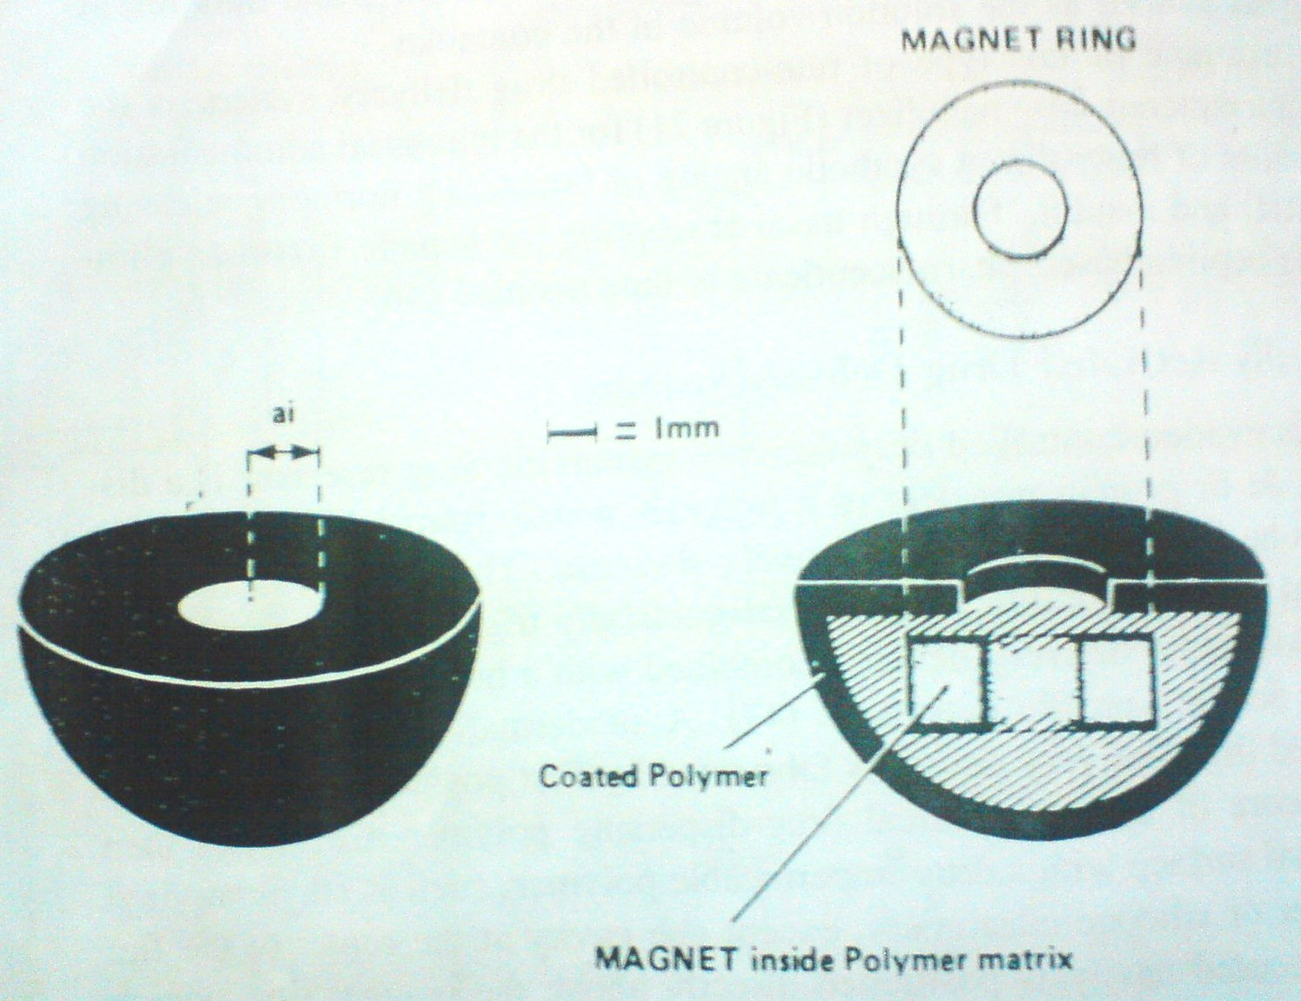
e.Magnetically activated drug delivery system

Slide 41
In this type, drug reservoir is a dispersion of peptide or protein powders in polymer matrix from which macromolecular drug can be delivered only at a relatively slow rate.
This low rate of delivery can be improved by incorporating electromagnetically triggered vibration mechanism into polymeric device combined with a hemispherical design.
Device is fabricated by positioning a tiny magnet ring in core of hemispherical drug dispersing polymer matrix.

Slide 42
Device is fabricated by positioning a tiny magnet ring in core of hemispherical drug dispersing polymer matrix.
The external surface is coated with drug impermeable polymer (ethylene vinyl acetate or silicon elastomer) except one cavity at the centre of the flat surface.
This delivery device used to deliver protein drugs such as bovine serum albumin, at a low basal rate, by a simple diffusion process under non triggering condition.
As the magnet is activated to vibrate by external electromagnetic field, drug molecules are delivered at much higher rate.

Slide 43
f.Sonophoresis - activated drug delivery system
Also called as Phonophoresis.
This type of system utilizes ultrasonic energy to activate or trigger the delivery of drug from polymeric drug delivery device.
System can be fabricated from nondegradable polymer (ethylene vinyl acetate) or bioerodiable polymer (poly[bis(p-carboxyphenoxy) alkane anhydride]
The potential application of sonophoresis to regulate the delivery of drugs was recently reviewed.

Slide 45
g.Iontophoresis activated drug delivery system
This type of system uses electrical current to activate & to modulate the diffusion of charged drug across biological membrane.
Iontophoresis – facilitated skin permeation rate of charged molecule (i) consist of 3 components & is expressed by,
J_{i}^{isp} = J^{p} + J^{e} +J^{c}

Slide 46
Where,
J^{p –} passive skin permeation flux.
= K_{s}D_{s} dC
h_{s}
K_{s} = partition coefficient for interfacial partitioning from donor solution to stratum corneum
D_{s} = diffusivity across the skin
dC = concentration gradient across the skin
h_{s}
J^{e} – electrical current driven permeation flux
= ZiDiF Ci dE
RT h_{s}

Slide 47
Zi = electric valency of the ionic species i
Di = diffusivity of ionic species i in the skin
F = faraday constant
T = absolute temperature
Ci = donor conc. of ionic species i in the skin
dE = electrical potential gradient across the skin
J^{c} = convective flow driven skin permeation flux
= k C_{s} I_{d}
Where,
K = propertionality constant
C_{s}= conc. In the skin tissue
I_{d} = current density applied
h_{s}

Slide 48
Schematic diagram illustrating the principles of iontophoresis.

Slide 49
This system to facilitate the percutaneous penetration of anti-inflammatory drugs such as dexamethasone sodium phosphate to surface tissue.

Slide 50
h. Hydration activated drug delivery system
In this system, the drug reservoir is homogeneously dispersed in a swellable polymer matrix fabricated from a hydrophilic polymer (ethylene glycomethacrylate).
The release of drug is controlled by the rate of swelling of polymer matrix.

Slide 51
i. pH- activated drug delivery system
This type of chemically activated system permits targeting the delivery of drug only in the region with selected pH range.
It fabricated by coating the drug-containing core with a pH – sensitive polymer combination.
For instances, a gastric fluid labile drug is protected by encapsulating it inside a polymer membrane that resist the degradative action of gastric pH.

Slide 53
In the stomach, coating membrane resists the action of gastric fluid (pH<3) & the drug molecule thus protected from acid degradation.
After gastric emptying the DDS travels to the small intestine & intestinal fluid (pH>7.5) activates the erosion of the intestinal fluid soluble polymer from the coating membrane.
This leaves a micro porous membrane constructed from the intestinal fluid insoluble polymer, which controls the release of drug from the core tablet.
The drug solute is thus delivered at a controlled manner in the intestine by a combination of drug dissolution & pore-channel diffusion.

Slide 54
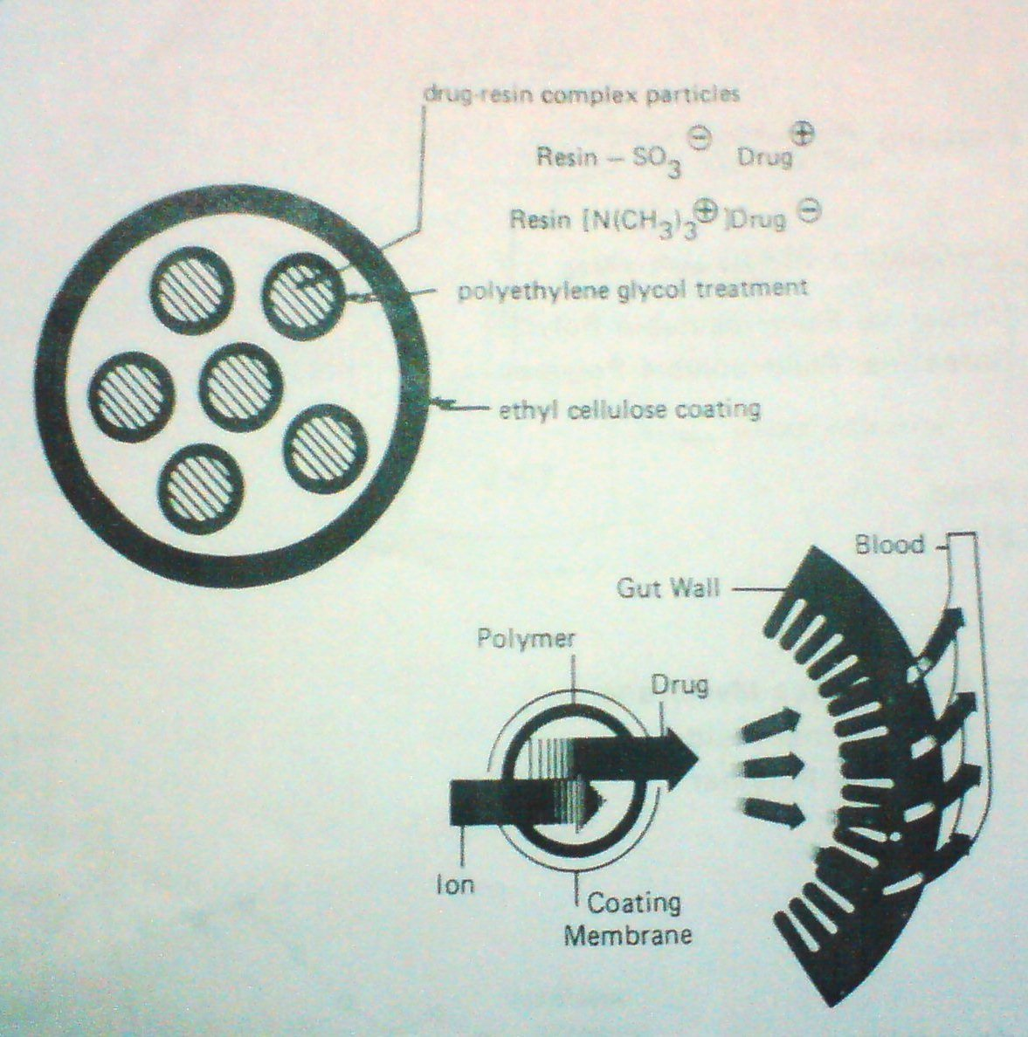
j. Ion- activated drug delivery system

Slide 55
An ionic or a charged drug can be delivered by this method & this system are prepared by first complexing an ionic drug with an ion-exchange resin containing a suitable counter ion.
Ex. By forming a complex between a cationic drug with a resin having a So₃⁻ group or between an anionic drug with a resin having a N(CH₃)₃ group.
The granules of drug-resin complex are first treated with an impregnating agent & then coated with a water-insoluble but water-permeable polymeric membrane.

Slide 56
This membrane serves as a rate-controlling barrier to modulate the influx of ions as well as the release of drug from the system.
In an electrolyte medium, such as gastric fluid ions diffuse into the system react with drug resin complex & trigger the release of ionic drug.
Since the GI fluid regularly maintains a relatively constant level of ions, theoretically the delivery of drug from this ion activated oral drug delivery system can be maintained at a relatively constant rate.

Slide 57
K.Hydrolysis- activated drug delivery system
This type of system depends on the hydrolysis process to activate the release of drug.
Drug reservoir is either encapsulated in microcapsules or homogeneously dispersed in microspheres or nano particles for injection.

Slide 58
It can also be fabricated as an implantable device.
All these systems prepared from bioerodible or biodegradable polymers (polyanhydride, polyorthoesters).
It is activated by hydrolysis-induced degradation of polymer chain & is controlled by rate of polymer degradation.
Ex. LHRH – releasing biodegradable subdermal implant, which is designed to deliver goserline, a synthetic LHRH analog for once a month treatment of prostate carcinoma.

Slide 59
l. Enzyme - activated drug delivery system
This type of biochemical system depends on the enzymatic process to activate the release of drug.
Drug reservoir is either physically entrapped in microspheres or chemically bound to polymer chains from biopolymers (albumins or polypeptides).
The release of drug is activated by enzymatic hydrolysis of biopolymers (albumins or polypeptides) by specific enzyme in target tissue.

Slide 60
Ex. Albumin microspheres release 5 – fluorouracil in a controlled manner by protease – activated biodegradation.

Slide 61
Feedback regulated drug delivery system
In this group the release of drug molecules from the delivery system is activated by a triggering agent.
Rate of drug release is controlled by concentration of triggering agent.

Slide 62
They are further classified as
Bioerosion-regulated drug delivery system
Bioresponsive drug delivery system
Self-regulating drug delivery system

Slide 63
A. Bioerosion-regulated drug delivery system
This system was developed by Heller & Trescony.
The system consisted of drug-dispersed bioerodible matrix fabricated from poly (vinyl methyl ether) ester which is coated with layer of immobilized urease.

Slide 64
In a solution with near neutral pH, the polymer only erodes very slowly.
In presence of urea, urease metabolizes urea to form ammonia. This causes increase in pH & rapid degradation of polymer with release of drug molecule.

Slide 65
B. Bioresponsive drug delivery system
Drug reservoir is contained in device enclosed by bioresponsive polymeric membrane whose drug permeability is controlled by concentration of biochemical agent.

Slide 66
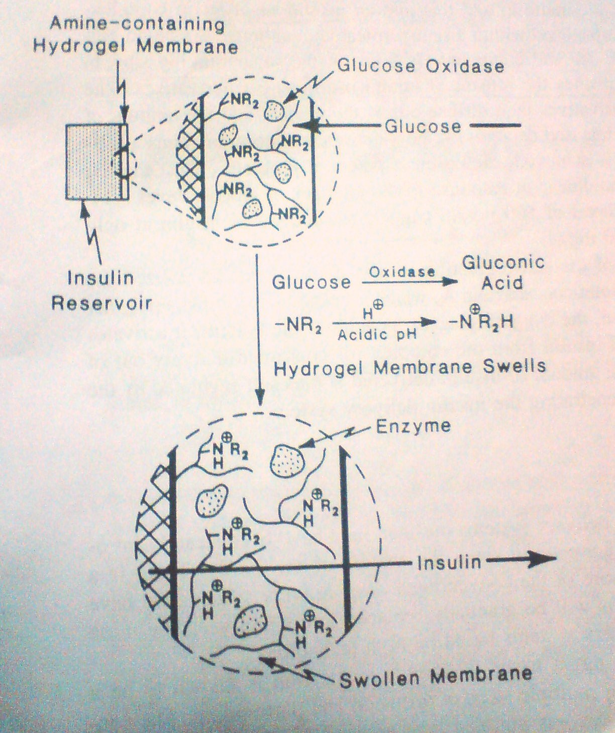
Ex. – glucose-triggered insulin drug delivery system.

Slide 67
In this system, the insulin reservoir is encapsulated within hydro gel membrane having –NR₂ group.
In alkaline solution, the –NR₂ are neutral & the membrane is unswollen & impermeable to insulin.
Glucose penetrates into the membrane, it oxidizes enzymatically by the glucose oxidase entrapped in the membrane to form gluconic acid.
The –NR₂ group is protonated to form –NR₂H⁺ & the hydro gel membrane then becomes swollen & permeable to insulin molecules.

Slide 68
C.Self-regulating drug delivery system
This type of system depends on a reversible & competitive binding mechanism to activate and to regulate the release of drug.
Drug reservoir is drug complex encapsulated within a semi permeable polymeric membrane.
The release of drug from the delivery system is activated by the membrane permeation of biochemical agent from the tissue in which the system is located.

Slide 69
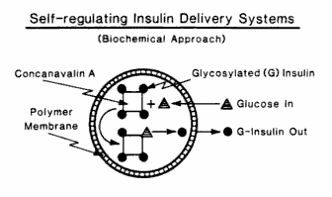
Ex. In the complex of glycosylated insulin concanavalin A, which is encapsulated inside a polymer membrane.
Glucose penetrates into the system & it activates the release of glycosylated insulin from the complex for controlled delivery out of system.

Slide 70
Effects of system parameters
Polymer solubility
Solution solubility
Partition coefficient
Polymer diffusivity
Solution diffusivity
Thickness of polymer diffusional path
Thickness of hydrodynamic diffusion layer
Drug loading dose
Surface area

Slide 71
Polymer diffusivity (D_{p})
The diffusion of small molecules in a polymer structure is a energy activated process in which the diffusant molecules move to a successive series of equilibrium positions when a sufficient amount of energy of activation for diffusion E_{d}, has been acquired by the diffusant & it’s surrounding polymer matrix.

Slide 72
This energy- activated diffusion process is frequently described by the following Arrhenius relationship :
D_{p} = D₀ e^{-(Ed/RT)}
The bulkier the functional group attached to polymer chain lower the polymer diffusivity.
Magnitude of polymer diffusivity is dependant upon type of functional group and type of stereo chemical position in diffusant molecule.

Slide 73
Polymer diffusivity also depends on
1) Effect of cross linking
2) Effect of crystallinity
3) Effect of fillers

Slide 74
Solution diffusivity (D_{s})
The diffusion of solute molecules in solution medium is a result of the random motion of molecules.
Under concentration gradient molecule diffuse spontaneously from higher concentration to lower concentration.
The diffusivity of the solute molecules in the aqueous solution whose molar volume is equal to or greater than the molar volume of water molecules is inversely proportional to the cube root of their volume.

Slide 75
When solution diffusivity are compared on bases of molecular volume, alkanes are most rapidly diffusing chemicals.
The relative rates of diffusion of various chemical classes are as follows :
alkane > alcohol > amides > acids > amino acids > dicarboxylic acid
Diffusivity of solute molecule in aqueous solution usually decreases as its concentration increases.

Slide 76
Thickness of polymer diffusional path (h_{p})
Control release of drug species from both polymer membrane & polymer matrix controlled drug delivery system is governed by,
The solute diffusion coefficient in the membrane lipid.
The thickness of the membrane.

Slide 77
h_{p} value for polymer membrane controlled reservoir devices, which are fabricated from non biodegradable and non swollen polymer, the value is defined by polymer wall with constant thickness that is invariable with time span.
In polymer matrix controlled reservoir devices, which are fabricated from non biodegradable polymers, the thickness of diffusional path is defined as drug depletion zone progressively in proportion to the square root of time.

Slide 78
The rate of growth in the h_{p} value can be defined mathematically by :
h_{p =} 2C_{p}D_{p}
t^{1/2} A – C_{p}/2
Where,
C_{p} = solubility of drug in the polymer phase
D_{p} = diffusivity of drug in the polymer matrix
A = loading dose of a drug
1/2
(
(

Slide 79
Thickness of hydrodynamic diffusion layer (h_{d})
The hydrodynamic diffusion layer has a rate limiting role on controlled release dosage form.
Magnitude of drug release value decreases as the thickness of hydrodynamic diffusion layer is increased.

Slide 80
Polymer solubility
Drug particles are not released until they dissociate from their crystal lattice structure, dissolve or partition into surrounding polymer.
Solubility of drug in polymer membrane or matrix plays important role in it’s release from a polymeric device.
For a drug to release at an appropriate rate the drug should have adequate polymer solubility.
Rate of drug release is directly proportional to magnitude of polymer solubility.

Slide 81
Solution solubility
Aqueous solubility varies from one drug to another.
Difference in aqueous solubility is depend on the difference in their chemical structure, types & physicochemical nature of functional groups & the variations in their stereo chemical configurations.
By using a water – miscible cosolvent as a solubilizer & addition of the cosolvent into the elution solution to increase the solution solubility of drugs.

Slide 82
Solubilization of poorly soluble drug in aqueous solution can be accomplished by using multiple co-solvent system.
Drug release increases with increase in Solution solubility of drug.

Slide 83
Partition coefficient
Partition co-efficient K of a drug for it’s interfacial partitioning from the surface of a drug delivery device towards an elution medium as given :
K = C_{s}/C_{p}
Where,
C_{s} = conc. Of drug at the solution/polymer interface
C_{p} = solubility of drug in the polymer phase.

Slide 84
Ratio of drug solubility in the elution solution C_{s} over its solubility in polymer composition C_{p} of device.
Any variation in either C_{s} or C_{p} result in increase or decrease in magnitude of ‘K’ value.
Rate of drug release increase with increase in partition coefficient.

Slide 85
Drug loading dose
In preparation of the device varying loading doses of drugs are incorporated, as required for different length of treatment.
Variation in the loading doses results only in the change in duration of action with constant drug release profile.

Slide 86
Surface Area
Both the in-vivo & in-vitro rates of drug release dependant on the surface area of the drug delivery device.
Greater the surface area greater will be the rate of drug release.

