Slide 1
Tissue Engineering & Drug Delivery
BBI 4203
Lecture 6
Cells for Tissue Engineering

Slide 2
Cell Supply
There are two modes for supplying exogenous cells into defect:
  Cell seeding
  Cell suspension
Cell incorporation into implantable matrices, which ensures their localization at treatment site - concept being referred to as cell seeding.
An alternative is to inject a cell suspension into sealed compartment containing defect.

Slide 3
Cell Sources
Autologous cells (the host’s own cells)
Allogenic cells (cells from a donor)
Xenogenic cells (cells from a different species)
Stem cells: either allogenic (fetal or adult derived) or autologous (adult derived).

Slide 4
Autologous Cells
Obtained from same individual to which they will be re-implanted.
Have fewest problems with rejection and pathogen transmission
Autologous cells not always available.

Slide 5
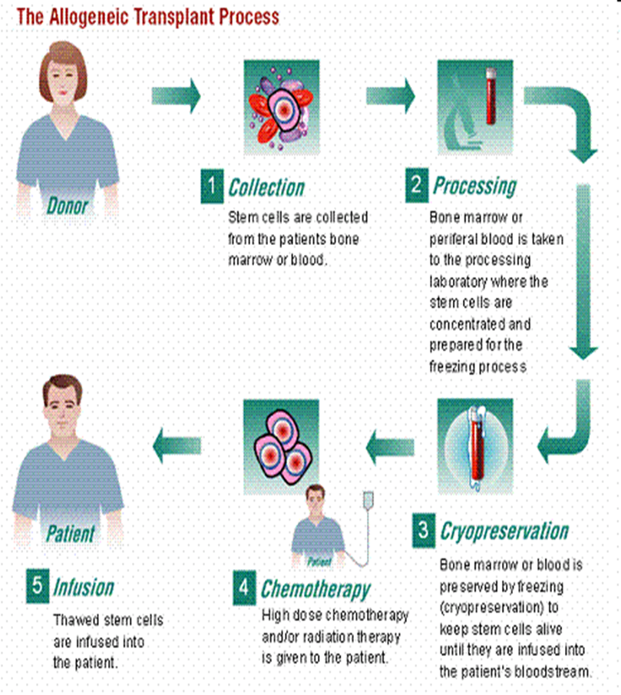
Allogenic cells
Come from a donor of same species.
Employment of dermal fibroblasts from human foreskin
Demonstrated to be immunologically safe & thus a viable choice for TE of skin.

Slide 6
Xenogenic cells
Donor from another species.
In particular animal cells have been used quite extensively in experiments aimed at construction of CV implants.

Slide 7
Stem cells
Undifferentiated cells with ability to divide in culture
Capable of dividing and renewing themselves for long periods
They can give rise to specialized cell types
Stem cells could be:
  Adult stem cells
  Embryonic stem cells

Slide 8
Adult Stem Cells
Also known as somatic (from Greek "of the body") stem cells and germline (giving rise to gametes) stem cells
Can be found in children, as well as adults.
Pluripotent adult stem cells are rare
Generally small in number but can be found in a number of tissues including umbilical cord blood and bone marrow
Main function: to maintain and repair the tissue in which they are found

Slide 9
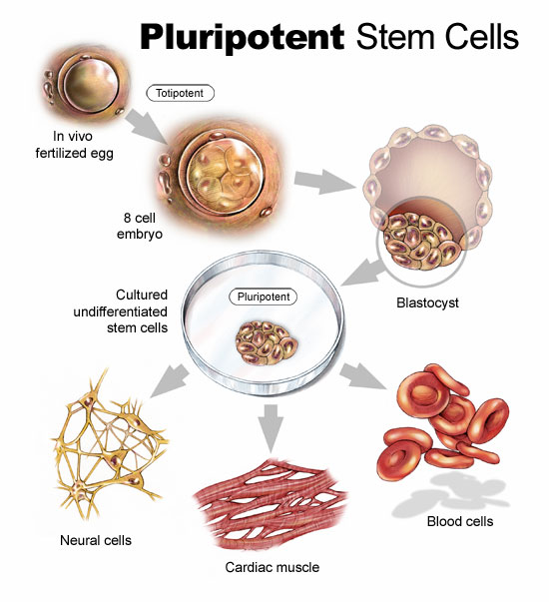
Embryonic Stem Cells
Isolated from epiblast tissue of inner cell mass of a blastocyst or earlier morula stage embryos
Approximately 4 to 5 days old in humans and consisting of 50–150 cells.
Pluripotent: give rise during development to all derivatives of 3 primary germ layers:
  Ectoderm
  Endoderm
  Mesoderm

Slide 10
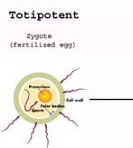
Totipotent Stem Cells
Can differentiate into embryonic and extra-embryonic cell types.
Such cells can construct a complete, viable organism
These cells are produced from fusion of an egg and sperm cell

Slide 11
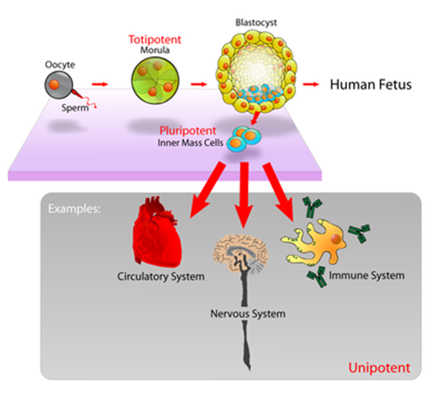
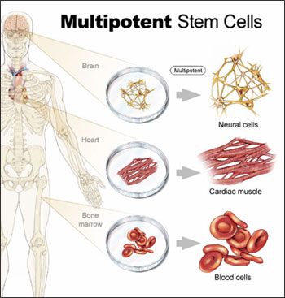
Pluripotent and Multipotent Stem Cells
Pluripotent stem cells
  cells derived from any of three germ layers
  can differentiate into nearly all cells
  cannot give rise to an entire organism
Multipotent stem cells
  give rise to a limited range of cells within a tissue type
  Hematopoietic and mesenchymal stem cells

Slide 12
Oligopotent Stem Cells and Unipotent Cells
Oligopotent stem cells can differentiate into only a few cells, such as lymphoid or myeloid stem cells.
Unipotent cells can produce only one cell type, their own, but have the property of self-renewal, which distinguishes them from non-stem cells.

Slide 13
Embryonic v. Adult Stem Cells
ESC
  Pluripotent
  Easy to culture
  Immortal
  Difficult to control
  Major ethical considerations
ASC
  Multipotent
  Challenging to culture
  Finite
  Simpler to control
  Minimal ethical considerations

Slide 14
Identification of Adult Stem Cells
Isolation and culture of single adult stem cells from tissue
Proliferation to genetically identical cells in culture
Transplantation into animal showing repopulation or differentiation in the tissue by the labeled stem cells

Slide 15
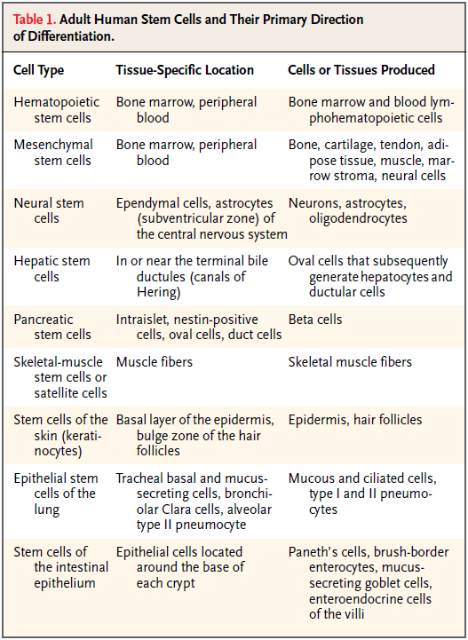
Adult Stem Cell Types
Medical Progress: Adult Stem Cells for Tissue Repair — A New Therapeutic Concept?
N Engl J Med 2003; 349:570 - 582

Slide 16
Bone Marrow Stem Cells
Notes:
Representative adult stem cells

Slide 17
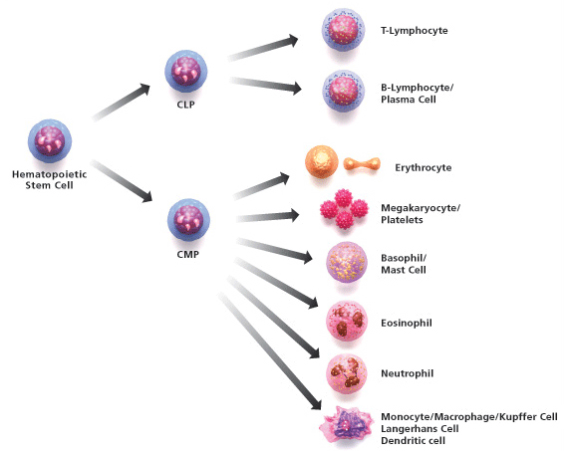
Hematopoietic Stem Cells
Monocytes
Macrophages
Neutrophils
Basophils
Eosinophils
Erythrocytes
Megakaryocytes/platelets
Dendritic cells
Lymphoid
T-cells
B-cells
NK-cells

Slide 18
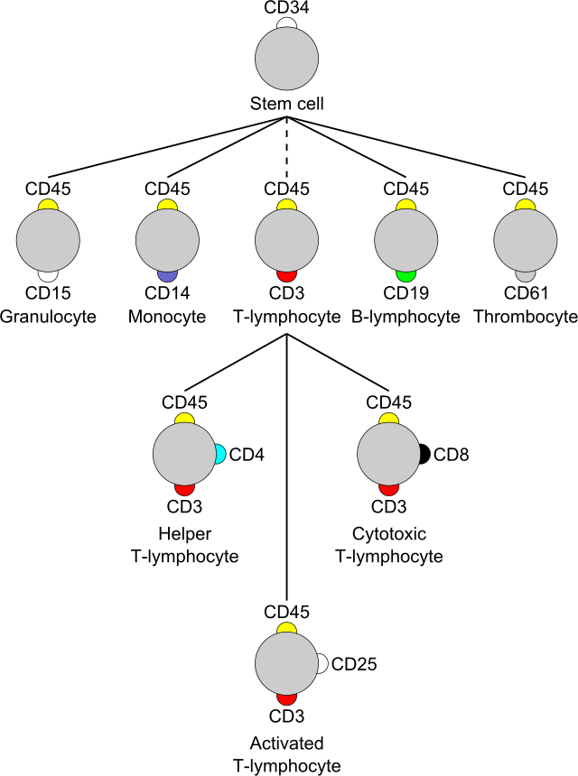
Classification Determinants or “CD markers”
identification and investigation of cell surface molecules providing targets for immunophenotyping of cells
acting as receptors or ligands (the molecule that activates a receptor) important to the cell
proposed surface molecule is assigned a CD number once two specific monoclonal antibodies (mAb) are shown to bind to the molecule
stem cells: CD34+, CD31-, CD117+

Slide 19
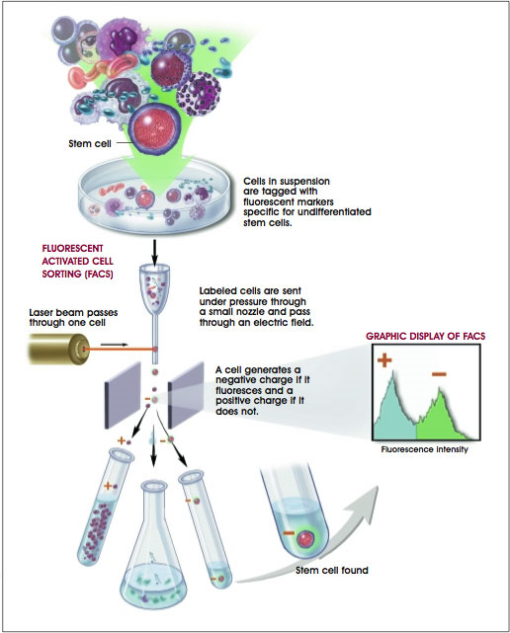
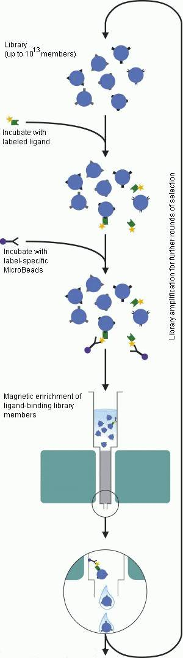
Adult Cell Purification
Stem cells
FACS
FACS (Fluorescent Activated Cell Sorting)
MACS (Magnetic Activated Cell Sorting)
Dilution Cloning (0.5-1 cells/ well in 96 well plate)-grow colonies
MACS
Notes:
Stem cells committed to a particular lineage are considered to be marked by a set of cell-surface molecules unique to that lineage. Monoclonal antibodies (mAbs) that identify such lineage-specific markers are of potential value in studies of cellular differentiation and identification of the cell-surface components involved.

Slide 20
Hematopoietic Stem Cell Markers
Identification: small size, lack of lineage (lin) markers, low staining with dyes (rhodamine or Hoechst), and presence of various antigenic markers on their surface
CD34: immature hematopoietic cells and endothelial cells. The dominant marker for identification and separation of hematopoietic stem cells
CD45: leukocytes and their hematopoietic progenitors
Lineage markers that correspond to a specific lineage, ex: TER119 (erythroid lineage, red blood cells)
Sca 1(stem cell antigen): committed lymphoid and mylroid progenitors and osteoblasts
C-kit (CD117): the receptor for stem cell factor
Human HSCs : CD34+, CD59+, Thy1/CD90+, CD38lo/-, C-kit/CD117+, lin-
Notes:
Glycoprotein: Any of a group of conjugated proteins that contain a carbohydrate as the nonprotein component. Includes most secreted proteins (serum albumin is the major exception) and proteins exposed at the outer surface of the plasma membrane.
TER119=glycophorin A

Slide 21
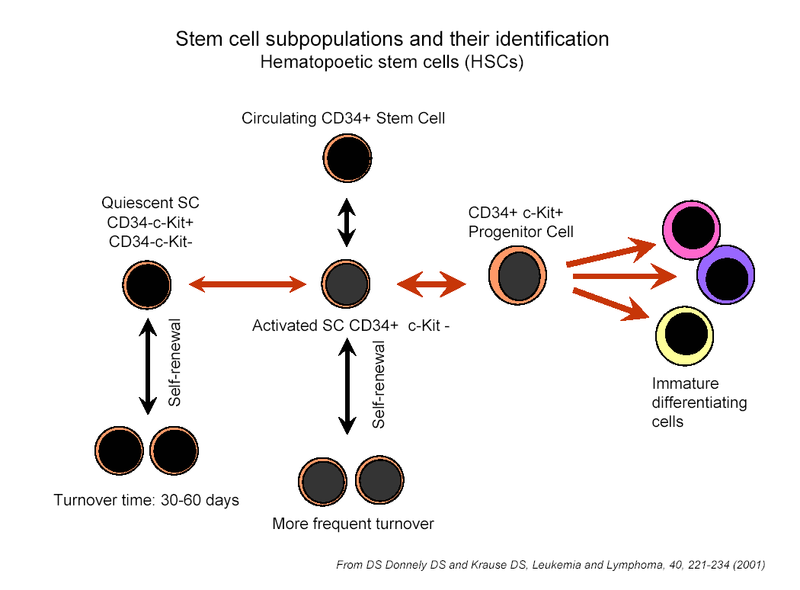
Notes:
Circulating CD34+ cells are a mix of activated and progenitor cells. Quiescent cells cannot be selected out using CD34+, and possibly not using c-kit.
C-kit is a cytokine receptor (stem cell factor)

Slide 22
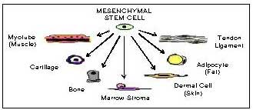
Mesenchymal stem cells
    Adherent cells on culture dish from bone marrow
    Found in adipose tissue, lung, placenta, umbilical cord, amniotic fluid, and teeth

Slide 23
Mesenchymal stem cell markers
    Do not express the hematopoietic markers (CD34, CD45, CD14, or CD11), the co-stimulatory molecules CD80, CD86, or CD40 and endothelial marker (CD31, PECAM)
    Express CD105 (SH2), CD73 (SH3/4), CD44, CD90 (Thy-1), CD71, Stro-1, adhesion molecules CD106 (VCAM), CD166 (ALCAM), ICAM, and CD29
Stem Cells. 2007 Nov;25(11):2739-49

Slide 24
Advantages of MSCs
    Well-characterized multipotent adult stem cells
    Easy to isolate and culture in a large quantity
    Can be maintained and propagated in culture for long periods of time, without loosing differential capacity
    Easy to manipulate genetically in culture
    Can be frozen and retrieved easily
    Autologous human application

Slide 25
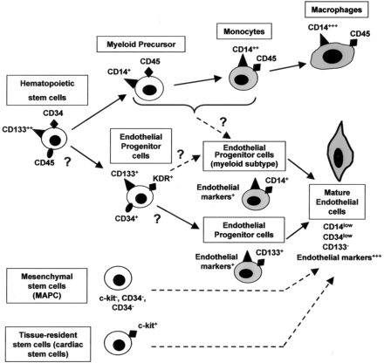
Endothelial Progenitor Cells (EPCs)
EC marker positive:
Flk1+
Angiogensis and neovascularization
Possible differenation to other mesenchymal lineages (smooth muscle, etc)

Slide 26
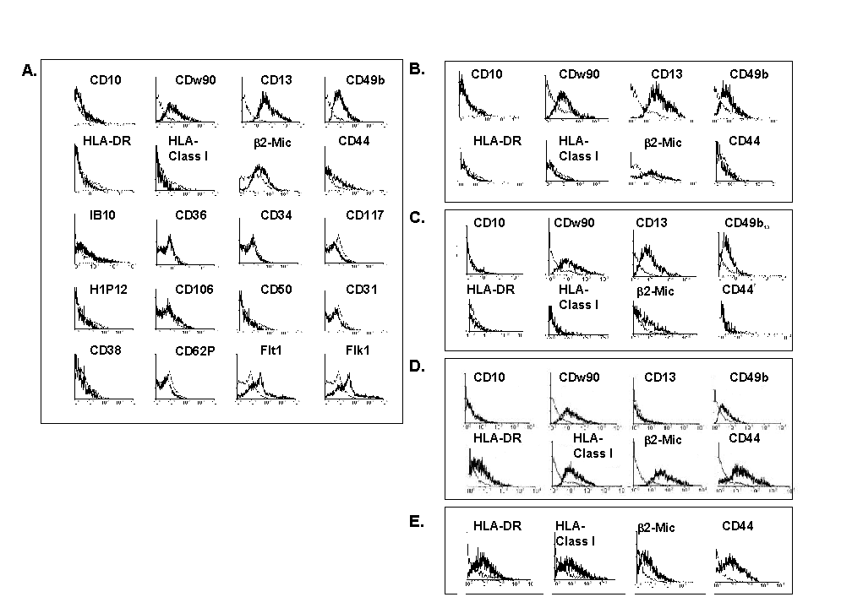
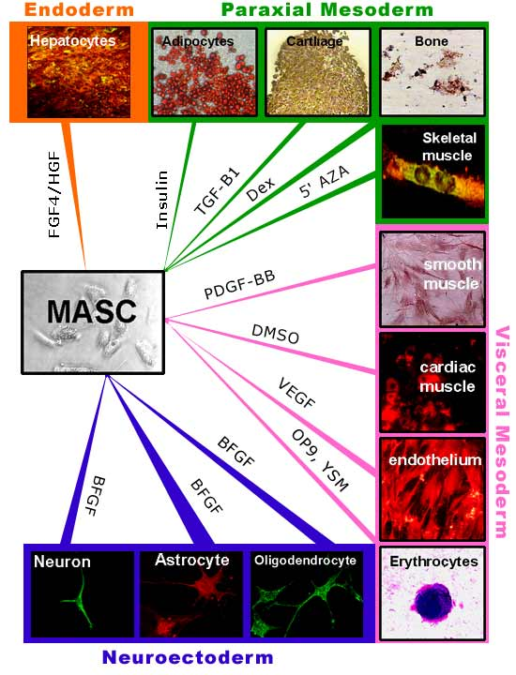
Multipotent Adult Progenitor Cells (MAPCs)
MAPC Positive:
  low levels of β2-microglobulin, CD44?, KDR and Flt1, and high levels of CD13, CD49b and CDw90
  MAPC Negative:
  CD31, CD34, CD36, CD38, CD44? CD50, CD62E, H1P12, CD106, fibroblast surface antigen (1B10), HLA-DR, HLA-class-I, CD45, Tie or Tek (not shown)
CD 34- / CD45- / TER119- / c-kit- / sca-1 +
Notes:
TER-119 was highly specific for erythroid cells at the stages from early proerythroblast to mature erythrocyte and that TER-119 recognized a cell-surface molecule which is strongly associated with glycophorin A. It was found that the TER-119 antigen was expressed only on normal erythroid cells but not on erythroleukaemia cells, even after induction of these cells with dimethylsulphoxide (DMSO).

Slide 27
Cord Blood Stem Cells
Hematopoietic & mesenchymal stem cells from umbilical cord after childbirth
No risk to donors, low risk of transmitting infections, easy availability
greater tolerance of human leukocyte antigen (HLA) disparity (immunocompatible)
A low risk of graft-versus host disease (GVHD)
CD34+/c-Kit+ (hematopoietic stem cells)
Int J Hematol (2010) 92:45–51
Developmental Cell, Vol. 8, 365–375, March 2005

Slide 28
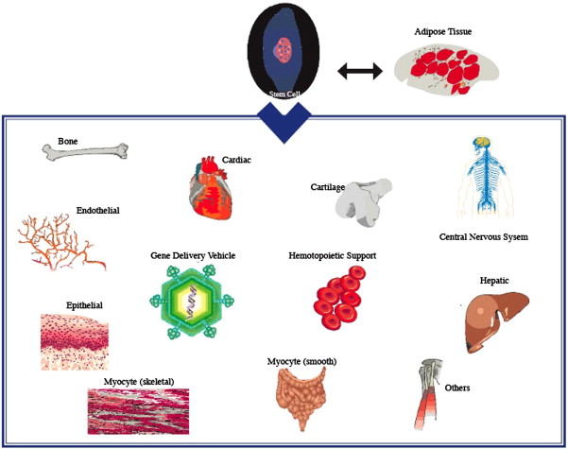
Adipose-derived stem cells
Stem cells isolated by lipoaspirate from adipose tissue
Immunophenotypically similar to BM-MSCs
Can obtain a large number of stem cells but could be variable among patients
Circulation Research. 2007;100:1249
Aesthetic Surgery Journal 2010. 30(3) 381-387
Methods. 2008 Jun;45(2):115-20

Slide 29
Skeletal myoblasts (satellite cells)
Quiescent small mononuclear progenitor cells with virtually no cytoplasm found in mature muscle
Found between the basement membrane and sarcolemma (cell membrane) of individual muscle fibers
Upon activation, proliferate as skeletal myoblasts, differentiate and form new myofibers
Genetic markers:
Transcription factors, PAX7, PAX3
myogenic transcription factors (Myf5, MyoD)
desmin
Nature 435 (7044): 898–9.

Slide 30
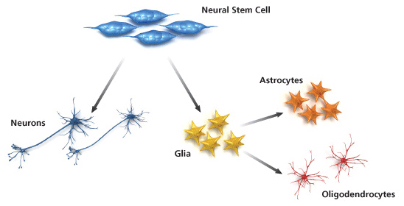
Neural Stem Cells
Isolated from brain
EGF and FGF promote cells growth in vitro (Neurosphere culture system)
Stem cell markers:
Transcription factors: Nestin and Sox2
Cell surface markers: ABCG2, FGF R4, and Frizzled-9
CD133, CD44, CD81, CD184, CD90, and CD29
J. Neurosci. Res. 74:838-851 (2003)

Slide 31
Cardiac stem cells (CSCs)
Stem cell markers: c-kit, MDR1, and Sca-1
1 CSC for every ∼30,000–40,000 myocardial cells
Can differentiate into myocytes, endothelial and vascular smooth muscle cells, and fibroblasts
Physiol Rev. 2005 Oct;85(4):1373-416

Slide 32
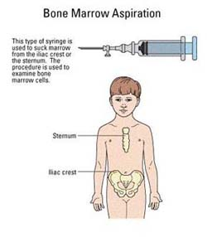
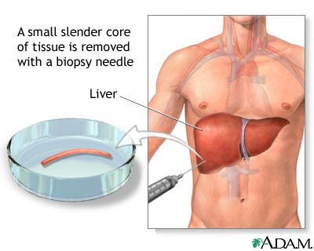
Adult Stem Cell Isolation
Hematopoietic
  Isolated from bone marrow, peripheral blood and cord blood,
  sorted for CD34+ marker
  1 in 10,000 positive
Mesenchymal
  Isolated from Bone marrow or periostium
Tissue Specific
  Tissue Biopsy
    Oval cells: Liver
    Cardiac stem cells: Heart
    Skeletal muscle satellite cells: Skeletal muscle
Tissue Biopsy
Notes:
CD34 is a cell-cell adhesion factor

Slide 33
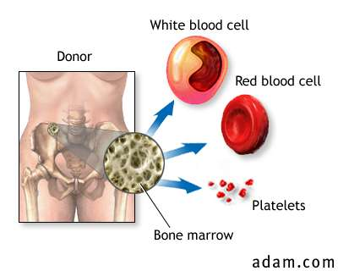
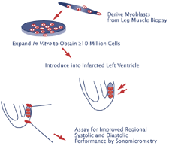
Current Stem Cell Uses
Bone Marrow Transplant
Bone Marrow Transplant
  Acute and chronic leukemias
  Aplastic anemia
  Breast cancer
  Congenital immunodeficiency diseases
  Growth factors
  Hodgkin's disease
  Lymphomas
  Metabolic diseases of childhood
  Multiple myeloma
  Myelodysplasia
  Ovarian cancer
  Testicular cancer
  Unrelated-donor bone marrow transplantation
Clinical Trials for Cardiomyoplasty
  Current cell sources: skeletal myoblasts, MSC, cardiac stem cells
Cardiomyoplasty

Slide 34
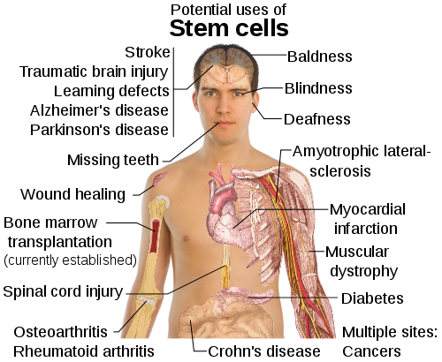
Notes:
Crohn’s disease: inflammation of digestive system (an inflammatory bowel disease)
ALS (Lou Gehrig's disease), generation of motor neurons
Myocardial infarction (heart attack)

Slide 35
Stem cell therapy
Proliferate extensively and generate sufficient quantities of tissue.
Differentiate into the desired cell type(s).
Survive in the recipient after transplant.
Integrate into the surrounding tissue after transplant.
Function appropriately for the duration of the recipient's life.

Slide 36
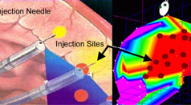
Direct Injection of Stem Cells
Injection directly within the tissue
Advantages
  Cells delivered directly to the site needed therefore increasing chances of engraftment
Disadvantages
  Cell death due to bolus injection
  Cells injected into “toxic/wound healing” environment
  Possible Invasive procedure
Injection via catheter
Notes:
Cerebral palsy, which affects about 500,000 people in the United States, is defined as brain damage that occurs before or during birth. The number of people with the disorder has increased over the last 30 years as more premature babies survive. Its effects run the gamut, from barely detectable to devastating loss of motor control. The causes are diverse as well, including everything from oxygen deprivation during birth to prenatal infections.
By entering the body through a tiny incision near the groin, doctors can thread a catheter into the left ventricle, measure electrical and motion capabilities of the heart, and pinpoint damaged or weakened areas of the muscle. The same catheter used to navigate the ventricle can then be used to deliver stem cells to those damaged areas. "The process is somewhat like a video game. The NOGA gives us a real-time, three-dimensional, color-coded image so we can target the treatment sites within a millimeter of precision," says Dr. Perin. (Texas Heart Institute, 2002) The doctors use a number of parameters and algorithms to verify placement before they begin the stem cell injections. Although only a tiny quantity is injected into the heart muscle, that injection contains millions of stem cells.

Slide 37
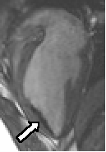
Indirect Injection of Stem Cells
Injection into the circulation prior to the diseased tissue
  Cardiac Repair
  Brain Regeneration
  Multi-Organs (India)
Advantages
  Non-invasive
  Possible improved cell viability
Disadvantages
  Cells need to “mobilize to location”
  Cells within circulation may not have time to engraft
Notes:
In this image of the heart, the white arrow points to cardiac muscle "blackened" by stem cells injected using real-time MRI. We are studying the fate of stem cells labeled in this way.
In India to correct for circulation moving cells away before engraftment, they are blocking with a catheter after the damaged area to allow time for the cells to engraft. It is not clear how long they leave the catheter inflated, inhibiting flow. (Feb 2005)

Slide 38
Case 1: Cartilage regeneration by MSC injection
Autologous mesenchymal stem cell culture and percutaneous injection into a knee
→ significant cartilage growth, decreased pain and increased joint mobility
Centeno CJ, Busse D, Kisiday J, Keohan C, Freeman M, Karli D (2008). "Increased knee cartilage volume in degenerative joint disease using percutaneously implanted, autologous mesenchymal stem cells". Pain Physician 11 (3): 343–53.

Slide 39
Case 2: Combination therapy of multi adult stem cells
Spinal cord injury patient
  intrathecal administration of allogeneic umbilical cord blood ex-vivo expanded CD34 and umbilical cord matrix
International Archives of Medicine 2010, 3:30

Slide 40
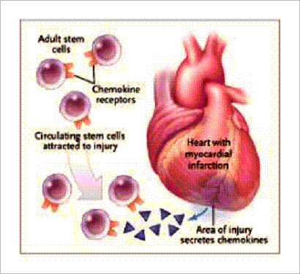
Case 3: Homing of Endogenous Stem Cells
Mobilize endogenous stem cells
Injections of growth factors
Wound regeneration signaling

Slide 41
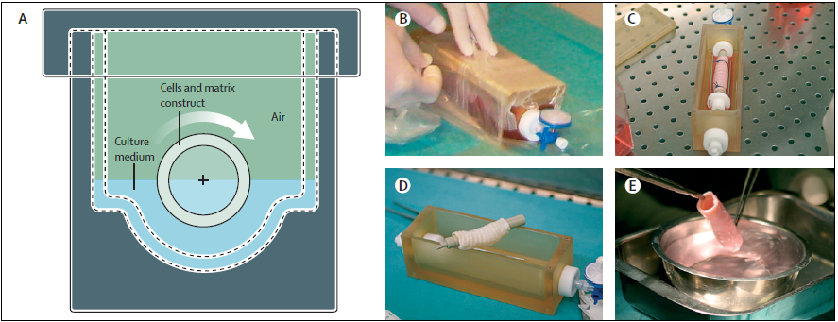
Case 4: First transplant of a human organ grown from adult stem cells
Donor connective tissue scaffold (decellularized trachea) is re-seeded with stem cells from the recipient
- Chondrocytes derived from mesenchymal stem cells (on the outer surface)
- Epithelial cells derived from bronchial mucosa (on the inner surface)
Paolo Macchiarini et al. Lancet, 2008 Dec 13; 372 (9655): 2023-30
Bioreactor developed for airway tissue engineering

Slide 42
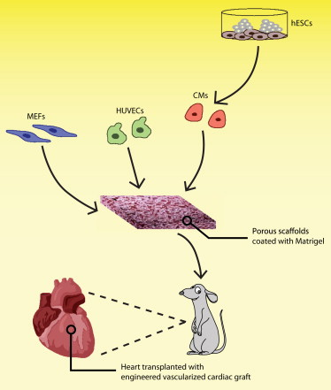
Case 5: combination with pluripotent stem cells: Vascularized cardiac patches
Cardiac patches
hESC-derived cardiomyocytes,
human umbilical vein endothelial cells (HUVECs)
mouse embryonic fibroblasts (MEFs)
Higher vessel structures
larger cell grafts
improved viability
Proc Natl Acad Sci U S A. 2009 Sep 29;106(39):16568-73
Cell Stem Cell, 5(6) 575-576, 2009

