Slide 1
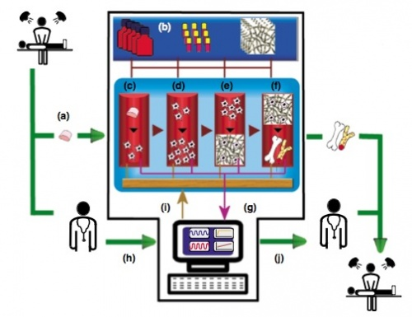
Bioreactors and scale up
Tissue Engineering & Drug Delivery BBI 4203
LECTURE 8
Most content taken from Sajad Sarvari sajad.sarvari@ut.ac.ir

Slide 2
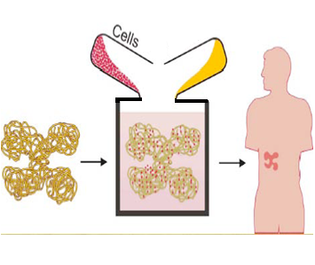
Principles of Tissue Engineering
Scaffolds Cell types Growth factors
+
Culture medium
Bioreactor culture system
Tissue constructs
Cartilage, bone, blood vessels…
Implantation
GF+CM
Notes:
Tissue engineering is a multidisciplinary, young and emerging biotechnology sector, which promises to change medical practice profoundly, regenerating diseased tissues and organs instead of just repairing them.---- Principles of engineering, chemistry, and biology are combined to create tissue substitutes from living cells and synthetic materials
Products of TE:1-Cells 2-Tissue 3-Organ composed cells and tissues
The main challenge in tissue engineering is to construct 3D tissues homologous to the natural ones with the ability imitate their specific functions. The in-vitro generation of 3D tissue construction requires not only a biological model, but also the development of new culture strategies including bioreactor concepts. Therefore, tissue-specific bioreactors should be designed on the basis of a comprehensive understanding of biological and engineering aspects. Till now, engineered tissues have generally been simple 2D structures using a single cell type. One of the main difficulties in tissue engineering is the ability to grow 3D tissue structures of relevant clinical sizes. Several bioreactor systems have been developed with an expectation to fulfill such problems. In this review, key pertinent technical challenges are identified and an overview of existing culture systems and bioreactors used for tissue engineering is provided. Particular focus will be given to the mass transfer, which is absolutely essential both for nutrient supply and waste elimination to maintain cell viability within large three-dimensional assemblages. Furthermore, different cell seeding strategies that can procure uniform cell distribution within large scaffolds are to be discussed.

Slide 3
OUTLINE
Mammalian cell culture technology
Fields of application
Bioreactors
Scale up
Tissue Engineering bioreactors
Engineering parameters
Computational modeling
Comparison between different TE bioreactors
Sensing in TE bioreactors
Case study

Slide 4
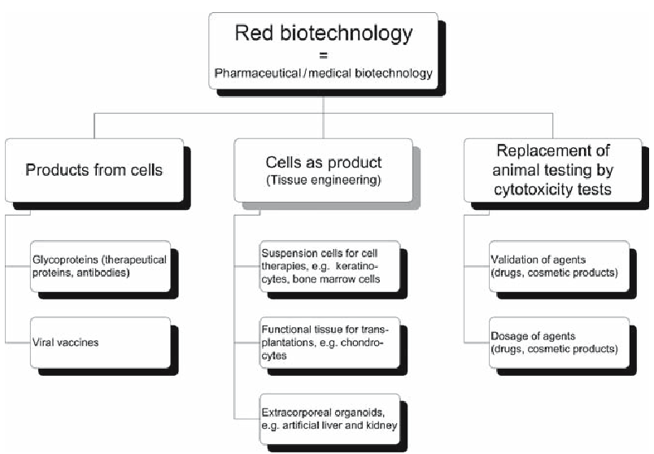
Mammalian Cell Culture Technology

Slide 5
Fields of Application and Products from Mammalian Cells
Cell-based concepts include the following:
Direct transplantation of isolated cells
Implantation of a bioactive scaffold for the stimulation of cell growth within the original tissue
Implantation of a three dimensional (3D) bio-hybrid structure of scaffold and cultured cells or tissue
physiological models for studying disease pathogenesis and developing new molecular therapeutics, e.g. drug screening

Slide 6
Bioreactors for Mammalian Cells: General Overview
In general, a cell culture bioreactor has to meet the following demands:
Guaranteed cell-to-cell contact and a surface for cell detachment in case of anchorage-dependent growing cells
Homogeneous and low-shear mixing and aeration
Sufficient turbulence for effectual heat transfer
Adequate dispersion of air and gas
Measurability of process variables and key parameters
Scale-up capability
Long-term stability and sterility
Ease of handling
Reasonable maintenance

Slide 7
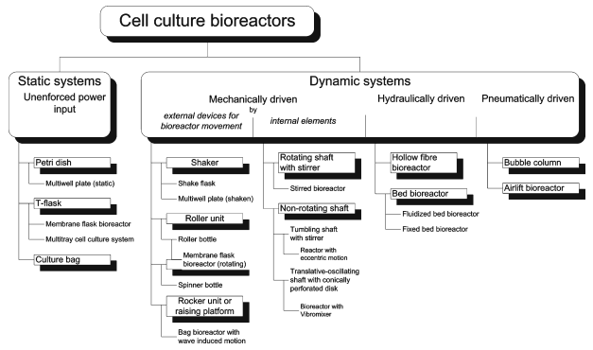

Slide 8
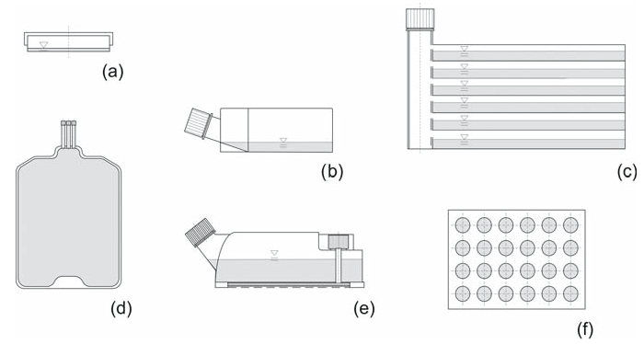
Static Bioreactors with Unenforced Power Input
Basic scheme of static cell culture bioreactors: (a) Petri dish, (b) Tissue culture flask, (c) Multi-tray cell culture system, (d) Culture bag (like blood bag), (e) Static membrane flask bioreactor (CELLine), (f) Multi-well plate

Slide 9
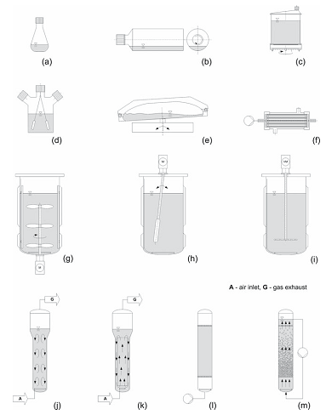
Dynamic Bioreactors
Basic scheme of dynamic cell culture bioreactors: (a) Shaker flask, (b) Roller bottle, (c) Rotating membrane flask bioreactor (MiniPerm), (d) Spinner flask, (e) Rocking bag bioreactor with wave induced motion, (f) Hollow fiber bioreactor, (g) Stirred bioreactor, (h) Bioreactor with eccentric motion stirrer, (i) Bioreactor with Vibromixer, (j) Bubble column, (k) Airlift bioreactor, (l) Fixed bed bioreactor, (m) Fluidized bed bioreactor
Bioreactors Mechanically Driven by Internal Elements (g)
Hydraulically Driven Systems (f)
Pneumatically Driven Systems (j, k)
Notes:
Dynamic culturing of cells and tissues has a direct impact on the composition, morphology and mechanical properties of engineered tissues grown in mechanically stimulated environments . This is primarily due to effects of dynamic culture media transport, which often enhance the functions of dynamic flow-based bioreactors , as compared to diffusion-based static culture systems

Slide 10
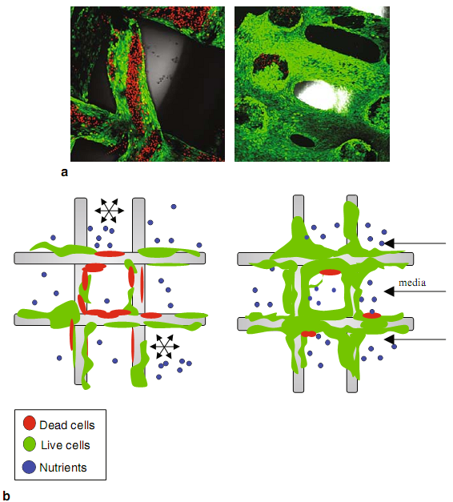
Dynamic Culturing
https://www.youtube.com/watch?v=dnXwm6-BBCQ
Notes:
(a) Confocal laser microscopy images of seeded scaffolds stained for live (green) and dead (red) cells reveal higher numbers of dead cells within the statically cultured scaffold (left) as compared to the dynamically cultured scaffold (right) and (b) graphical illustration showing that nutrient diffusion occurring within the statically cultured scaffold is driven by concentration (left) in contrast to convection driven (dynamic) flows where nutrients are uniformly distributed (right)
Vunjak-Novakovic G, Meinel L, Altman G, Kaplan D (2005) Bioreactor cultivation of osteo- chondral grafts. Orthod Craniofac Res 8(3):209–218

Slide 11
Scale up
Factors that need to be considered include the following:
How big does the vessel need to be to produce sufficient product;
How are the materials in the vessel to be mixed efficiently but without damage to the cells in the vessel;
What is the required aeration rate and the power input;
What is the process time;
How many scale-up steps are required;
What are the costs (capital, running, depreciation) of various types of equipment, etc.

Slide 12
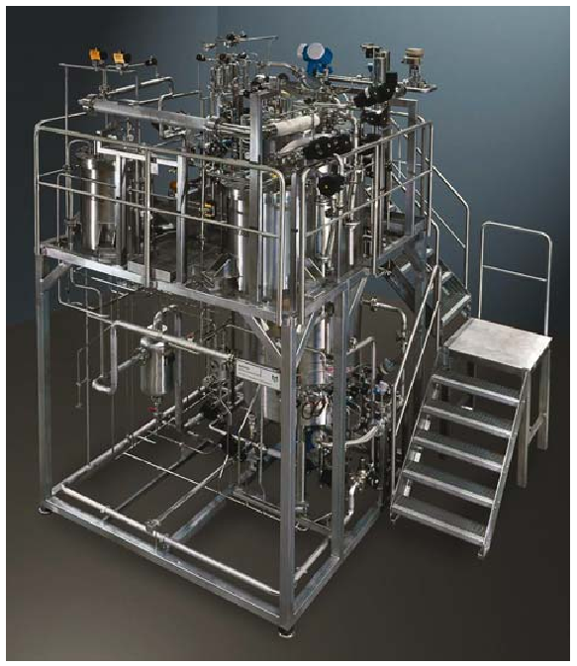
Scale up
Production-scale bioreactors for cell culture (courtesy of Zeta AG, Switzerland)

Slide 13
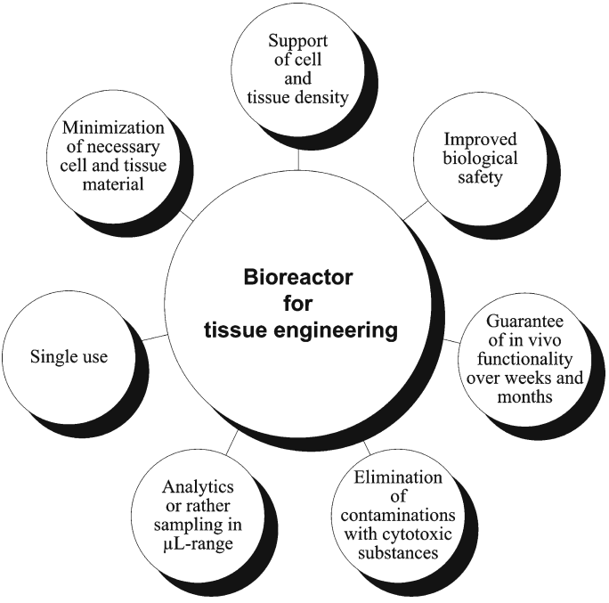
Notes:
Moreover each special type of tissue structure and production procedure (e.g., skin, bone, blood vessel, and cartilage) necessitates an individualized bioreactor design which requires both biological and engineering conditions to be undergone simultaneously and addressed along with reliability, reproducibility, scalability and safety issues

Slide 14
BIOREACTOR
environment control and nutrient delivery/waste removal
mechanical stimulation
SCAFFOLD
migration attachment
degradation proliferation
CELLS
intracellular activity
intracellular signaling
• pH
• Oxygen
Temp
Notes:
Figure 2 shows some of the potential interactions that should be appreciated when engineering tissues in a bioreactor system. The figure represents a simple systems approach to tissue engineering; ie it is important to consider a complex interacting system and that we cannot only focus on single components working alone. Since many of the interactions can be studied on a biological, physical or chemical level, these interactions demonstrate the complexity of tissue engineering. Some authors have derived data or constructed models for specific parts of this model (Endy and Brent 2001; Lauffenburger and Griffith 2001). The increasing use of bioreactors in tissue engineering means that control and manipulation of the culture environment will become as important as cell and scaffold issues.

Slide 15
necessary conditions for a proper development of tissue in a bioreactor
Maintaining a desired uniform cell concentration within the scaffold during cell seeding
Environmental parameters to be under control (e.g., temperature, pH, pressure, oxygen tention, metabolites, regulatory molecules and shear stress) as well as allowing aseptic operations (e.g., feeding, waste removal and sampling)
facilitating mass transfer and more importantly allowance for automated processing steps

Slide 16
key functions of bioreactors used for tissue engineering
(1) Cell seeding of three-dimensional matrices: bioreactors can maximize the cell utilization, control the cell distribution, and improve the reproducibility of the cell seeding process. (2) Maintenance of a controlled culture environment: bioreactors that monitor and control culture parameters can provide well-defined model systems to investigate fundamental aspects of cell function and can be used to enhance the reproducibility and overall quality of engineered tissues. (3) Physical conditioning of cell/scaffold constructs: bioreactors that apply physiological regimes of physical stimulation can improve the structural and functional properties of engineered tissues (T, temperature; pO2 , oxygen partial pressure; pH, concentrations)
1

Slide 17
Cell Seeding on Three-Dimensional Matrices
“static seeding”
Inhomogeneous: since gravity may not suffice for the cells to penetrate throughout the scaffold pores
“dynamic seeding”:
spinner flasks
wavy-walled reactors
rotating wall vessels
“perfusion seeding,” consisting of direct—unidirectional or alternating—perfusion of a cell suspension through the pores of a 3D scaffold
Notes:
Hence a variety of “dynamic” cell-seeding techniques, relying on the use of biore- actors, have been recently developed with the aim to increase quality, reproducibility, efficiency, and uniformity of the seeding process as compared to conventional static methods.
When defining and optimizing seeding protocols (i.e., the selection of parameters such as cell concentration in the seeding suspension, medium flow rate, flow directions, and timing of the perfusion pattern), most of the studies found in the literature rely upon experimental, application-specific, trial and error investigations, rather than turning to the support of theoretical models. Definition of the cell seeding parameters based on computational models (as extensively described in the following Section) could allow for a more rational design of experiments, ultimately leading to more efficient optimization strategies. However, the inherent complexity of dynamic seeding systems represents a major challenge for modeling, because of high dependence on the specific cell type and scaffold implemented (i.e., complex pore architecture and related fluid-dynamics, kinetics of cell adhesion, molecular mechanics, biomaterial properties, etc.).

Slide 18
Maintenance of a Controlled Culture Environment
static conditions
The high degree of structure heterogeneity
presence of a necrotic central region, surrounded by a dense layer of viable cells
diffusional transport does not properly assure uniform and efficient mass transfer within the constructs
Bioreactors that perfuse culture medium
design of new perfusion bioreactors and the optimization of their operating conditions
computational fluid dynamics (CFD) modeling
Notes:
The high degree of structure heterogeneity usually noticed in 3D-engineered constructs cultured in static conditions (i.e., presence of a necrotic central region, surrounded by a dense layer of viable cells) suggests that diffusional transport does not properly assure uniform and efficient mass transfer within the constructs

Slide 19
Physical Conditioning of Developing Tissues
physical forces
hydrodynamic/hydrostatic
establish shear stress acting directly on cells: cartilage, bone, cardiac tissue
create a differential pressure: blood vessels and heart valves
combine these two mechanisms (again with vessels and heart valves)
Mechanical
direct tension (tendons, ligaments, skeletal muscle tissue, cardiac tissue)
compression (cartilage)
bending (bone)
and electrical
skeletal muscle
cardiac constructs
fluid-driven mechanical stimulation
development of excitable tissues
Notes:
A number of in vivo and ex vivo studies over centuries contributed to demonstrate that physical forces (i.e., hydrodynamic/hydrostatic, mechanical, and electrical) play a key role in the development of tissues and organs during embryogenesis, as well as their remodeling and growth in postnatal life.
Bioreactors applying fluid-driven mechanical stimulation , for example, were employed to establish shear stress acting directly on cells
(e.g., in the case of carti- lage, bone, cardiac tissue), create a differential pressure (e.g., for blood vessels and heart valves) or combine these two mechanisms (again with vessels and heart valves)
Similarly, interesting findings on the effect of electrical stimulation on the development of excitable tissues were derived by conditioning skeletal muscle and cardiac constructs. Moreover, a promotion of neu- ral gene expression by activation of calcium channels was observed as a result of the application of physiological electrical patterns to primary sensory neurons.

Slide 20
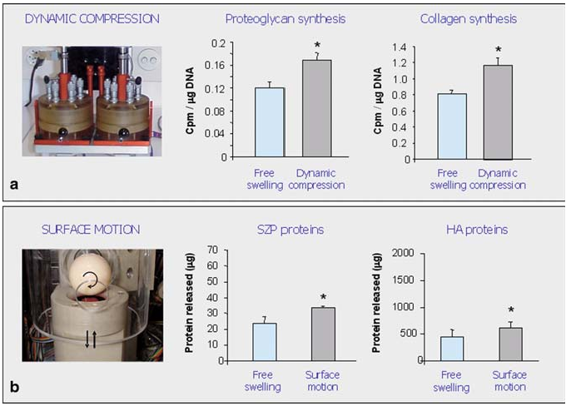
Response of nasal chondrocytes to physical stimuli that simulate joint loading. Amounts of newly synthesized proteoglycans and collagen, were significantly higher in constructs subjected to a single application of dynamic compression as compared to those maintained under free swelling. Proteins involved in joint- lubrication (superficial zone protein “SZP” and hyaluronan “HA”) were released into the culture medium in significantly higher amounts when constructs were subjected to intermittent applications of surface motion as compared to those maintained under free swelling conditions
Candrian C, Vonwil D, Barbero A, Bonacina E, Miot S, Farhadi J, Wirz D, Dickinson S, Hollander A, Jakob M, Li Z, Alini M, Heberer M, Martin I (2007) Arthritis Rheum 58:197

Slide 21
Engineering Parameters in TE Bioreactor Design
Generally providing biochemical environment which is controlled by nutrient transfer e.g. glucose and dissolved oxygen to the cells along with metabolism products from the cells and biomechanical environment is of a bioreactor responsibility
Mass Transfer through Bioreactors
Mechanical Stimulation

Slide 22
Mass transfer
external mass transfer: transferring Nutrients, oxygen, and regulatory molecules have to be efficiently from the bulk culture medium to the tissue surfaces
hydrodynamic conditions in a bioreactor
internal mass transfer transferring to the interior cells of the tissue construct
combination of diffusion and convection mechanisms (typically induced by medium perfusion or scaffold deformation due to imposed mechanical loads)
In a vise versa maneuver metabolites and CO₂ are to be removed similar to what mentioned above, i.e. from the cells through the tissue matrix, then to the surface and finally to the bulk medium
Notes:
he diffusive penetration depth of oxygen within tissues in vivo, is namely in the range of 100 to 200 μm
The transport of dissolved oxygen in a bioreactor occurs in three regions:
bulk fluid phase of the bioreactor (i.e. global mass transfer)
local region in where the oxygen transfers from the bulk fluid to the surface of the aggregated cells (internal mass transfer)
Through the aggregated cells (external mass transfer)
In the first step, at the gas-liquid
Therefore, the oxygen concentration experienced by cells is a result of the balance between the oxygen delivery across the medium layer called Oxygen Transfer Rate (OTR) and the rate of oxygen consumption by cells named Oxygen Uptake Rate (OUR).
During the initial expansion phase, cell density increases with time; and hence, the overall demand for oxygen also increases. Conversely, cells may convert from a proliferative state to the state of differentiation during the later stages of the culture, a change that has implications on oxygen transfer. Proliferating cells typically have a higher oxygen demand per cell than differentiating cells
Mass transfer of nutrients and oxygen in central parts of cell-scaffold complexes, and consequent improvement of metabolic function of cells, could be achieved by medium flow either through or around semi-permeable tubes. Further development of this concept can be obtained by direct perfusion from bioreactor inherent tubes through prefabricated interconnecting tubes and pores of scaffolds taking advantage of reducing mass transfer limitations particularly in central parts of scaffolds

Slide 23
Mechanical Stimulation
mechanical stimulation
hydrodynamic pressure
fluid flow
shape and function of the cells is affected by fluid flow
Shear stress is also among particular challenging issues in delicate mammalian cell cultures, while many cell types respond to shear stress
cells in aggregates are exposed to higher shear stresses than single cells due to their large particle diameter
shear stress has a dominant impact on tissue function and viability
shears more than 1 dyn/cm² are damaging to the cells, those of 0.1 dyn/cm² are ideal, and those of less than 0.01 dyn/ cm² are insufficient to promote growth
Notes:
For cell suspensions, viscometer experiments have shown that for a wide variety of mammalian cell lines, shears more than 1 dyn/cm² are damaging to the cells, those of 0.1 dyn/cm² are ideal, and those of less than 0.01 dyn/ cm² are insufficient to promote growth
Indeed, high shear stress on the surface of the scaffold, caused by the flow, can peel off attached cells and in this condition growth is significantly slower. Because the internal geometry of the scaffold can control this phenomenon (as mentioned by Martin et al. [9]), CFD analysis can be considered as a powerful method to investigate how the construct is affected by the flow field

Slide 24
Computational Modeling in Bioreactor Systems
The goal: basic design and the optimization of bioreactors for tissue engineering applications
Macro-Scale Computational Models for Bioreactor Design
simulate the fluid-dynamics and mass transport environment at the level of the bioreactor system
use of CFD simulations, validated through imaging techniques such as particle image velocimetry (PIV)
Computational modeling , helped to tune construct location and agitation rate in order to provide a more homogeneous shear stress distribution over the scaffolds.
Notes:
CFD simulations, validated through imaging techniques such as particle image velocimetry (PIV), showed that flow in spinner flasks and wavy- walled bioreactors was unsteady, periodic and fully turbulent, resulting in hetero- geneous fluid-induced shear stress distributions over the outer surface of the scaffolds. Computational modeling of these systems helped to tune con- struct location and agitation rate in order to provide a more homogeneous shear stress distribution over the scaffolds

Slide 25
Macro-Scale Computational Models for Bioreactor Design
Distribution of wall shear stresses, τ, within the pores of 3D scaffolds (average pore diam- eter of 100 µm, 77% porous) subjected to direct perfusion at rates of 0.5 cm
( a ) Simulations based on a simplified pore architecture ( left panel ) showed a relatively uniform distribution of shear stress with an average of 2.7 mPa (indicated by vertical dashed line ). ( b ) Simulations based on a µCT reconstruction of the actual porous microarchitecture ( left panel ) showed an average shear stress (3.0 mPa) similar to that based on the simplified geometry, however, the µCT-based model revealed a more heterogeneous distribution of shear within the pores
Cioffi M, Boschetti F, Raimondi MT, Dubini G (2006) Biotechnol Bioeng 93:500

Slide 26
(a) Velocity flow field: speed of media flow (mm s) through a transversely perfused cylindrical trabecular bone scaffold ( shown in white ) from side and top views. (b) Local shear stress field: map of shear stresses (Pa) in media transversely perfused through a 3D trabecular bone scaffold from side and top views.
Porter B, Zauel R, Stockman H, Guldberg R, Fyhrie D (2005) 3-D computational modeling of media flow through scaffolds in a perfusion bioreactor. J Biomech 38(3):543–549

Slide 27
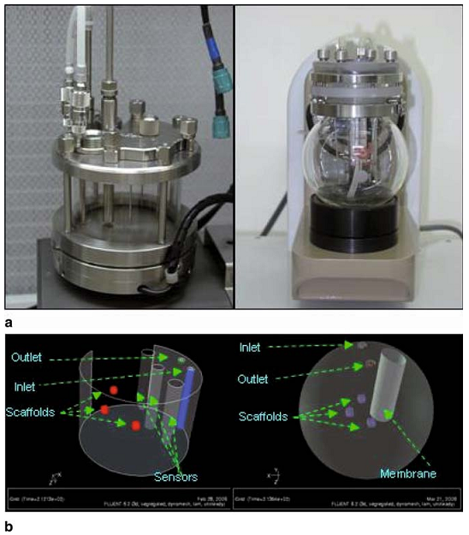
(a) Cylindrical chamber ( left ) and new Mk. 3 spherical chamber ( right ). The complex cylindrical chamber houses multiple probes which are likely to interfere with the flow dynamics of culture media to a greater extent than the spherical vessel and (b) model of cylindrical ( left ) and spherical vessels ( right )
Singh H, Teoh SH, Low HT, Hutmacher DW (2005) Flow modelling within a scaffold under the influence of uni-axial and bi-axial bioreactor rotation. J Biotechnol 119(2):181–196

Slide 28
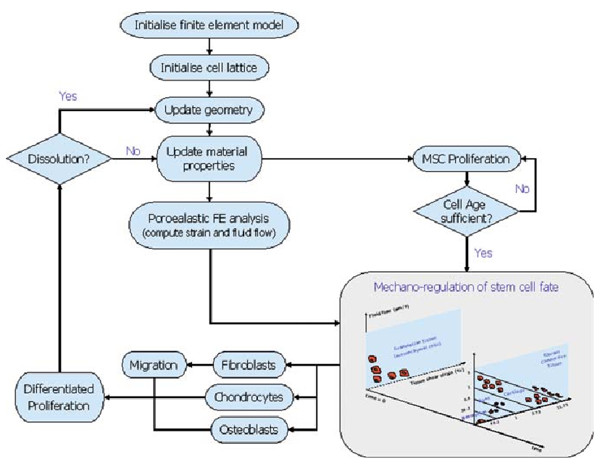
Computational model of temporal tissue differentiation and bone regeneration in a 3D printed scaffold during fracture healing. The model accounted for cell proliferation and migration based on a three-dimensional random-walk approach and for tissue differentiation based on a mechano-regulation algorithm both in terms of the prevailing biophysical stimulus and number of precursor cells. Simulations were a function of the scaffold porosity, Young’s modulus, and dis- solution rate, under both low and high loading conditions. Figure adapted from
Byrne DP, Lacroix D, Planell JA, Kelly DJ, Prendergast PJ (2007) Biomaterials 28:5544

Slide 29
Comparison between Different types of TE Bioreactors Based on Engineering Parameters
Static culture
is simply designed and operated
there are nutrient diffusion limitations with large constructs
statically cultured constructs have frequently heterogeneous structure and composition, including a necrotic central region and dense layers of viable cells encapsulating the construct outer edge
stirred flask
scaffolds are attached to needles hanging from the lid of the flask for dynamic seeding. Convective flow, generated by a magnetic stirrer bar, allows continuous mixing of the medium surrounding the construct

Slide 30
Comparison between Different types of TE Bioreactors Based on Engineering Parameters
rotating wall
Enhancement of external mass transfer under laminar flow condition
Dynamic laminar flow of rotating bioreactors generally improves properties of the peripheral tissue layer.
fibrous capsule does not form, but the limitations of the diffusional transfer of oxygen to the construct interior still remain
Interestingly, as compared to the turbulent flow within stirred flasks, the dynamic laminar flow in rotating wall vessels, contributed to reduced levels of shear stress

Slide 31
Comparison between Different types of TE Bioreactors Based on Engineering Parameters
Perfusion
force culture medium through the scaffold pores
enhancing nutrient transport and providing mechanical stimuli to the cells
The flow rate can be optimized in respect of the limiting nutrient, and chiefly oxygen due to its low solubility in culture medium
If the culture medium perfused directly through the pores of the scaffold, not only mass transfer rate is enhanced at the construct periphery, but also within the internal pores.
their applicability easily monitor the metabolite consumption of the cells e.g. oxygen, glucose and cellular proliferation using online biosensors
Notes:
Bioreactors that perfuse the culture medium directly through the pores of the scaffold, not only enhance mass transfer rate at the construct periphery, but also within the internal pores. This can potentially eliminates mass transfer limitations. Another advantage of perfusion bioreactors is their applicability easily monitor the metabolite consumption of the cells e.g. oxygen, glucose and cellular proliferation using online biosensors

Slide 32
Comparison between Different types of TE Bioreactors Based on Engineering Parameters
Reactor Type | General Descriptions | Mass Transfer Mechanism | Shear Stress | Special Usage | Tissue | Consideration
Stirred tank | magnetically stirred flasks, Biochemical CSRT! | convective mixing | High | dynamic seeding of scaffolds | cartilage | appropriate scaffold is essential, balance between increasing mass transfer and modulating shear stresses
Perfusion | Flow of media over or through a cell population/bed of cells | Convection | Moderate | Most relevant system to fixed, adherent human tissue, | epithelial organoid units, Bone, Cartilage, Intestinal | seeding and attachment of human cells
Rotating Wall | rotating at a speed so the constructs in the reactor are maintained ‘‘stationary’’ in a state of continuous free-fall | Reynolds numbers more conducive to a minimal boundary layer and hence better mass transfer | Low |  | Cartilage, Skin | limited use to grow large tissue mass
Hollow Fiber | a closed vessel filled with medium and mammalian cells into which a bundle of semi-permeable hollow fibers is inserted | Diffusion, Moderate convction | Low | Provides nutrients to the center of the growing tissues | Streptomyces aureofaciens, Bone, Cartilage, Liver | At high cell densities or with solid-like matrices, convective contribution can be significantly hindered especially for Oxygen
Others: Fluidized bed, Fixed bed, Airlift | Not common for Tissue engineering | Covection | High | - | - | -

Slide 33
Sensing in Tissue Engineering Bioreactors
milieu parameters
physical (temperature, pressure, flow rate)
chemical (pH, dissolved O2 and CO2, chemical contaminants, concentration of significant metabolites/cat- abolites such as glucose, lactate or secreted proteins)
biological (sterility)
construct parameters
physical (stiffness, strength, and permeability)
chemical (composition of the scaffold and of the developing extracellular matrix)
biological (cell number and proliferation rate, concentration of intracellular proteins, cell viability)
Notes:
Sensing in tissue culture bioreactors represents a major premise to clarify still unknown aspects of the cellular response in dynamic culture conditions, as well as a step forward towards the automation and in-process control of tissue manufac- turing processes. Monitoring the partial pressure of O2 and CO2 in the culture medium, or detecting the concentrations of glucose and lactate, for instance, allows quantitative evaluation of the metabolic behavior of cultured cells, thus supporting/substituting subjective, qualitative conclusions traditionally derived by simply observing the color of the medium.
the noteworthy parameters which should be adequately monitored and controlled during in vitro organogenesis can be classified in two main categories, namely the milieu parameters and the construct parameters . Milieu parameters are then physical (e.g., temperature, pressure, flow rate), chemical (e.g., pH, dissolved O2 and CO2, chemical contaminants, concentration of significant metabolites/cat- abolites such as glucose, lactate or secreted proteins) and biological (e.g., sterility). Similarly, the construct parameters can be different in nature: physical (e.g., stiff- ness, strength, and permeability), chemical (e.g., composition of the scaffold and of the developing extracellular matrix) and biological (e.g., cell number and prolifera- tion rate, concentration of intracellular proteins, cell viability).

Slide 34
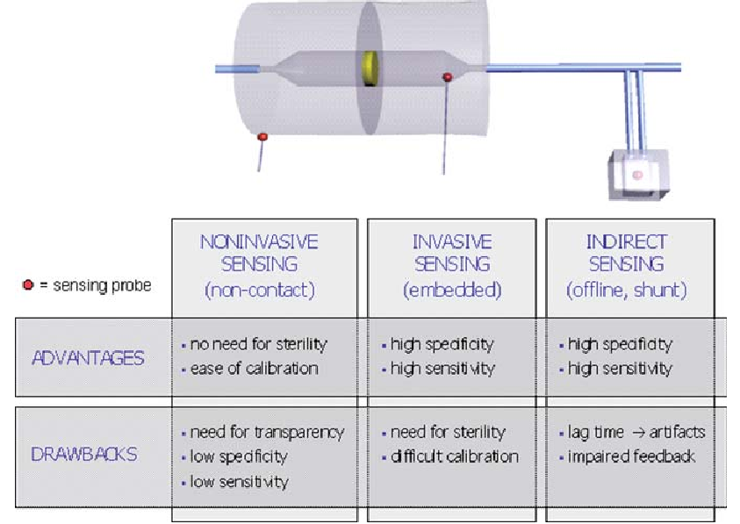
Sensing in Tissue Engineering Bioreactors
Notes:
The three main modalities to monitor the milieu in bioreactors, as described in Sect. 3.3. (1) “ Invasive sensing ” implies that the sensor probe is placed directly inside the culture chamber of the bioreactor, either immersed in the culture fluid or in direct contact with the engineered construct. (2) “ Noninvasive sensing ” involves sensors that do not come in contact with the interior of the culture chamber, but are capable of measuring via interrogation through the bioreactor wall. (3) “ Indirect sensing ” is performed directly on the culture media, but via sampling means, either by offline analysis or shunt sensing.
Rolfe P (2006) Meas Sci Technol 17:578
The most common invasive sensors currently in use are based on optical and electrochemical principles: fiber optic fluorescence-based sensors, for example, have been manufactured for the measurement of dissolved oxygen and of pH, while typical electrochemical sensors are membranes functionalized with appropriate enzymes for the detec- tion of glucose or urea.
Invasive: by using ultrasounds or optical methods such as spectrophotometry or fluorimetry. Typically, the flow rate of medium in perfusion bioreactors is detected via noninvasive techniques, mainly based on Doppler velocimetry. DOCT (Doppler Optical Coherence Tomography)

Slide 35
Monitoring of the Construct
real-time characterization of (1) functional and (2) morphological properties of engineered constructs, both at the micro- and at the macro-scale
Monitoring of the functional properties
physical properties (e.g., strength, elastic modulus, permeability),
monitoring of cell function within the engineered construct itself, e.g., in terms of proliferation, viability, metabolism, phenotype, biosynthetic activity, and adhesive forces.
Monitoring of the morphological properties
the amount, composition, and distribution of the extracellular matrix which is being deposited throughout the scaffold during bioreactor culture.
Notes:
image real-time cell/material interactions in a perfusion bioreactor based on the use of an upright microscope. The kinetics of cell aggregation and organoid assembly in rotating-wall vessel bioreactors, instead, could be performed according to the method developed by Botta et al, relying on a diode pumped solid state laser and on a CCD video camera. Boubriak and co-authors recently proposed the use of micro-dialysis for detecting local changes in cellular metabolism (i.e., glucose and lactate concen- trations) within a tissue-engineered construct. By means of this method, concen- tration gradients could be monitored within the construct, with the highest lactate concentrations in the construct center, thus allowing early detection of inappropriate local metabolic changes.
In this context, OCT (Optical Coherence Tomography) has been successfully employed as a real-time, nonde- structive, noninvasive tool to monitor the production of extracellular matrix within engineered tendinous constructs in a perfusion bioreactor

Slide 36
On-Line Monitoring in Bioreactors
Notes:
Many experiments, which previously could only be carried out laboriously in a fermenter with gas analytics, can now be conducted much cheaper and moreover in a fraction of the time with RAMOS.
Even from a conservative point of view, RAMOS pays off within short time by reduction of laboratory costs and development periods (see economic efficiency considerations). Furthermore, the production costs can be reduced and made effective by more efficient stems that can be detected with the help of RAMOS.

Slide 37
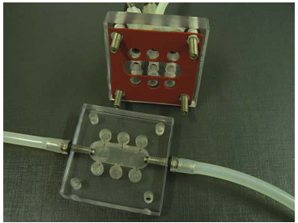
Bioreactor Technology in Cardiovascular Tissue Engineering
Bioreactors to evaluate systematically the angiogenetic effect. The lumen of the chamber can be filled with a tubular scaffold, collagen or hydrogels. The six notches, three on the left and three on the right can be filled up with different growth factors in diverse concentrations. The lumen of the scaffold will be seeded with endothelial cells and cultured under mechanical stimulation. The influence on the angiogenetic behaviour of the endothelial cells can be followed under the microscope or in a histological or molecular follow up. This bioreactor provides a sufficient sample capacity for statistically significant comparisons at multiple time points (developed by Jan Hansmann, Fraunhofer IGB)

Slide 38
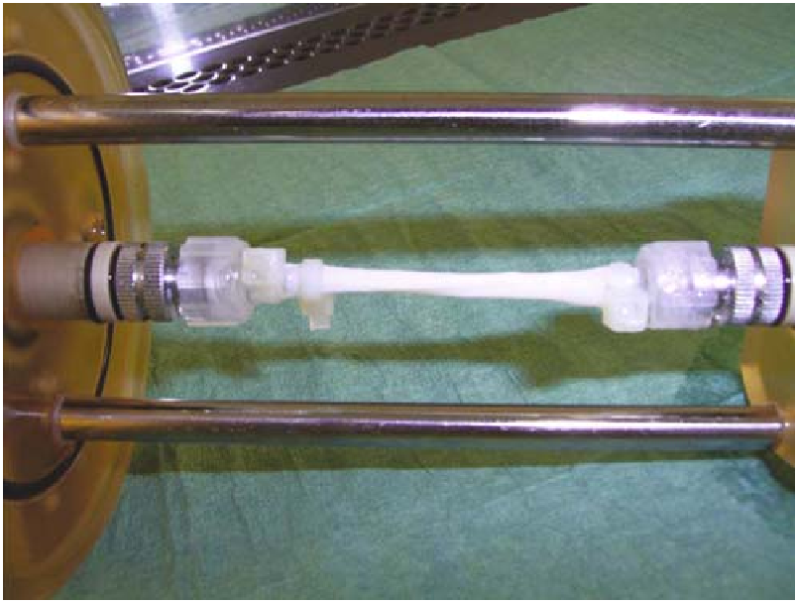
Bioreactor Technology in Cardiovascular Tissue Engineering
Carotid scaffold inserted in a typical bioreactor for vascular tissue engineering. A scaffold for the generation of a carotid was inserted into a typical two-chamber vascular bioreactor. The whole construct can be inserted in a glass tube to guaranty sterility during the culture period. The whole construct will be placed in an apparatus for pulsatile perfusion, to mimic the cardiovascular conditions in vitro. The perfusion system provides intra-luminal pulsatile flow ensuring the necessary shear stress and culture medium for the endothelial cells. The surrounding container can be filled up with smooth muscle cell specific culture medium
Niklason LE et al (1999) Functional arteries grown in vitro. Science 284 (5413):489–493
https://www.youtube.com/watch?v=5jb7ed2iCJs

Slide 39
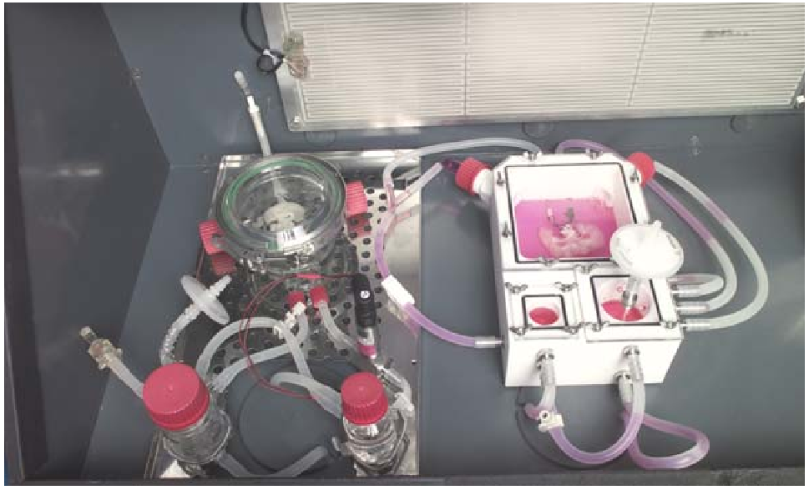
Bioreactor Technology in Cardiovascular Tissue Engineering
Bioreactor for the generation of vascularised tissue with an arterial inflow and a venous reflux system. In the bioreactor a scaffold for the in vitro generation of vascularised liver tissue is inserted and connected to an arterial supply to provide fresh nutrients to the culture medium. The metabolites are then removed with the pulsatile flowing medium through the venous reflux system into the smaller chamber. The small chamber and the larger chamber are connected, providing a closed circulation . Using this bioreactor we are able to simulate the natural environment of the body, from blood pressure to temperature and control and regulate the culture conditions during the whole culture period

Slide 40
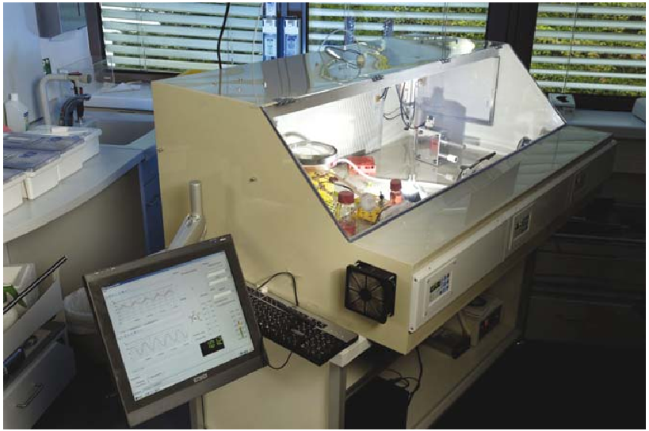
Bioreactor Technology in Cardiovascular Tissue Engineering
A computer-based bioreactor system for vascular tissue engineering developed at the Fraunhofer IGB. The figure shows the whole bioreactor system. The bioreactor described in last figure is inserted into a climate chamber. A computer simulation forms the basis of the fluid dynamics of the bioreactor system to control the hydrodynamic regime and temperature. The medium flow through the growing vascularised tissue is provided by a roller pump in the same way as the heart pumps blood through the human circulatory system. The computer regulates the arterial oxygen and nutrient supply via parameters such as blood pressure, temperature and flow rate
This work was awarded in 2006 the 1st Hugo Geiger Prize for the life sci- ences of the Fraunhofer Gesellschaft and the Lewa prize of the University of Stuttgart

Slide 41
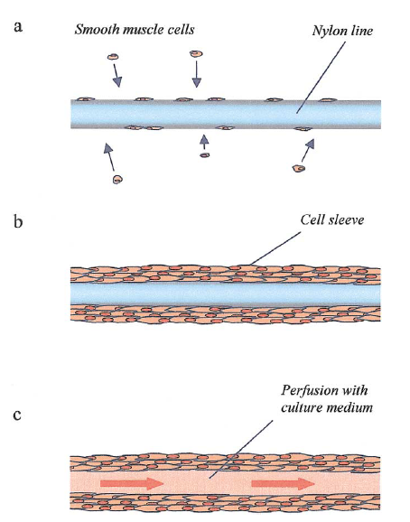
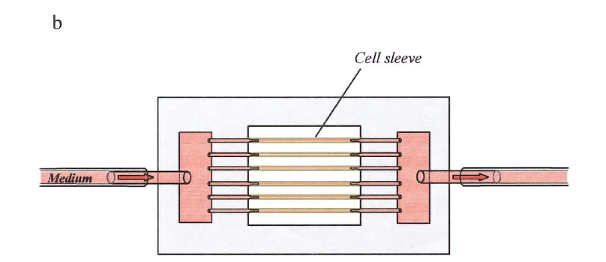
Perfused microvessels
Source: Tissue engineering of perfused microvessels, Thomas Neumann, Microvascular Research 66 (2003) 59–67
Notes:
One major obstacle toward the creation and survival of larger, three-dimensional tissues is the lack of a functioning
vascular network that provides transport of oxygen, nutrients, and metabolic byproducts throughout the construct.
Most tissue-engineering strategies to date depend on diffusion in vitro and ingrowth of host vessels after grafting.
In the present study, we examined whether it would be possible to create a microvessel system in vitro by culturing
vascular smooth muscle cells (SMCs) in circular layers around polymer strands that were then mechanically removed. We also tested to see if such microvessels could be connected to a tubing system. Their performance during perfusion was examined over 7 days.
In our preparation, we perfused each microvessel at a flow rate of 5.5 _l/min (provided that all six vessels were
perfused equally). Assuming the viscosity of the culture medium to be 0.012 poise and the inner diameter of the
vessels to be 150 _m, this flow rate corresponds to a shear stress of 3.3 dyn/cm2. Physiological shear stress in vasculature is reported in the literature between 0.75 and 30 dyn/cm2, depending on vessel type and caliber. For maximally relaxed rat-cremaster arterioles (ID 80 _ 4_m), shear stresses of 21 _ 6 dyn/cm2 were reported (Bakker et al., 2003).

Slide 42
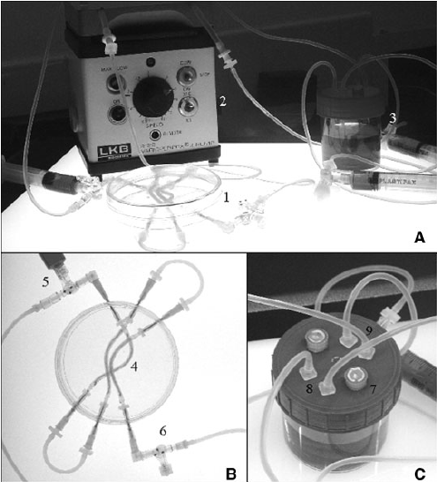
Bioreactor for Evaluating Novel Nerve Conduits
synthetic microfiber scaffolds of
viscose rayon and electrospun polystyrene
That were inserted into the lumen of silicone
tubes (1.2 mm internal diameter)
Development of a Bioreactor for Evaluating Novel Nerve Conduits Tao Sun et al, Biotechnology and Bioengineering, Vol. 99, No. 5, April 1, 2008
Notes:
For more information I storngly recommend you to read new poblished article from our group,

