Slide 1

CHAPTER 4
Biomaterials Ceramic
Dr. Syafiqah Saidin
SMBE3313
2016/2017 Semester 1

Slide 2

OUTLINE
Dr. Syafiqah Saidin
Ceramic
Bioceramic
Alumina
Bioactive Ceramic
Bioactivity test – In-Vitro SBF
Bioactive Glass
Bioactive Glass Ceramic
Calcium Phosphate
CaP Production

Slide 3
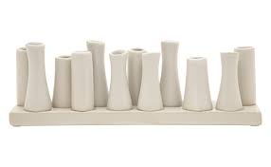
Dr. Syafiqah Saidin
Ceramic
Ceramic
Inorganic solid material composed of metal, non-metal or metalloid atoms primarily held in ionic and covalent bonds.
Compounds formed between metallic and non-metallic elements such as alumina (Al2O3), calcium oxide (CaO), and silicon nitride (Si3N4).
General properties
Typically crystalline in nature
Usually inorganic
Highly inert
Hard and brittle
High compressive strength
Generally good electric and thermal insulators
Good aesthetic appearance
Transparency to light
Notes:
Metalloid is between metal and non-metal such as silica, boron, germanium

Slide 4
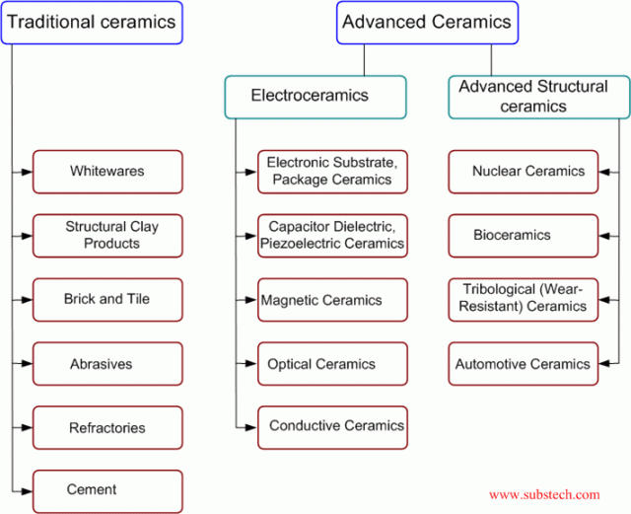
Dr. Syafiqah Saidin
Ceramic
http://www.substech.com/dokuwiki/doku.php?id=general_classification_of_ceramics

Slide 5
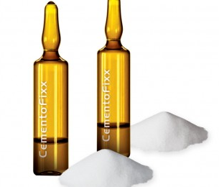
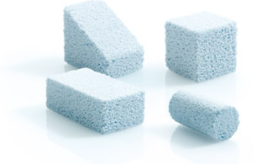
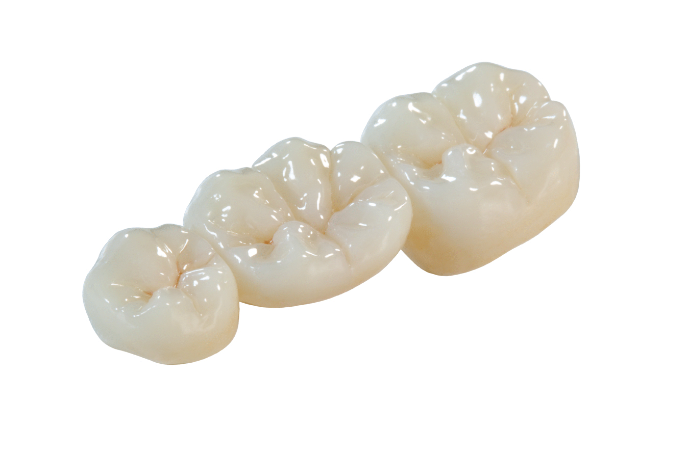
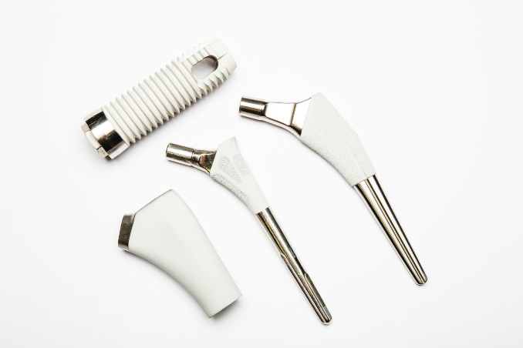
Dr. Syafiqah Saidin
Introduction to Bioceramic
Bone scaffold
Bioceramic
The class of ceramics used for repair and replacement of diseased and damaged parts of the organ.
Bone cement
Implantable ceramic
Implant coating
Prosthesis crown
http://www.ceramisys.com/bone_graft_substitutes.html
http://tlzzirconia.blogspot.my/
http://apsmaterials.com/biomedical/
http://siddharthatrust.com/2013/04/bone-cement-in-orthopaedics-powerpoint-presentation/

Slide 6
Dr. Syafiqah Saidin
Introduction to Bioceramic
Degradable vs stable
Bio-compatible
General Requirement for Ceramic Implant/ Device
Appropriate mechanical properties for specific application
Bioactive

Slide 7
Dr. Syafiqah Saidin
Introduction to Bioceramic
Bioceramic
Bioinert
Bioactive
Biodegradable
Alumina, Al2O3
Zirconia, ZrO2
Carbon
Sintered hydroxyapatite, HA
Silicon nitride, Si3N4
Silicon carbide, SiC
Calcium aluminate, CaAl2O4
HA
Bioglass
Glass ceramic
Calcium sulphate, CaSO4
Coral calcium carbonate, CaCO3
Calcium phosphate, CaP
α-TCP, ß-TCP
OCP
DCP
TTCP

Slide 8
Dr. Syafiqah Saidin
Bioceramic Materials
Alumina
CaP
Zirconia
Bioceramics
Carbon
Other bio-ceramics

Slide 9
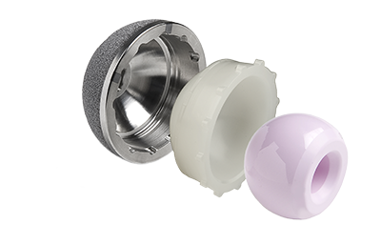
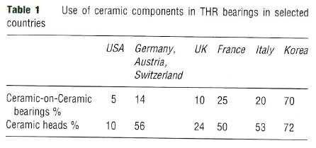
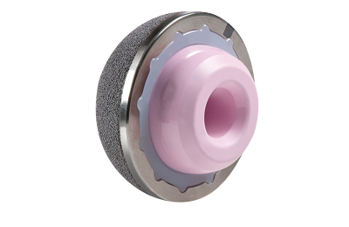
Dr. Syafiqah Saidin
Alumina
  Dense, hard, wear resistance and stable in chemical environment
  Widely used in the application of total hip joint replacement as materials for femoral head
Ceramic utilization in total hip joint replacement
C. Piconi, “Ceramics – Inert ceramics”, Comprehensive Biomaterials: Metallic, Ceramic and Polymeric Biomaterials, P. Ducheyne, Elsevier Ltd, 2011.
http://www.zimmer.com/medical-professionals/products/hip/continuum-acetabular-system.html

Slide 10
Dr. Syafiqah Saidin
Alumina – History as Bioceramic
< 1960
1960
L. W. Smith introduced Cerosium, silica aluminate as bone substitute materials
1970
Development of alumina compound for load-bearing application such as total hip arthroplasty
Eyring & Campbell developed temporary alumina osteotomy spacer
Sandhaus utilized screw shape alumina as dental implant
Alumina has been introduced in German patent as one of biomaterials
Improvement in ceramic density by reducing grain size and homogenous distribution
Improvement in purity of materials
Improvement in production through hot isostatic pressing (HIP) and engraving laser
Introduction of mechanical test for final quality assurance

Slide 11
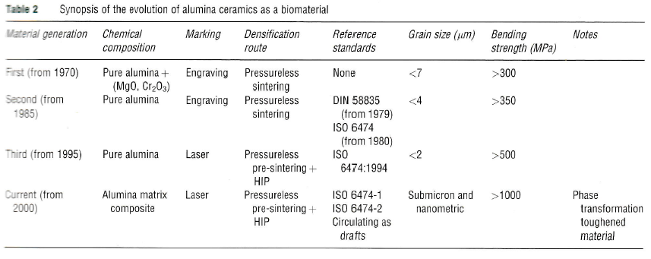
Dr. Syafiqah Saidin
Alumina – History as Bioceramic
C. Piconi, “Ceramics – Inert ceramics”, Comprehensive Biomaterials: Metallic, Ceramic and Polymeric Biomaterials, P. Ducheyne, Elsevier Ltd, 2011.

Slide 12
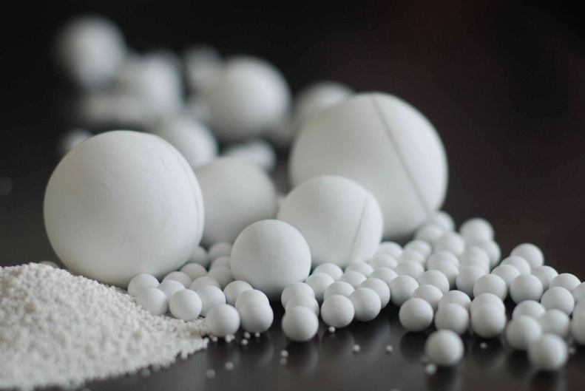
Dr. Syafiqah Saidin
Alumina
Alumina / Aluminium oxide, Al2O3
High melting point
High wettability
Resistant to scratch
High hardness : 2000-2200 Gpa.
Resistance to strong acids such as HCl and H3PO4
Biocompatible, minimal growth of bone and fibrous tissues
Disadvantage:
  Moderate tensile and bending resistance
  Brittle
  Low electric and thermal conductivity
  Complex and costly machining process due to high melting point
Notes:
High chemical and physical stability

Slide 13
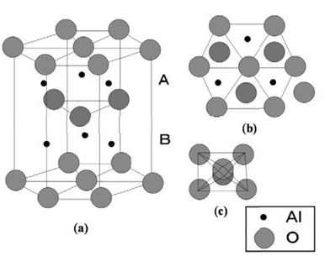
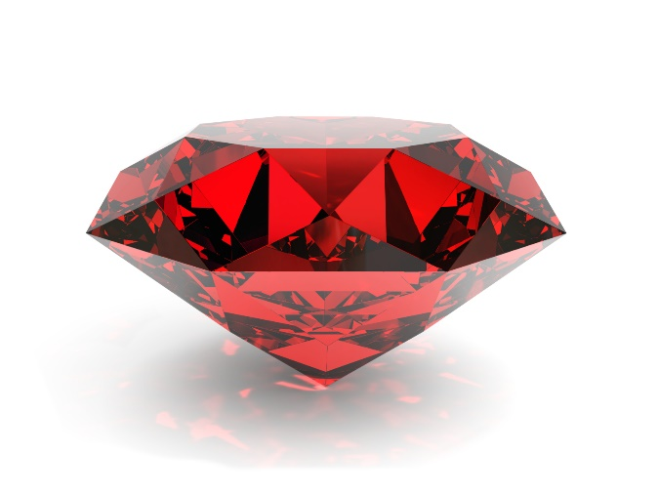
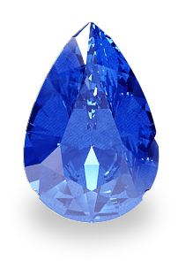
Dr. Syafiqah Saidin
Alumina
  α-alumina / corundum
  Alumina heated to >1200ºC
  Closed packed hexagonal arrangement
  High thermodynamically stable
  Highest oxidative state
  α-alumina forms several germstone:
Sapphire (Blue color from Ti)
Ruby (Red color from Cr)
http://voitlab.com/courses/thermodynamics/index.php?title=Advanced_NanoFabric_Engineering
Notes:
Highest oxidative state: No more oxidation. High chemical and physical stability

Slide 14
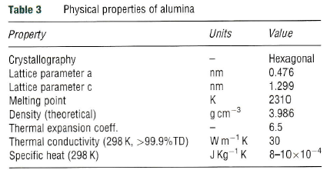
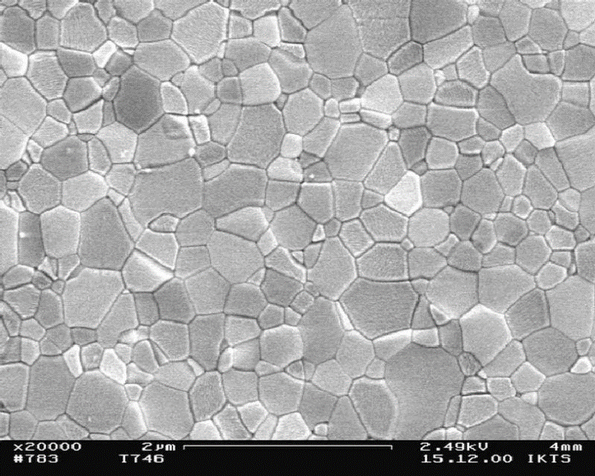
Dr. Syafiqah Saidin
Alumina
Medical grade alumina :
Max 0.5% sintering additive
MgO : To control discontinuous grain growth and to achieve optimum density and grain size
Cr2O3 : To improve hardness as addition of MgO will reduce alumina’s hardness
The ceramics precursor must be free of impurities such as CaO, NaO and SiO2 to fabricate homogenous, high density and pore free structure
Highly pure microstructure of sintered α-Al2O3 grinding balls. Average grain size 0.41 µm
C. Piconi, “Ceramics – Inert ceramics”, Comprehensive Biomaterials: Metallic, Ceramic and Polymeric Biomaterials, P. Ducheyne, Elsevier Ltd, 2011.
http://www.ikts.fraunhofer.de/en/departments/structural_ceramics/oxide_ceramics/materials_synthesis_development/highly_wear_resistant_Al2O3_grinding_balls.html
Notes:
Fail without plastic deformation. Thermal cycle must be controlled to avoid dissolution of MgO

Slide 15
Dr. Syafiqah Saidin
Alumina
Powders pre-processing
Shaping
Dye pressing
Firing / sintering
Oxidizing atmosphere in kiln tunnel
Proceed with HIP
Diamond polishing
Roundness and linearity
Laser engraving
Surface notch
Followed by proof testing
Total hip replacement application:
The main manufacturer worldwide, utilizing alumina is CeramTec Ag, Plochingen, Germany
Fabrication process (Powders consolidation)
Notes:
HIP: high pressure at relatively high temp

Slide 16
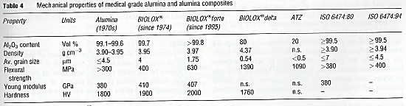
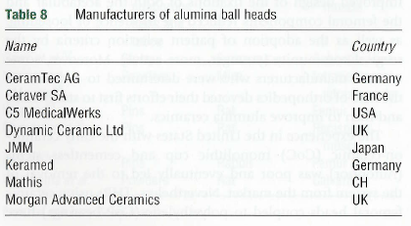
Dr. Syafiqah Saidin
Alumina
C. Piconi, “Ceramics – Inert ceramics”, Comprehensive Biomaterials: Metallic, Ceramic and Polymeric Biomaterials, P. Ducheyne, Elsevier Ltd, 2011.

Slide 17
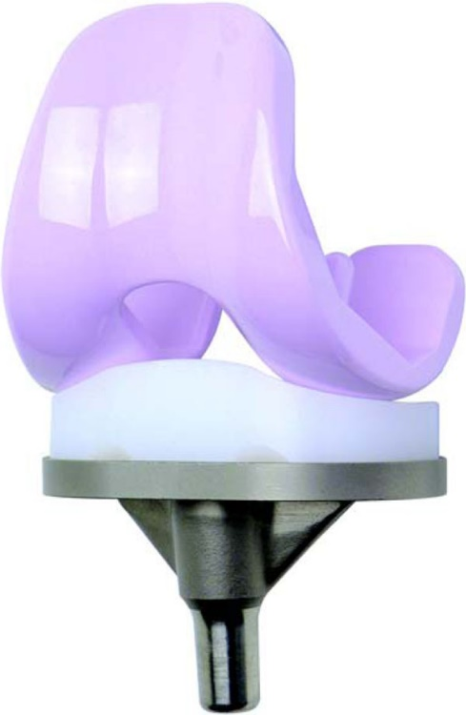
Dr. Syafiqah Saidin
Alumina
Other medical devices application:
Ceramic knee replacement
  High wettability alumina by synovial fluid is suitable for the lubrication of articulating surface
  Lower wear rate
  Better scratching resistance compared to metallic implant
  Prevent allergic reaction
http://benthamopen.com/FULLTEXT/TOORTHJ-6-172

Slide 18
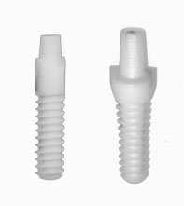
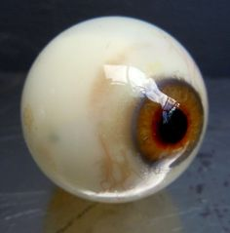
Dr. Syafiqah Saidin
Alumina
Other medical devices application:
Alumina dental implant (Japan)
  Synthetic sapphire
  Aesthetically
  Clear and transparent gingival emergence
Inorbital implant
  High biocompatibility
  High porosity
  Hardness for eye movement
http://www.mdperio.com/
https://www.pinterest.com/acuriouswork/cabinet-of-curiosities/

Slide 19
Dr. Syafiqah Saidin
Bioactive Ceramic
Osteointegration
Ability to integrate with surrounding bone
Osteoinductive
Capable of promoting differentiation of cells
Osteoconductive
Support bone growth and facilitate ingrowth of surrounding bones
Bioactive Ceramic
Calcium phosphate
Bioactive glass
Bioactive glass ceramic

Slide 20
Dr. Syafiqah Saidin
Bioactive Ceramic
Bioactive
Compatible with bone cells and has an ability to integrate with bone while stimulating bone growth
Device restoration / implantation
Protein attachment
Cell adhesion
Intracellular reaction
Bone tissue formation
Enhancement of bone formation on bioactive ceramic due to high pool calcium ions
Dissolution of bioactive materials while deposition of CaP layer mimicking bone mineral phase
Notes:
Mg2+, K+, CO32- and Cl- are also deposited together with Ca-P. No fibrous capsule formation

Slide 21
Dr. Syafiqah Saidin
Bioactive Ceramic
Non-Bioactive Material | Bioactive Material
Inert metal, polymer | Bioactive ceramic
Formation of fibrous capsule between material and bone | Fusion of bone integration between material and bone without the formation of fibrous capsule
Bond strength at the interface between material and bone approximately approach 0.5 Mpa for inert glass and 2 Mpa for smooth Ti | Bond strength at the interface between material and bone approximately between 15 and 25 MPa
C. Piconi, “Ceramics – Inert ceramics”, Comprehensive Biomaterials: Metallic, Ceramic and Polymeric Biomaterials, P. Ducheyne, Elsevier Ltd, 2011.

Slide 22
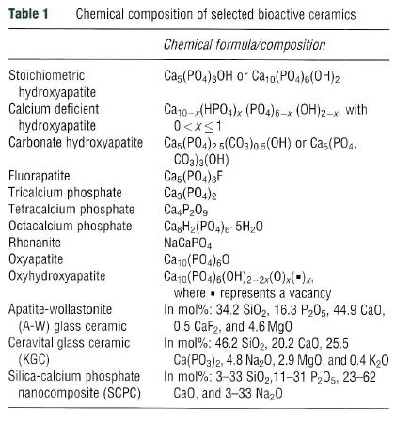
Dr. Syafiqah Saidin
Bioactive Ceramic
C. Piconi, “Ceramics – Inert ceramics”, Comprehensive Biomaterials: Metallic, Ceramic and Polymeric Biomaterials, P. Ducheyne, Elsevier Ltd, 2011.

Slide 23
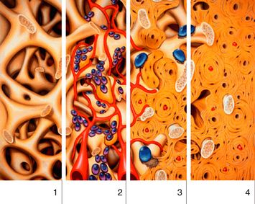
Dr. Syafiqah Saidin
Bioactive Ceramic
Resorbable / degradable bone graft
Dissolution of bone graft materials will create porosity and leave empty spaces
Complete dissolution of bone graft while allowing complete bone formation and remodeling
Proliferation of bone cells that lead to osseointegration
Deposition of bone cells and integration of blood capillaries within the empty spaces
http://pocketdentistry.com/basics-of-bone-grafting-and-graft-materials/

Slide 24
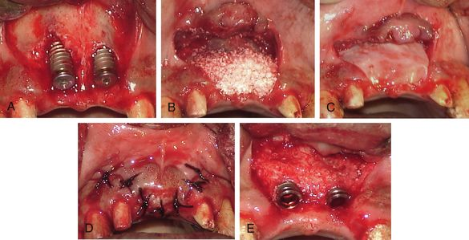
Dr. Syafiqah Saidin
Bioactive Ceramic
Bone graft materials
Guided bone regeneration membrane
Restoration of resorbable / degradable bone graft and guided bone regeneration membrane for prosthodontic application
Dental implant
http://pocketdentistry.com/basics-of-bone-grafting-and-graft-materials/

Slide 25
Dr. Syafiqah Saidin
Bioactivity Test : In-Vitro SBF
Simulated body fluid (SBF) solution : Tris buffer with pH and ionic composition similar to blood plasma
In-vitro SBF bioactivity test :
To investigate the ability of the sample to induce apatite (bone mimic) formation
Immersion of sample in SBF for several weeks at physiological temperature
Visualization of apatite formation by SEM or FESEM
Screening test to predict bone growth on sample
In real situation, bone growth might be disturbed by sample dissolution as well as serum protein and cell adhesion

Slide 26
Dr. Syafiqah Saidin
Bioactivity Test : In-Vitro SBF
Comparison between ionic concentration in SBF and human blood plasma
Ion | SBF (mM) | Human blood plasma (mM)
Na⁺ | 142 | 142
K⁺ | 5 | 5
Mg²⁺ | 1.5 | 1.5
Ca²⁺ | 2.5 | 2.5
Cl⁻ | 148.8 | 103
HOC3⁻ | 4.2 | 27
HPO4²⁻ | 1 | 1
SO4²⁻ | 0.5 | 0.5
C. Piconi, “Ceramics – Inert ceramics”, Comprehensive Biomaterials: Metallic, Ceramic and Polymeric Biomaterials, P. Ducheyne, Elsevier Ltd, 2011.

Slide 27
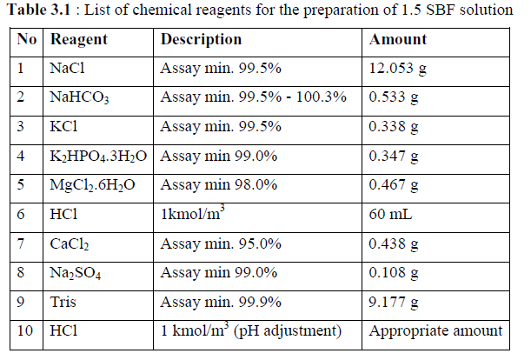
Dr. Syafiqah Saidin
Bioactivity Test : In-Vitro SBF
Experimental procedure of in-vitro SBF bioactivity test
  Preparation of SBF solution at 36 - 37ºC, pH 7.4
Immersion of bioactive sample in SBF solution from 3 days up to 1 months
Immersion parameter: Waterbath incubation at 37ºC in a mild shaking condition
Refreshing the solution every day
Collection of the sample at specific time point
S. Saidin, “Immobilisation of Hydroxyapatite & Silver Nanoparticles,: Bioactive & Antibacterial Coating on Metallic Implant”, Lamber Academic Publishing, Germany, 2013.

Slide 28
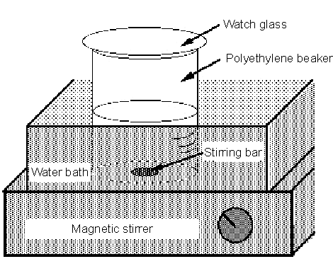
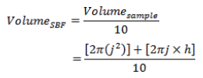
Dr. Syafiqah Saidin
Bioactivity Test : In-Vitro SBF
Experimental procedure of in vitro SBF bioactivity test
S. Saidin, “Immobilisation of Hydroxyapatite & Silver Nanoparticles,: Bioactive & Antibacterial Coating on Metallic Implant”, Lamber Academic Publishing, Germany, 2013.
http://www.life.kyutech.ac.jp/~tmiya/SBF-e.html

Slide 29
Apatite formation on the surface of bioactive glasses occurs through a sequence of chemical reactions when immersed in SBF. First two stages involve the ion exchange reactions between the modifier ions of glass network (like Ca2+ and Na+) and H+ ions from the medium (SBF) which promote the hydrolysis of silica groups and followed by formation of silanol (Si–OH) groups on the glass surface.

Slide 30
At stage 3, condensation and polymerization of SiO2-rich layer take place on the surface, whereas stage 4 implies migration of Ca2+ and PO4 3− ions from the glass network and also from SBF medium to the SiO2-rich layer leading to the formation of amorphous calcium phosphate (ACP) layer. At the final stage, uptake of additional ions from medium such as OH−,CO3 2− and Na+ into the ACP layer promotes the conversion of ACP into HCA via crystallization.

Slide 31


Dr. Syafiqah Saidin
Bioactivity Test : In-Vitro SBF
Immersion of bioceramic in SBF solution
Saturation of calcium ions on the bioactive ceramic surface
Simulated body fluid (SBF) solution
Bioceramic
Bioceramic
Mechanism of apatite layer formation

Slide 32
Dr. Syafiqah Saidin
Bioactivity Test : In-Vitro SBF
Electrostatic interaction of phosphate ions to the bound calcium ions
Formation of apatite layer which is influenced by time
Simulated body fluid (SBF) solution
Apatite layer
Bioceramic
The longer the immersion time in SBF, the thicker the apatite layer
Mechanism of apatite layer formation

Slide 33
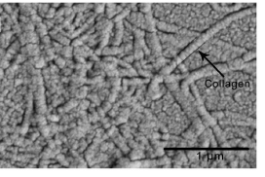
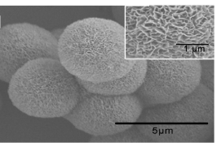
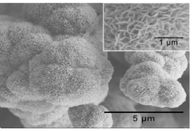
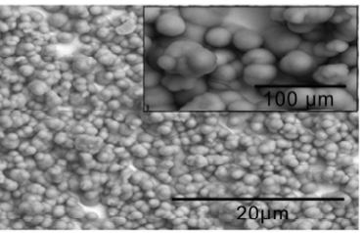
Dr. Syafiqah Saidin
Bioactivity Test : In-Vitro SBF
Formation of apatite layer on bioactive collagen sample
Z. Tapsir and S. Saidin, “Synthesis and Characterization of Collagen-Hydroxyapatite Immobilized on Polydopamine Grafted Stainless Steel”, Surface & Coatings Technology, vol. 285, pp. 11-16, 2016.

Slide 34
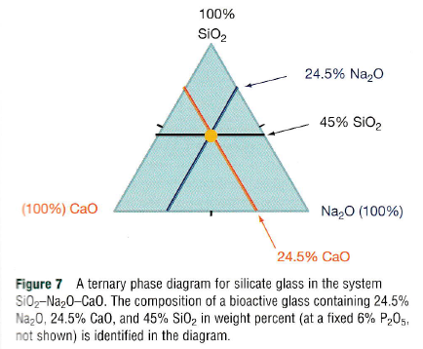
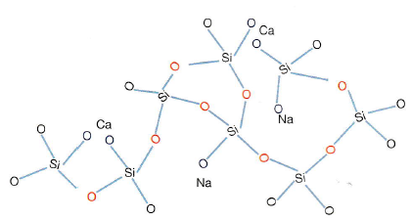
Dr. Syafiqah Saidin
Bioactive Glass
Most common composition
Network chemical stability
Bridging O2
Non-bridging O2
Network modifier that facilitate glass melting
C. Piconi, “Ceramics – Inert ceramics”, Comprehensive Biomaterials: Metallic, Ceramic and Polymeric Biomaterials, P. Ducheyne, Elsevier Ltd, 2011.
Notes:
Reactive. Bridgg/Non bridgg = bioactivity and resorbability. Low ratio, low bioactive

Slide 35
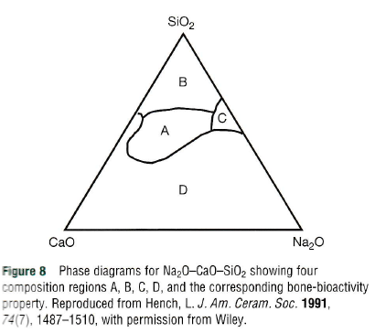
Dr. Syafiqah Saidin
Bioactive Glass
>60% SiO2: Chemically stable but not bioactive
45% SiO2: Very bioactive
Bioactive
Chemically stable and bioinert
Resorbable in 10-30 days
Very bioactive with strong interfacial bond within 30 days
Non-practical glass
C. Piconi, “Ceramics – Inert ceramics”, Comprehensive Biomaterials: Metallic, Ceramic and Polymeric Biomaterials, P. Ducheyne, Elsevier Ltd, 2011.
Notes:
Additive ions: MgO, K2O, B2O3, Al2O3, Zr2O3, CaF2, Ta2O5: May improve properties but limit by bioactivity property

Slide 36
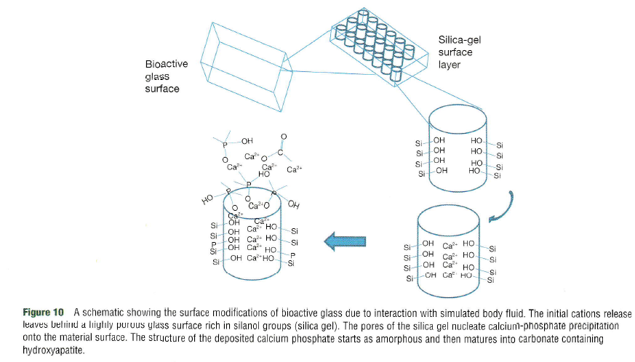
Dr. Syafiqah Saidin
Bioactive Glass
Mechanism of apatite layer formation
Na ions are easily exchange with H⁺ from H2O when in contact with fluid
Render the surface Si-O2 and H⁺ to form silanol Si-OH
More alkaline, increase pH
Trap Ca ions and induce apatite formation
C. Piconi, “Ceramics – Inert ceramics”, Comprehensive Biomaterials: Metallic, Ceramic and Polymeric Biomaterials, P. Ducheyne, Elsevier Ltd, 2011.
Notes:
Silanol=hydrated silica

Slide 37
Dr. Syafiqah Saidin
Bioactive Glass
Melting method
Primary source: Sand, SiO2
Na2O and CaO are from carbonate compounds
Production of CO2 mix the composition homogenously
Sol-gel method
Common precursors: tetraethoxysilane, NaCl and Ca2NO3
Gel formation: Various hydrolysis and polycondensation processes
Acid catalyst: Longer chain and fewer crosslinkage. Vice versa
P2O5 is incorporated as an oxide before the melting process
Gel is formed when particles in the solution form long chain polymer
Melting
1350 – 1400ºC
Annealing
350 – 700ºC
Annealing
450 – 550ºC
ºC
ºC
Drying
110ºC
Room temperature
Room temp
Time (h)
Time (h)

Slide 38
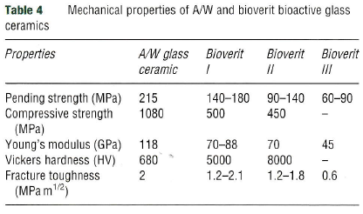
Dr. Syafiqah Saidin
Bioactive Glass Ceramic
Bioactive glass ceramic: Subjection of bioactive glass to heat treatment in converting its amorphous structure into crystalline structure for the purpose of mechanical strength improvement
Mostly used as load bearing implants
C. Piconi, “Ceramics – Inert ceramics”, Comprehensive Biomaterials: Metallic, Ceramic and Polymeric Biomaterials, P. Ducheyne, Elsevier Ltd, 2011.

Slide 39
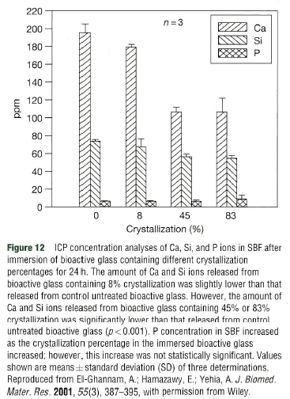
Dr. Syafiqah Saidin`
Bioactive Glass Ceramic
High crystallization Low surface reactivity Low material dissolution
C. Piconi, “Ceramics – Inert ceramics”, Comprehensive Biomaterials: Metallic, Ceramic and Polymeric Biomaterials, P. Ducheyne, Elsevier Ltd, 2011.

Slide 40
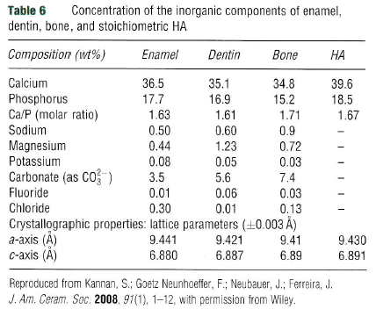
Dr. Syafiqah Saidin
Calcium Phosphate
Crystalline materials with similar composition to bone minerals
C. Piconi, “Ceramics – Inert ceramics”, Comprehensive Biomaterials: Metallic, Ceramic and Polymeric Biomaterials, P. Ducheyne, Elsevier Ltd, 2011.

Slide 41
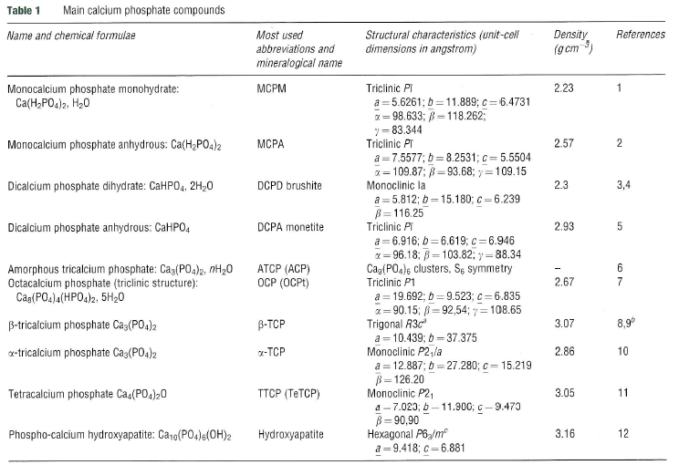
Dr. Syafiqah Saidin
Calcium Phosphate
C. Piconi, “Ceramics – Inert ceramics”, Comprehensive Biomaterials: Metallic, Ceramic and Polymeric Biomaterials, P. Ducheyne, Elsevier Ltd, 2011.

Slide 42
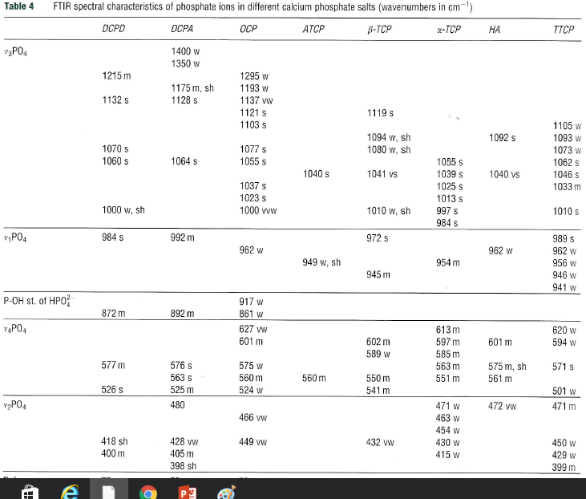
Calcium Phosphate
Dr. Syafiqah Saidin

Slide 43
Dr. Syafiqah Saidin
Calcium Phosphate
Hydroxyapatite (HA) – Ca10(PO4)6(OH)2
Stoichiometry Ca/P ratio: 1.67
Natural bone composed of only 20% OH⁻ ions and 3 - 8% CO3²⁻ ions present in HA
Fluoroapatite is more stable than HA but less bioactive; carbonated HA is more soluble and more bioactive
Crystal lattice of HA can be modified for ions substitution:
  Metal cation (Ag²⁺, Mg²⁺, Na²⁺, etc) will substitute Ca²⁺
  Anion (CO3²⁻, SO4²⁻, SiO4⁴⁻, etc) will substitute PO4³⁻
Solubility and bioactivity of HA depends on:
  Crystal lattice
  Substitution/dopant
  Ca/P ratio
  Crystallinity
Notes:
Monoclinic alpha, hexagonal alpha, rhombohedral beta

Slide 44
Dr. Syafiqah Saidin
Calcium Phosphate
Tricalcium phosphate (TCP) – Ca3(PO4)2
There are three polymorphic structures: α-TCP, ß-TCP, α’-TCP
Higher resorption compared to other CaP
Commonly used as bone graft materials
Ca/P ratio: 1.5
Rate of calcium dissolution
TTCP > α-TCP > ß-TCP
Rate of phosphate dissolution
α-TCP > ß-TCP > TTCP

Slide 45
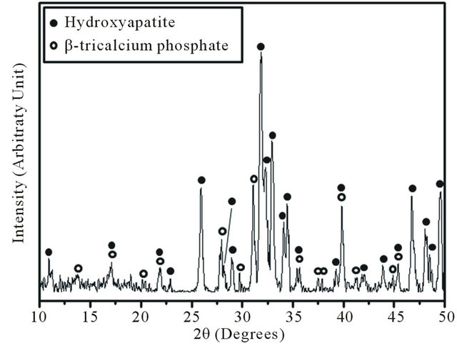
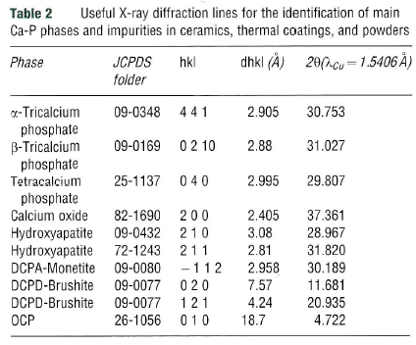
Dr. Syafiqah Saidin
Calcium Phosphate
Example of XRD spectra:
Hydroxyapatite (HA) – Ca10(PO4)6(OH)2
Tricalcium phosphate (TCP) – Ca3(PO4)2
Specific compound determination can be done by referring to JCPDS data
D. S. H. Lee, Y. Pai, S. Changin, “Effect of thermal treatment of the hydroxyapatite powders on the micropore and microstructure of porous biphasic calcium phosphate composite granules”, Journal of Biomaterials and Nanobiotechnology, vol. 4, pp. 1-5, 2013.
C. Piconi, “Ceramics – Inert ceramics”, Comprehensive Biomaterials: Metallic, Ceramic and Polymeric Biomaterials, P. Ducheyne, Elsevier Ltd, 2011.

Slide 46
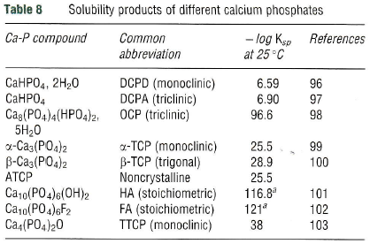
Dr. Syafiqah Saidin
Calcium Phosphate
Low ilog Ksp value : High solubility and degradation
C. Piconi, “Ceramics – Inert ceramics”, Comprehensive Biomaterials: Metallic, Ceramic and Polymeric Biomaterials, P. Ducheyne, Elsevier Ltd, 2011.

Slide 47
Dr. Syafiqah Saidin
Calcium Phosphate
CaP production
Solid-state reactions
Wet-chemical method
Emulsion processing
Hydro -thermal treatment
Sol-gel
Microwave synthesis
All methods involve the combination of calcium precursor and phosphorus precursor
CaP powders will be dried to remove excess water or to evaporate solvent
Finally, the powders will be sintered to improve its crystallinity

Slide 48
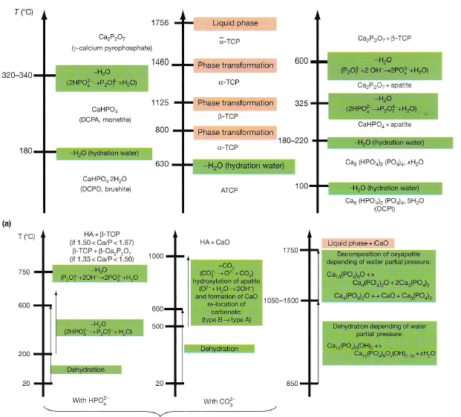
Calcium Phosphate
Dr. Syafiqah Saidin
Thermal
decomposition
of CaP
C. Piconi, “Ceramics – Inert ceramics”, Comprehensive Biomaterials: Metallic, Ceramic and Polymeric Biomaterials, P. Ducheyne, Elsevier Ltd, 2011.

