Slide 1
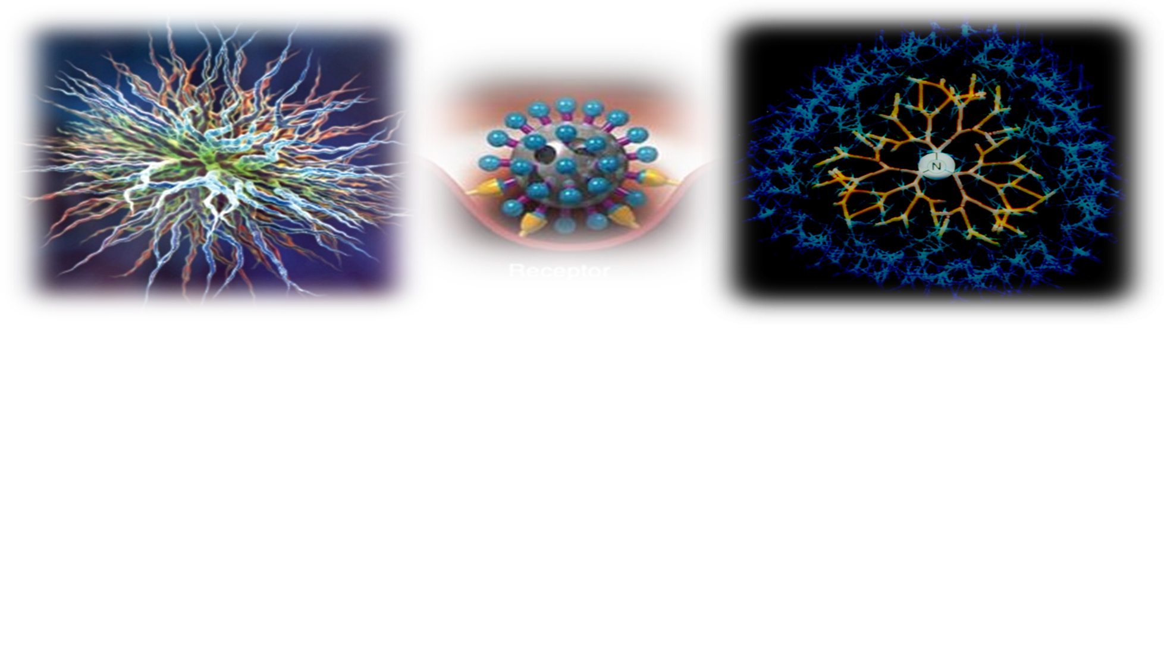
DENDRIMERS
By: Badie Zomlut
Omara Under supervision: Ph.D Hend Abu

Slide 2
INTRODUCTION
Nano Technology is one of the most widely used concept in the field of drug delivery and therapeutics in modern day pharmaceutics.
Dendrimers are a class of Nano materials which has been found particularly useful in the drug delivery.
Even though dendrimer technology is in its infancy it offers many attractive features which makes them desirable to be used as novel carriers.
Dendrimers, also referred as modern day polymers, they offer much more good properties than the conventional polymers.

Slide 3
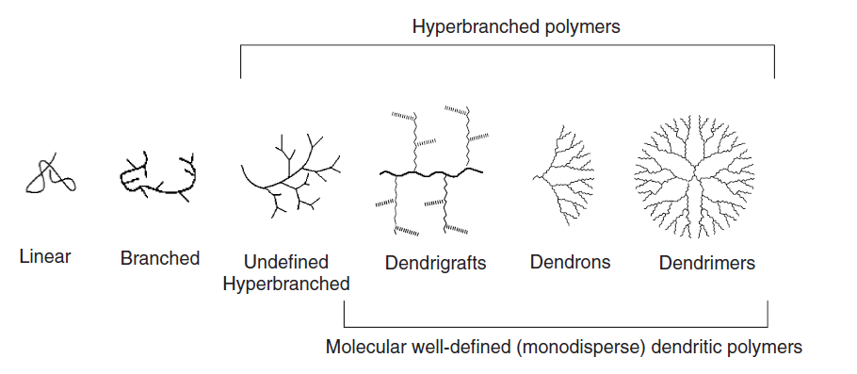

Slide 4
A suitable drug delivery system would protect the drug against degradation and ensure that drug reaches proper permeability properties and further provides a combined transportation and protection system against the natural barriers, as done by the dendrimers.
The term “Dendrimer” arise from two Greek word :
- “Dendron” meaning tree
- “Meros” meaning part
The dendrimers are also called as
- Cascade Molecules or
- Arborols.

Slide 5
Dendrimers are hyper-branched, globular, monodisperse, three dimensional nanoscale synthetic polymers, having very well defined size, shape and definite molecular weight.
Dendrimers are highly defined nanoparticles:
– Size: 1 -15 nanometers
– Very versatile surface functionalization
– Synthetic: Practical and cost effective
– Well tolerated pharmaceutica.
Dendrimer is a nanoparticle (10⁻⁹) and so has advantages over microparticles or others due to its small size, easy uptake by cells (through endocytosis).

Slide 6
Dendrimers exhibit characteristics features of both molecular chemistry and polymer chemistry.
Molecular chemistry like properties are due to their step by step controlled synthesis while it shows polymer chemistry like properties as it is made up of monomers

Slide 7
HISTORY
In 1978,
Fritz Vogtle
Synthesized
the first “cascade
molecules”.
In 1985, Donald
A. Tomalia,
synthesized the first family of dendrimers.
Newkome’s
group
Independently
Reported
synthesis of
Similar
Macromolecules &
name them
as a “arborols”.

Slide 8
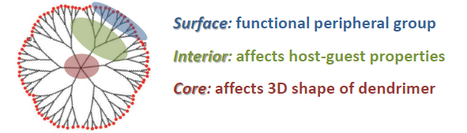
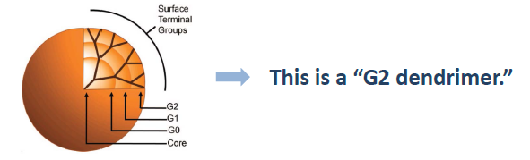
STRUCTURE OF DENDRIMERS
Dendrimers consist of three main components…
Count branching points as the “generation”

Slide 9
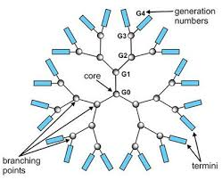
Higher generation dendrimers form more dense, dimensional shape.

Slide 10
dimensional projection of dendrimer core shell architecture for G-4.5 PAMAM Dendrimers

Slide 11
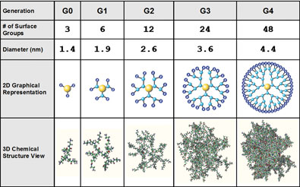

Slide 12
UNIQUENESS OF DENDRIMERS
Architecture
- Dendrimers shows improved physical and chemical properties due to their molecular architecture.
- The dendrimers shape depend on the generation .
- lower generation shows open planar elliptical shape while higher generation shows compact-spherical shape.

Slide 13
Solubility
Surface groups of the dendrimers plays an important role in the solubility of dendrimers.
If the surface end groups are hydrophobic in nature, then dendrimers are soluble in nonpolar solvent
If the surface end groups are hydrophilic in nature and dendrimers are soluble in polar solvent.
The high solubility, miscibility and reactivity and binding capacity of dendrimers is due to the presence of many chain end groups.

Slide 14
Monodispersity
Dendrimers are monodisperse in nature i.e. they have isomolecular species, whose molecular size, shape and disposition of organic moieties are adjusted and controlled
Viscosity
In solution dendrimers form a tightly packed ball which influences its rheological properties.
The intrinsic viscosity dendrimers solution does not exhibit linear relationship with mass but it is highest for a specific generation and then it begins to decrease.

Slide 15
Electrostatic interactions
Molecular recognition events at dendrimer surfaces are distinguished by the large number of often identical end-groups presented by the dendritic host.
When these groups are charged, the surface may have as a polyelectrolyte and is likely to electrostatically attract oppositely charged molecules.
Self-assembling dendrimers
Self-assembly is the spontaneous, precise association of chemical species by specific, complementary intermolecular forces

Slide 16
Covalent conjugation strategies
The conjugated dendritic assembly functions as pro-drug where, upon internalization into the target cell, the conjugate must be liberated to activate the drug.
Polyvalency
Polyvalency is useful as it provides for versatile functionalization
It is also extremely important to produce multiple interactions with biological receptor sites, for example, in the design of antiviral therapeutic agents.

Slide 17
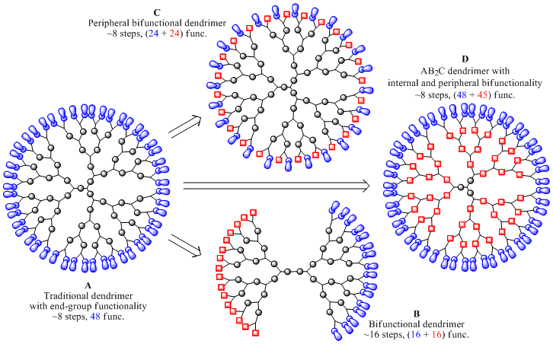

Slide 18
Ideal Properties of Dendrimers
Inert and non-toxic;
Biodegradable;
Non-immunogenic;
Able to cross barriers such as intestine, blood-tissue
barriers, cell membranes etc;
Able to stay in circulation for the time needed to
have a clinical effect;
Able to target to specific structures;
Compatible with guest molecules;
Must protect the drug until it reaches to the desired
site of action and release the drug.

Slide 19
PHYSICOCHEMICAL PROPERTIES OF DENDRIMERS
Nanoscale sized that have similar dimensions to important bio-building blocks, such as proteins, DNA etc.
It improves the pharmacokinetic and pharmacodynamics properties of a drug so that there is also an increase in bioavailability.
Multiple numbers of terminal surface groups suitable for bio-conjugation of drugs, signaling groups, targeting moieties or biocompatibility groups.

Slide 20
Surfaces may be designed with functional groups to augment or resist transcellular, epithelial or vascular bio-permeability.
Interior void space may be used to encapsulate small molecule drugs, metals, or imaging moieties. Encapsulating in that void space reduces the drug toxicity and facilitates controlled release
Positive biocompatibility patterns that are associated with lower generation anionic or neutral polar terminal surface groups as compared to higher generation neutral a polar and cationic surface groups.

Slide 21
None or low immunogenicity associated with most dendrimer surfaces modified with small functional groups or polyethylene glycol (PEG).
Surface groups that can be modified to optimize bio-distribution; receptor mediated targeting, therapy dosage or controlled release of drug from the interior space.
Have ability to be excreted from body as a function of nanoscale diameter.
Size and molecular mass of dendrimers can be specifically controlled during synthesis which cannot be done for linear polymers.

Slide 22
These carriers have significantly lower viscosity than linear polymers. When the molecular mass of dendrimers increases, their intrinsic viscosity goes through a maximum at the fourth generation and then begins to decline. Such behavior is unlike that of linear polymers.
These have high solubility, miscibility and reactivity due to the presence of many chain ends.
These carriers possess solubility in a large number of solvents. Dendrimers terminated in hydrophilic groups are soluble in polar solvents, while dendrimers having hydrophobic end groups are soluble in nonpolar solvents.

Slide 23
These carriers have the possibility to encapsulate guest molecules in the macromolecule interior.
Controlled and targeted release of drug can be achieved at sites restricted for drugs.
Distinct from traditional linear polymers, dendrimers synthesized step-by-step have well organized structures with a very low polydispersity.
It has the useful property of polyvalency as it provides for versatile funtionalization; it is also extremely important to produce multiple interactions with biological receptor sites, for example such as antiviral therapeutic agents.

Slide 24
ADVANTAGES OF DENDRIMERS
Enhanced permeability and retention effect:
Size of dendrimers i.e. (Generation 4) is in Nano range.
Cancer cells have leaky membranes and having higher bio-permeability for anticancer drugs. Lymphatic system is one way and drug loaded dendrimers may get retained inside.

Slide 25
High uniformity and purity:
The synthetic process used produces dendrimers with uniform sizes range, well defined surface functionality, and negligible impurity. Monodispersed dendrimers would facilitate us to attain targeted drug delivery
Low immunogenicity:
Dendrimers shows low or negligible immunogenic response when injected or used topically

Slide 26
Sustained /extended effect:
Dendrimers releases drug in a sustained manner. PAMAM dendrimers exhibited slower release, higher accumulation in solid tumors, and lower toxicity.
Conjugation with Polyethylene glycol on the surface of these Nano carriers avoids non-specific interaction with plasma proteins or engulfment. Increase in blood circulation time is essential to achieve desired clinical effect

Slide 27
Higher solublization Potential:
Ionic interaction, hydrogen bonding and hydrophobic interactions are probable mechanism by which dendrimers show its solubility enhancing property. Most anticancer drugs have poor solubility and can be loaded into dendrimers to improve solubility.
Multifunctional platform:
Free surface groups can form complex or conjugates with drug excellent molecules or ligands by using cross linking agents. The surface of dendrimers may be conjugated with ligands, solubility modifiers, and stealth molecules

Slide 28
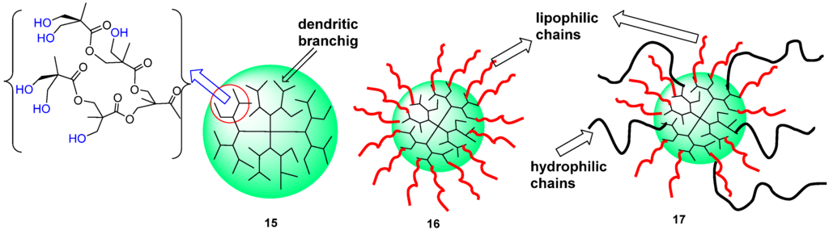

Slide 29
High loading capacity:
Dendrimers structures can be used to load and store a wide range of organic or inorganic molecules by encapsulation and absorption on surface. Drug can get entrapped inside the internal cavities as well as electro statically in the surface of dendrimers
High stability:
Dendrimers drug complex or conjugate demonstrate good stability
Low toxicity:
Most dendrimers systems display very low cytotoxicity levels

Slide 30
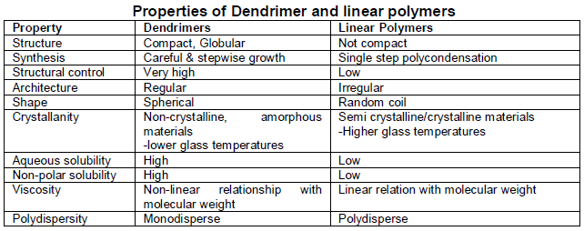

Slide 31
TYPES OF DENDRIMERS
PAMAM Dendrimers
PPI Dendrimers
Chiral Dendrimers
Multilingual Dendrimers
Tecto Dendrimers
Hybrid Dendrimers
Amphiphilic Dendrimers
Frechet type Dendrimers
Peptide Dendrimers
PAMAMOS Dendrimers

Slide 32
PAMAM Dendrimer
Poly (amido amine) dendrimers (PAMAM) are synthesized by the divergent method starting from ammonia or ethylenediamine initiator core reagents.
PAMAM dendrimers are commercially available, usually as methanol solutions.
Starburst dendrimers is applied as a trademark name for a sub-class of PAMAM dendrimers based on a tri-aminoethylene-imine core.
The name refers to the star like pattern observed when looking at the structure of the high-generation dendrimers of this type in two-dimensions.

Slide 33
Pamamos Dendrimer
Radially layered poly(amidoamine-organosilicon) dendrimers (PAMAMOS) are inverted unimolecular micelles that consist of hydrophilic, nucleophilic polyamidoamine (PAMAM) interiors and hydrophobic organosilicon (OS) exteriors.
These dendrimers are exceptionally useful precursors for the preparation of honeycomb-like networks with nano-scopic PAMAM and OS domains.

Slide 34
PPI Dendrimer
PPI-dendrimers stand for “Poly (Propylene Imine)”
These dendrimers are generally poly-alkyl amines having primary amines as end groups, the dendrimer interior consists of numerous of tertiary tri-propylene amines.
PPI dendrimers are commercially available up to G5, and has found widespread applications in material science as well as in biology.
As an alternative name to PPI, POPAM is sometimes used to describe this class of dendrimers. POPAM stands for Poly (Propylene Amine)

Slide 35
- In addition, these dendrimers are also sometimes denoted “DAB-dendrimers” where DAB refers to the core structure, which is usually based on Diamino butane.
Multilingual Dendrimers
- In these dendrimers, the surface contains multiple copies of a particular functional group
Hybrid Dendrimers Linear Polymers
These are hybrids (block or graft polymers) of dendritic and linear polymers.
It has predominantly found its use in biological applications, e.g. vaccine and diagnostic research.

Slide 36
Fréchet-Type Dendrimers
It is a more recent type of dendrimer developed by Hawker and Fréchet, based on poly-benzyl ether hyper branched skeleton.
These dendrimers usually have carboxylic acid groups as surface groups, serving as a good anchoring point for further surface functionalisation, and as polar surface groups to increase the solubility of this hydrophobic dendrimer type in polar solvents or aqueous media

Slide 37
Tecto dendrimer
These are composed of a core dendrimer, surrounded by dendrimers of several steps (each type design) to perform a function necessary for a therapeutic nano-device. Different compounds perform varied functions ranging from diseased cell recognition, diagnosis of disease state drug delivery.
Chiral Dendrimers
- The chirality of the dendrimers are based upon the construction of constitutionally different but chemically similar branches to chiral core

Slide 38
Amphiphilic Dendrimers
They are built with two segregated sites of chain end, one half is electron donating and the other half is electron withdrawing
Micellar Dendrimers
These are unimolecular micelles of water soluble hyper branched polyphenylenes
Multiple Antigen Peptide Dendrimers
It is a dendron-like molecular construct based upon a polylysine skeleton.
Lysine with its alkyl amino side-chain serves as a good monomer for the introduction of numerous of branching points.

Slide 39
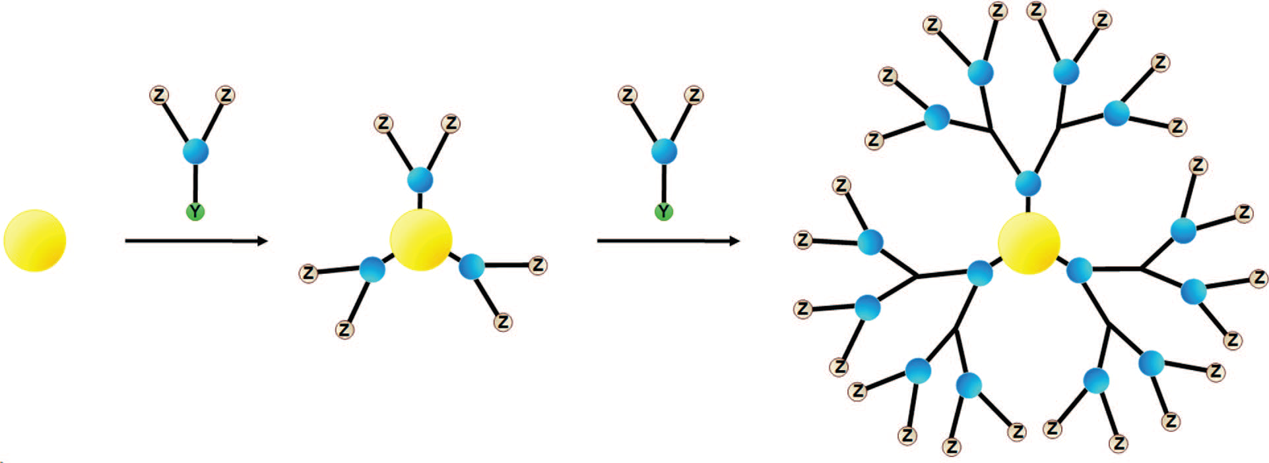
SYNTHESIS OF DENDRIMERS
Divergent method
In the divergent approach, used in early periods, the synthesis starts from the core of the dendrimer to which the arms are attached by adding building blocks in an exhaustive and step-wise manner.
Schematic drawing showing the divergent method for synthesis of dendrimers.

Slide 40
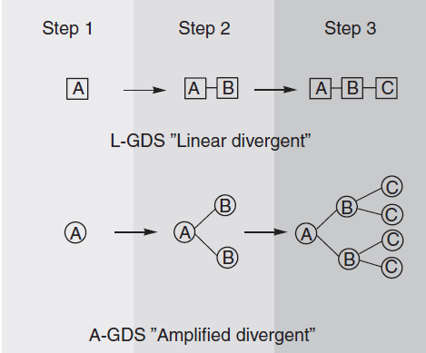

Slide 41
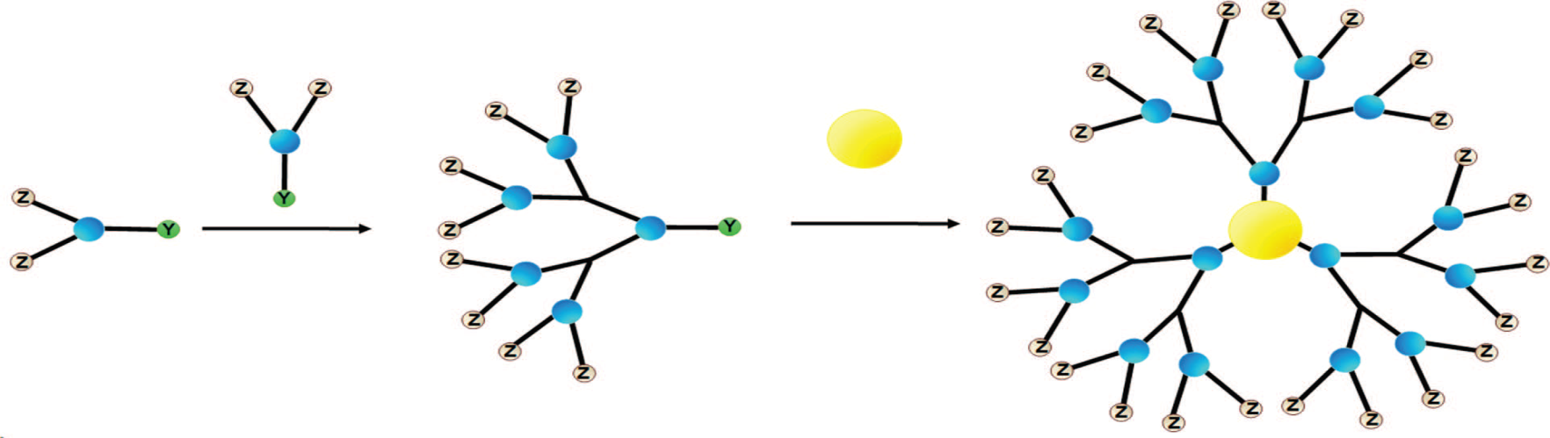
Convergent method
In the convergent approach, synthesis starts from the exterior, beginning with the molecular structure that ultimately becomes the outermost arm of the final dendrimer.
Schematic drawing showing the convergent method for synthesis of dendrimers

Slide 42
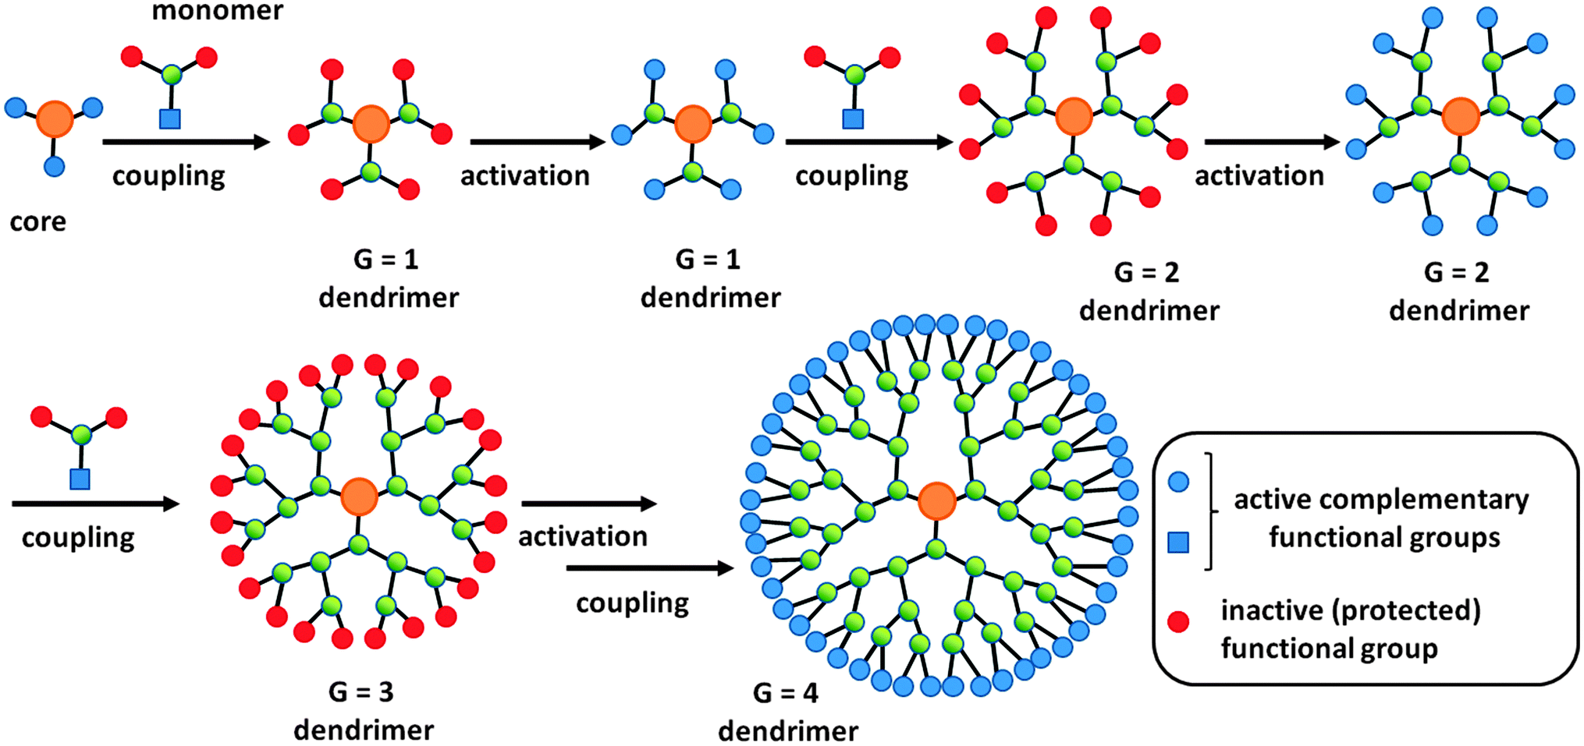

Slide 43
Double Exponential and Mixed Method
It is most advance and recent method of dendrimers synthesis. In this method a single starting material is taken from which two monomers are prepared by divergent and convergent method. Then these two monomers are reacted together to give an orthogonal protected trimer. This protected trimer may be use to repeat the growth process again.

Slide 44
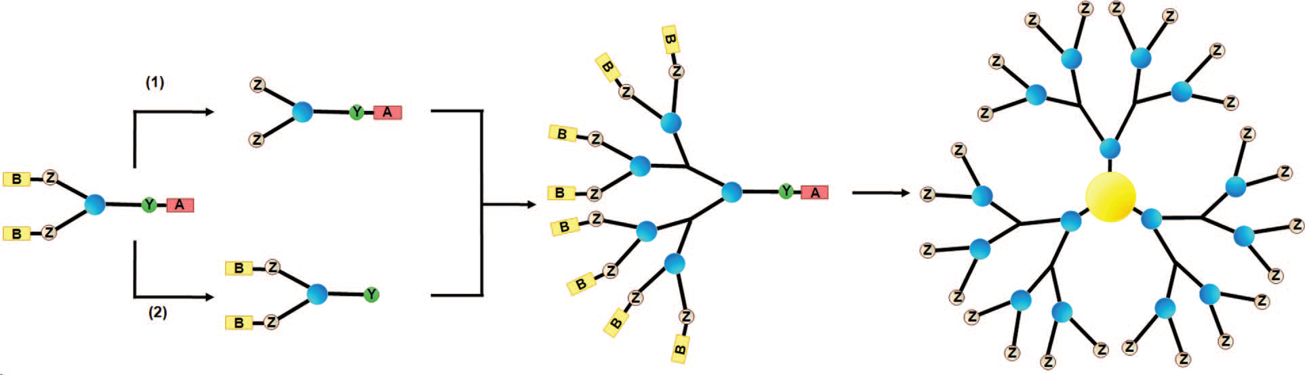
Schematic drawing showing the convergent-divergent
method for dendrimer synthesis.

Slide 45
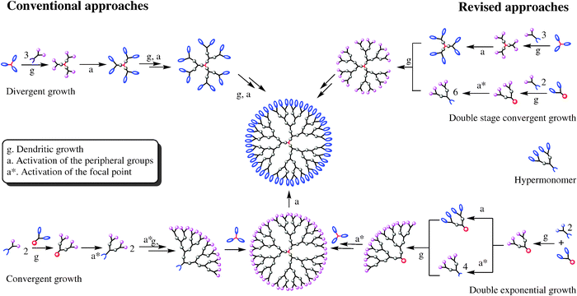

Slide 46
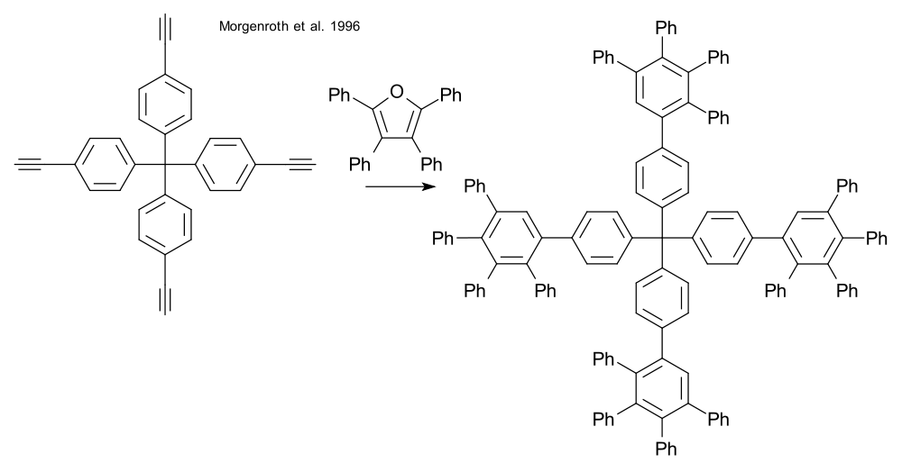
Dendrimers have been prepared via click chemistry, employing Diels-Alder reactions,thiol-yne reactions and azide-alkyne reactions.An example is the synthesis of certain polyphenylene dendrimers

Slide 47
CHARACTERIZATION OF DENDREMIRS
Spectroscopy and spectrometry methods
Nuclear Magnetic Resonance (NMR), Infra-red (IR) and Raman, Ultra-violet-visible (UV-VIS), Fluorescence, Chirality, Optical rotation, Circular dichroism (CD), X-ray diffraction, and Mass spectrometry
Scattering techniques
- Small angle X-ray scattering (SAXS), Small angle neutron scattering (SANS), and Laser light scattering (LLS)

Slide 48
Electrical techniques
Electron paramagnetic resonance (EPR), Electrochemistry, and Electrophoresis
Size exclusion chromatography (SEC)
Microscopy
Transmission electron microscopy, Scanning electron microscopy and atomic force microscopy
Rheology, physical properties
intrinsic viscosity, Differential Scanning Calorimetry (DSC), and Dielectric spectroscopy (DS)
Miscellaneous
- X-ray Photoelectron Spectroscopy (XPS), measurements of dipole moments, titrimetry, etc

Slide 49
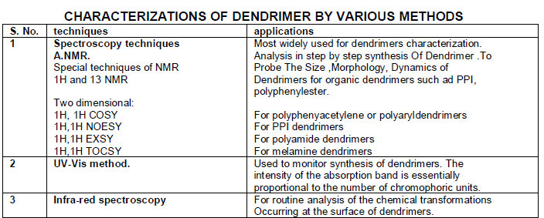

Slide 50
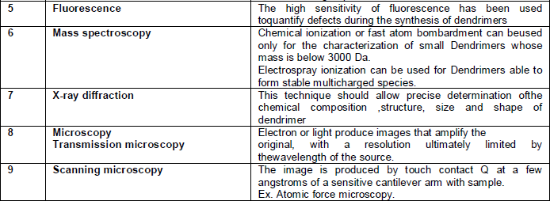

Slide 51
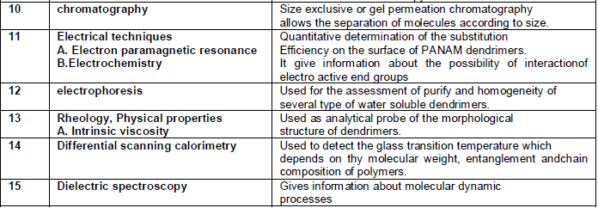

Slide 52
MECHANISMS OF DRUG LOADING
Physical Encapsulation of Drug Molecules
Entrapment of guest molecules into branched polymers represents an earlier form of physical encapsulation of poorly soluble drug molecules in dendrimer’s voids to improve their aqueous solubility and control their release profile .

Slide 53
Physical Encapsulation

Slide 54
Electrostatic interaction
- The high density of functional groups like amine or carboxyl on surface of dendrimer have potential application in enhancing the solubility of hydrophobic drugs by electrostatic attractions.
OR.. Covalent conjugation
- The presence of large functional groups on the surface of dendrimers make them suitable for covalent conjugation of numerous drugs with relevant functional groups.

Slide 55
Electrostatic interaction OR.. Covalent conjugation

Slide 56
A Dendrimer molecule with
Drug molecules loaded at terminal
surface of branches.
(electrostatic interactions or covalent conjugate) .
A Dendrimer molecule with terminal drug molecules encapsulated within branches.
(simple encapsulation) .

Slide 57
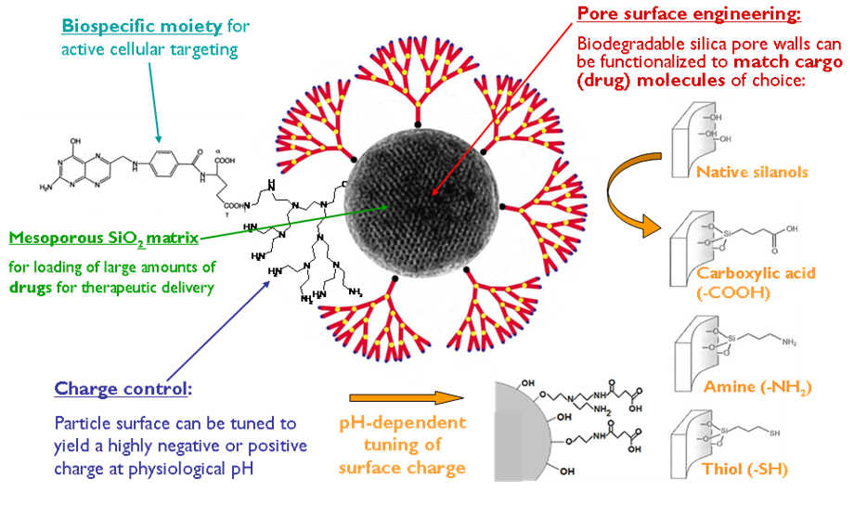

Slide 58
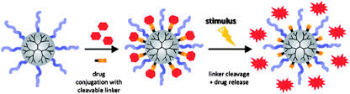
MECHANISM OF DRUG DELIVERY THROUGH DENDRIMERS
In-vivo degradation of drug dendrimer

Slide 59
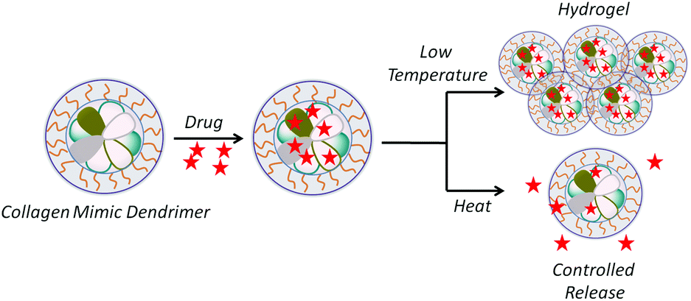
Drug release due to change in physical environment.
Due to change in temperature

Slide 60
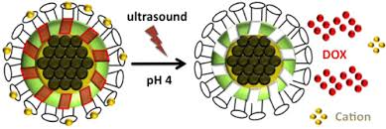
Due to change in pH

Slide 61
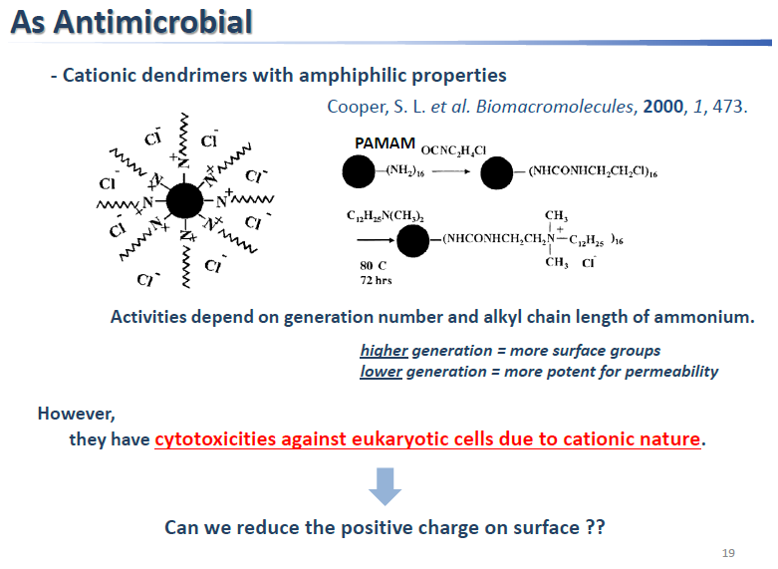
APPLICATIONS OF DENDRIMERS

Slide 62
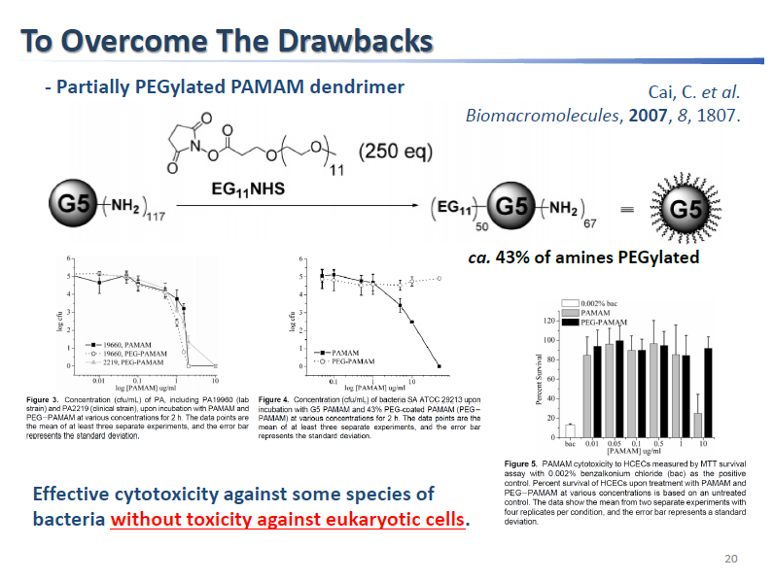

Slide 63
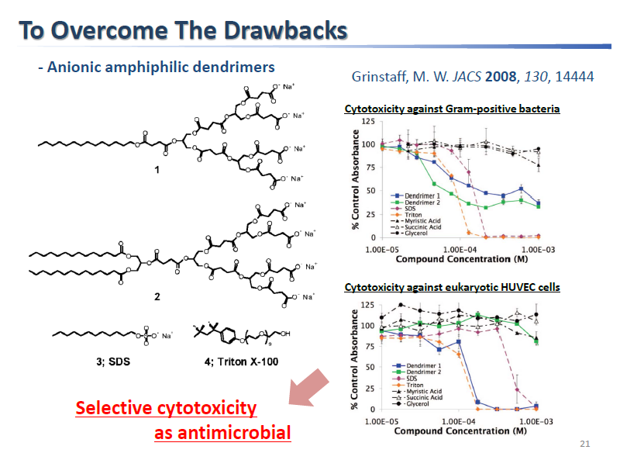

Slide 64
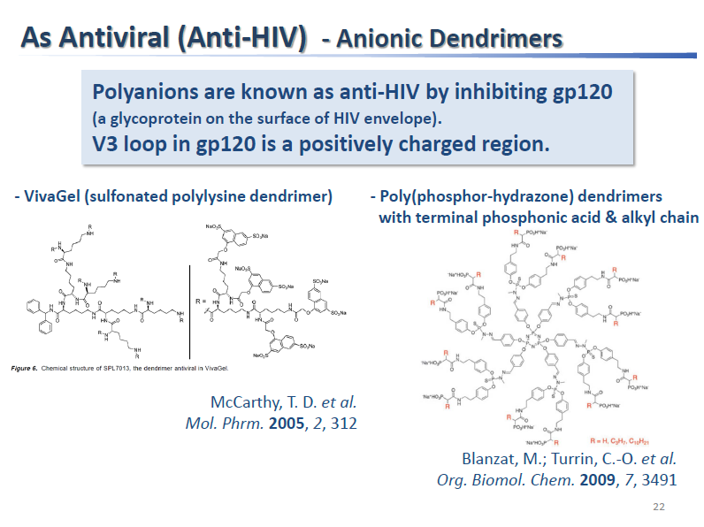

Slide 65
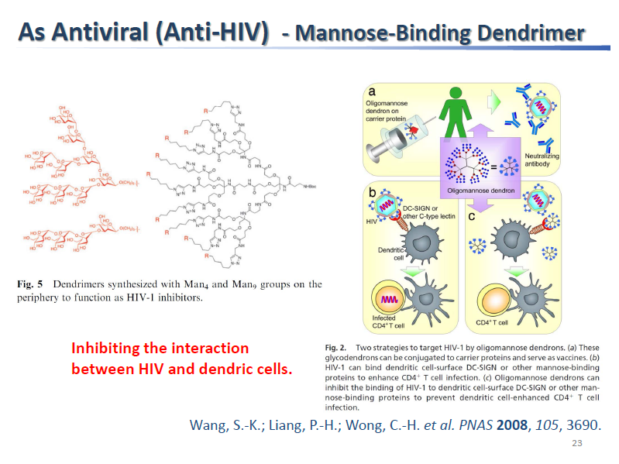

Slide 66
Dendrimers in biomedical field
Dendritic polymers have advantage in biomedical applications.
These dendritic polymers are analogous to protein ,enzymes, and viruses, and are easily functionalized.
Modern medicine uses a variety of this material as potential blood substitutes, e.g., polyamidoamine dendrimers
The dendrimer should be non toxic, non immunogenic, bio permeable, able to target specific structure.

Slide 67
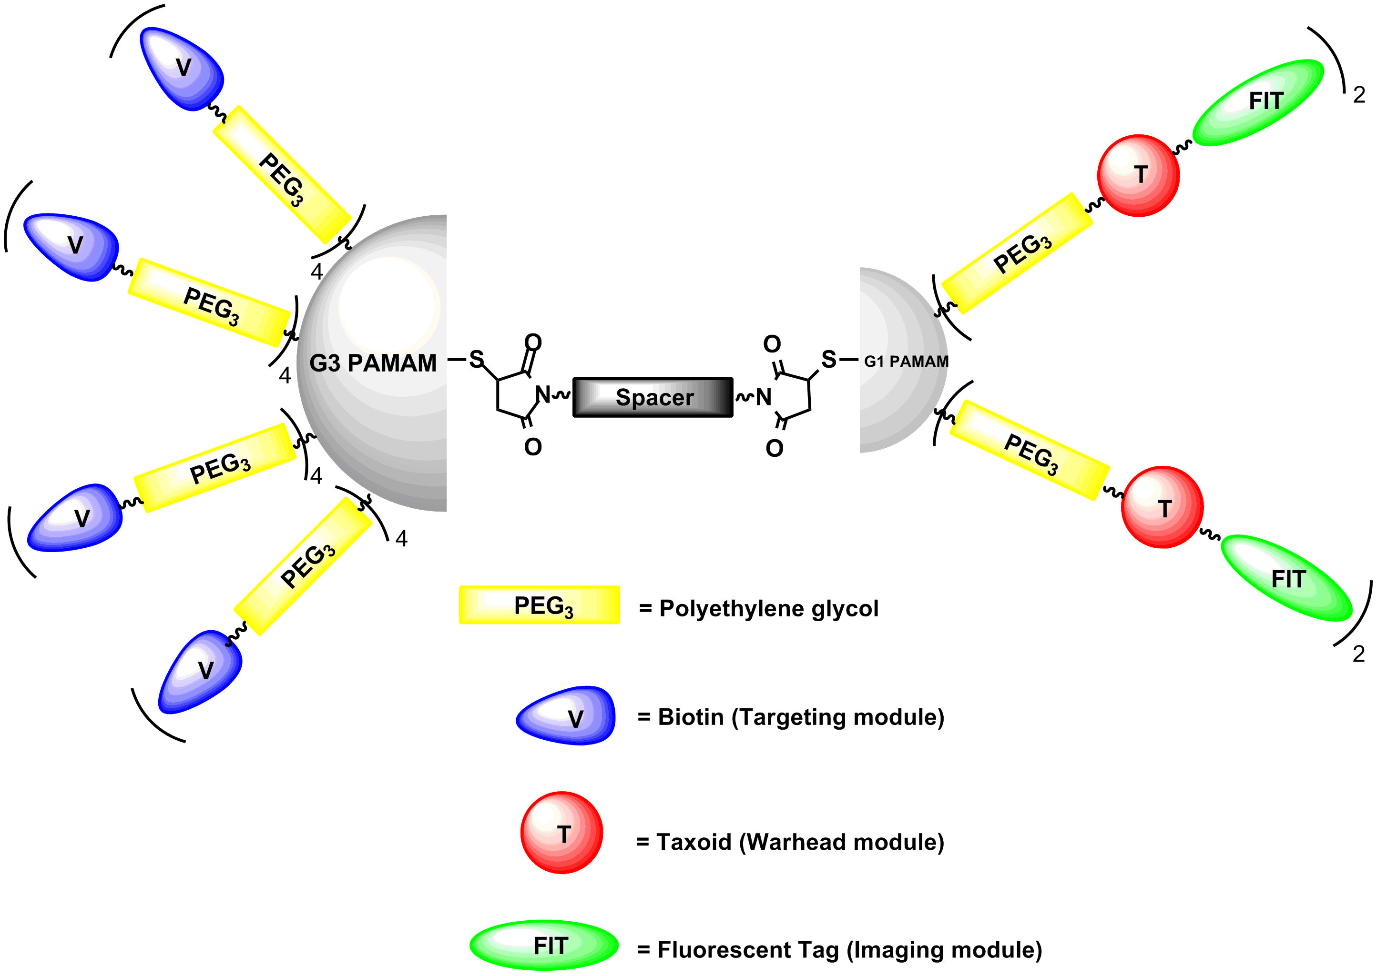

Slide 68
PAMAM dendrimers can also be used to target tumor cells.
Targeting groups can be conjugated to the host dendrimers surface to allow the imaging agent to bond selectively to specific site such as receptors on tumor cell to improve detection.
Cisplatin was complexed to the surface groups of a carboxylate-terminated PAMAM dendrimer which led to a tenfold increase in the solubility of cisplatin compared to the free drug

Slide 69
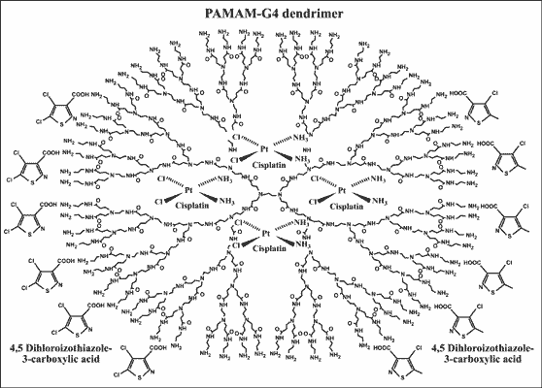

Slide 70
Dendrimer as magnetic resonance imaging contrast agents
Dendrimer based metal chelates act as a magnetic resonance imaging contrast agent.
Many tests carried on dendrimers have shown that dendrimers are stronger contrast agent than conventional ones.
They can improve visualisation of vascular structure in magnetic resonance angiography (MRA) of the body.

Slide 71
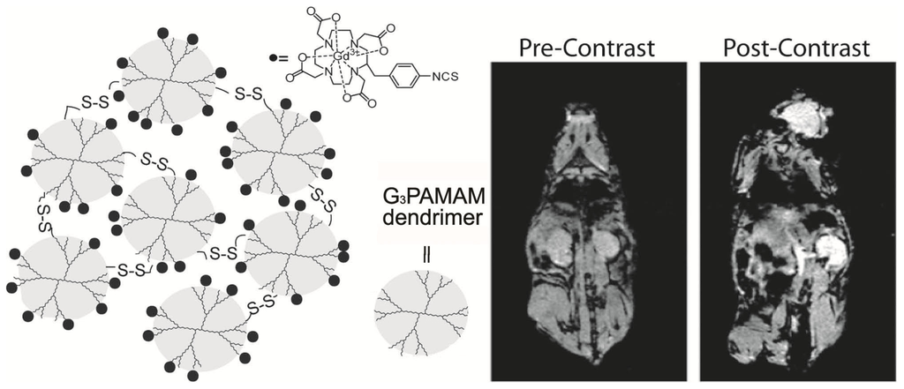
the sixth generation polygadolinium dendrimer displayed a prolonged enhancement with a half-life of 200 min compared to 24 min for monovalent gadolinium agent.
This prolonged enhancement time is extremely useful for3D time-of-flight MR angiography

Slide 72
Dendrimers in Antitumor
Dendrimers containing photosensitises named 5- aminolevulinic acid has been attached to the surface of dendrimers and studied as an agent for photodynamic therapy (PDT) of tumorigenic keratinocytes
The administration of a light activated photosensitizing drug that selectively concentrates in diseased tissue were involved in cancer treatment.
The dendrimers were investigated with the purpose of producing a drug that would interact with carcinoma derived T antigen- binding receptors to interfere with carcinoma growth.

Slide 73
This type of Glycodendrimer reacted in a generation dependent way with monoclonal antibodies against the T-antigen with higher generation having higher affinities.

Slide 74
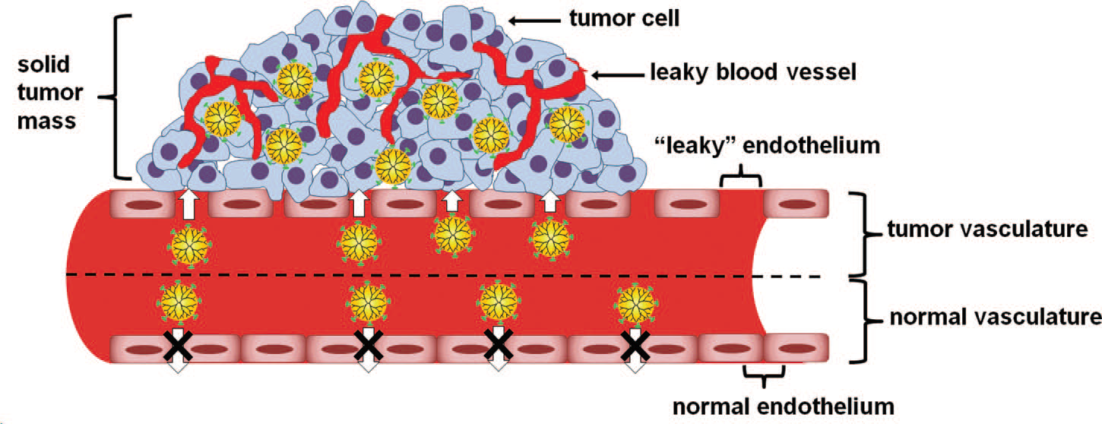
Illustration showing the diffusion of dendrimers-based drug delivery systems (yellow) across the tumor’s leaky vasculature
into the tumor tissue and their retention due to the impaired lymphatic drainage, which is a phenomenon known as the enhanced permeability
and retention (EPR) effect.

Slide 75
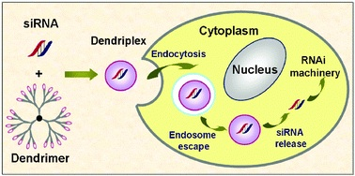
Dendrimers as Gene Transfer
Dendrimers can also carry siRNA through surface electrostatic interactions. A generation- 3 nanoglobular dendrimer (poly-l-lysine) octa (3-aminopropyl) silsesquioxane) surface modified with a tumor-targeting peptide, c (RGDFK), has been reported to carry both doxorubicin and siRNA for targeted combination therapy.

Slide 76
Dendrimers in targeted drug delivery
The dendrimers facilitate the passive targeting of drug to solid tumors. This is due to their enhanced solubility and plasma circulation time.
EPR (Enhanced Permeation and Retention) in tumor tissues leads to reduce cytotoxicity of anticancer drug and increased uptake by cancer cell lines. Example- Doxorubicin
Water soluble dendrimers are capable of binding and solubilising small acidic hydrophobic molecules with antifungal or antibacterial properties.

Slide 77
Dendrimers in drug delivery
Tests showed that the pure drug (Ibuprofen) takes 3 hours to enter the cell membrane whereas the dendrimer-drug complex have taken only 1hour to enter the cell membrane. This conforms that the dendrimers can carry the complex drug efficiently inside the cell
Encapsulation of the well-known anticancer drug cisplatin within PAMAM dendrimers gave conjugates which can slow down release and higher accumulation in solid tumors and it has low toxicity than free cisplatin

Slide 78
Dendrimers in transdermal drug delivery
-PAMAM dendrimer complex with Non Steroidal Anti-inflammatory Drugs (e.g. Ketoprofen, Diflunisal) which are very effective in treatment of acute and chronic rheumatoid and osteoarthritis, could be improving the drug permeation through the skin as penetration enhancers
- The model drugs Ketoprofen and Diflunisal were conjugated with G5 PAMAM dendrimer and investigated for different studies.

Slide 79
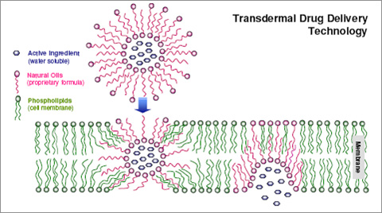

Slide 80
Dendrimers in oral drug delivery
Dendrimers provide unique solutions to complex delivery problems for ocular drug delivery.
An ideal ocular drug delivery system should be non-irritating, biocompatible, sterile, isotonic and biodegradable
The recent problems for ocular drug delivery focus on increasing the residence time of pilocarpine in the eye was overcome by using PAMAM dendrimers with carboxylic or hydroxyl surface groups.

Slide 81
Dendrimers in pulmonary drug delivery
it was observed that G2and G3 generation positively charged PAMAM dendrimers increased the relative bioavailability of Enoxaparin by 40%.
While G2.5 PAMAM half generation dendrimers containing negatively charged carboxylic groups had no effect.

Slide 82
Dendrimers used for enhancing the solubility
Dendrimers that are soluble in water are capable of binding and solubilizing small acidic hydrophobic molecule with antifungal or antibacterial activities.
dendrimer nanocarriers offer the potential to enhance the bioavailability of drugs that are poorly soluble and/or substrates for efflux transporters

Slide 83
Dendrimers as Catalyst
Dendrimers have multifunctional surface with active catalytic site.
Insoluble materials can be encapsulated such as metals, and transport them into a solvent in interior of dendrimer.
Fluorinated dendrimers which are soluble in supercritical CO2 and can be used to extract strongly hydrophilic compounds from water into liquid CO2.

Slide 84
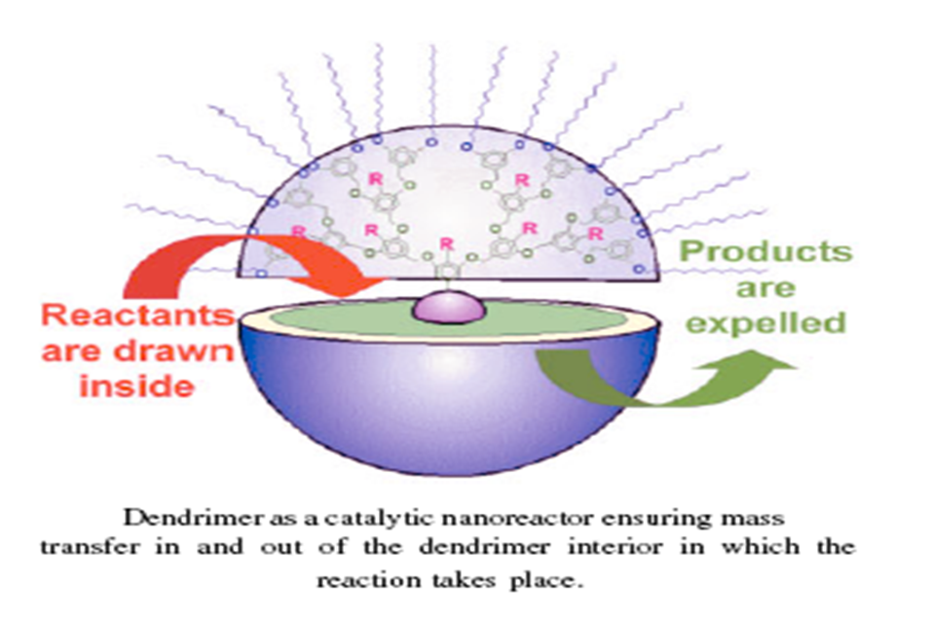

Slide 85
Dendrimers as Biomimics
-Dendrimers having their well defined macromolecular dimensions and compartmentalized structure are ideal mimics for a wide variety of biomolecules.
- Glycomometics are synthesized analogous carbohydrate whose structure has been simplified and modified, and is an active ingredient, which can be used for treatment of chronic inflammatory ailment such as rheumatism ,dermatitis and psoriasis.

Slide 86
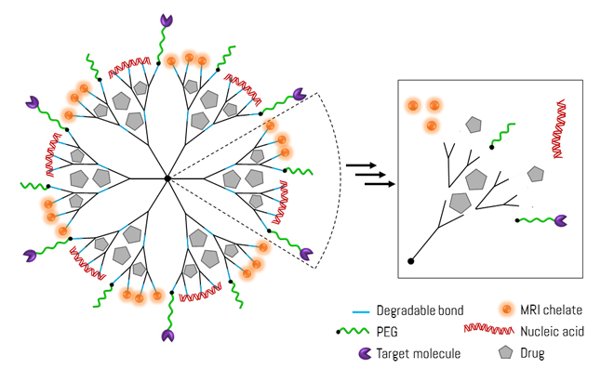

Slide 87
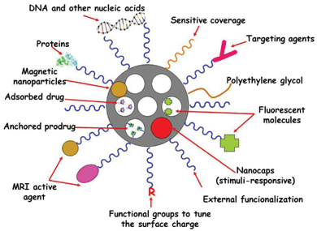

Slide 88
APPLICATIONS OF DENDRIMERS
Dendrimer based products
VIVAGEL ™ (Starpharma): In clinical phase II trials, its a topical vaginal microbicide, prevents infection by HIV (polyvalent properties).
Stratus® CS Acute Care ™ (Dade Behring) - for cardiac diagnostic testing
SuperFect ™ (Qiagen) – gene transfection agent applicable to abroad range of cell lines.

Slide 89
Alert ticket(US army Laboratory) - anthrax detection.
Riofect™, Priostar™ and STARBURST starpharma) - targeted diagnostic, therapeutic delivery for cancer cells16.

Slide 90
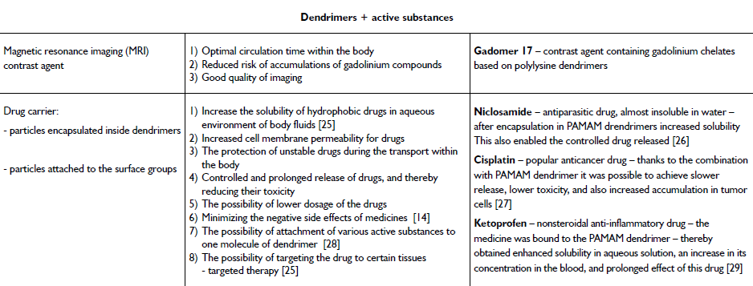

Slide 91
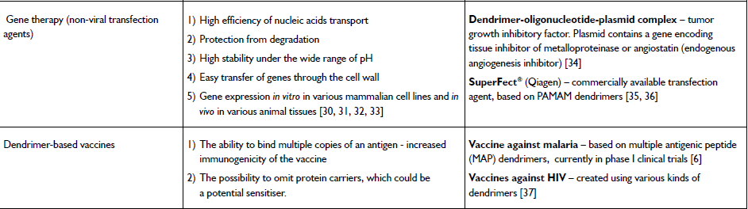

Slide 92
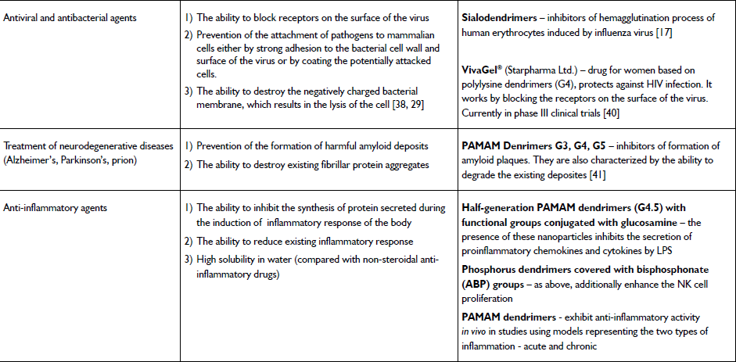

Slide 93
Reference's
H.N.Patel & DR. P.M.Patel, DENDRIMER APPLICATIONS – A REVIEW, Int J Pharm Bio Sci 2013 Apr; 4(2): (P) 454 – 463
SWATI Biswas & VLADIMIR P. Torchilin , DENDRIMERS FOR SIRNA DELIVERY, Pharmaceuticals 2013, 6, 161-183;
Priya.P , Sivabalan. Mand Jeyapragash.R, DENDRIMER: A NOVEL POLYMER, IJRPC 2013, 3(2)
Małgorzata Kubiak, DENDRIMERS – FASCINATING NANOPARTICLES IN THE APPLICATION IN MEDICINE, chemik 2014

Slide 94
Anisha Agrawal, Sunisha Kulkarni, DENDRIMERS: A NEW GENERATION CARRIER, International Journal of Research and Development in Pharmacy and Life Sciences, August - September, 2015, Vol. 4, No.5, pp 1700-1712
Senthil kumar.M, Valarmathi.S, Priyanka Bhima, Prudhvi Devabaktuni.S, Raja.A, DENDRIMERS: A NOVEL DRUG DELIVERY SYSTEM, Journal of Pharmaceutical Science and Technology Vol. 4 (7), 2012, 972 – 984
A. Stephen Prawin Kumar, Dr.S.Latha, Dr.P.Selvamani, DENDRIMERS: MULTIFUNCTIONAL DRUG DELIVERY CARRIERS, International Journal For Technological Research In Engineering Volume 2, Issue 8, April-2015

Slide 95
Scott H. Medina and Mohamed E. H. El-Sayed, Dendrimers as Carriers for Delivery of Chemotherapeutic Agents, Chem. Rev. 2009, 109, 3141–3157
Anirudha Malik, Sudhir Chaudhary, Garima Garg and Avnika Tomar, Dendrimers: A Tool for Drug Delivery, Advances in Biological Research 6 (4): 165-169, 2012
Barbara Klajnert and Maria Bryszewska, DENDRIMERS: PROPERTIES AND APPLICATIONS, Acta Biochemica Polinica Vol. 48 No. 1/2001
Elham Abbasi1, Sedigheh Fekri Aval1, Abolfazl Akbarzadeh, Morteza Milani1, Hamid Tayefi Nasrabadi, Sang Woo, Younes Hanifehpour, Kazem Nejati-Koshki, and Roghiyeh Pashaei-Asl, DENDRIMERS: SYNTHESIS, APPLICATIONS, AND PROPERTIES, Nanoscale Research Letters 2014, 9:247

Slide 96
Thank’s

